Slide 1
Social Media for Pediatric GI
Jay Hochman, MD
October 9, 2013
Notes:
This template can be used as a starter file for presenting training materials in a group setting.
Sections
Right-click on a slide to add sections. Sections can help to organize your slides or facilitate collaboration between multiple authors.
Notes
Use the Notes section for delivery notes or to provide additional details for the audience. View these notes in Presentation View during your presentation.
Keep in mind the font size (important for accessibility, visibility, videotaping, and online production)
Coordinated colors
Pay particular attention to the graphs, charts, and text boxes.
Consider that attendees will print in black and white or grayscale. Run a test print to make sure your colors work when printed in pure black and white and grayscale.
Graphics, tables, and graphs
Keep it simple: If possible, use consistent, non-distracting styles and colors.
Label all graphs and tables.

Slide 2
Objectives
Discuss online reputation
Describe constructing a blog
Discuss blog’s utility
Review opportunities to use social media for knowledge translation
Notes:
Give a brief overview of the presentation. Describe the major focus of the presentation and why it is important.
Introduce each of the major topics.
To provide a road map for the audience, you can repeat this Overview slide throughout the presentation, highlighting the particular topic you will discuss next.

Slide 3

Questions
  What do you hope to achieve by sharing your message?
  Who is your target audience?
Notes:
This is another option for an Overview slides using transitions.

Slide 4
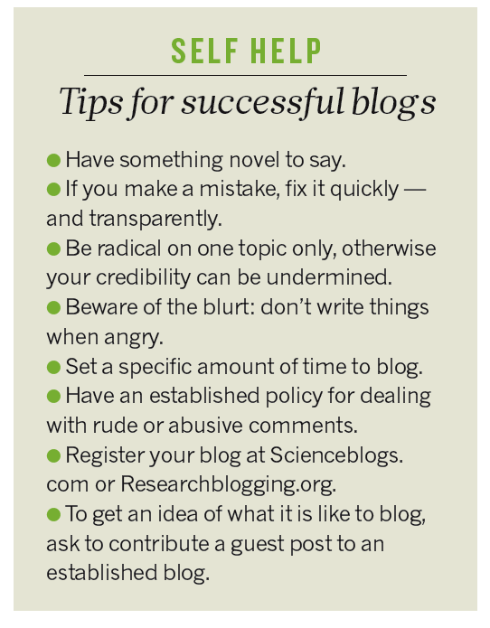

New Environment
Slide content borrowed from Eric Benchimol

Slide 5
Why I Started to Blog
Death of the Palm Pilot
  Point of care useful information
NASPGHAN meeting 2011 & Bryan Vartabedien’s ideas (33charts)
  Physician voices important
  Digital Footprint
Notes:
The death of the palm pilot and other PDAs. After my fellowship, in 1997 I joined Mike Hart in Atlanta at Egleston Children's Hospital. He had started using a palm pilot and I began using one as well. I stored a lot of useful information on drugs and personal contacts. By each local physician, in addition to their name, I kept the names of referred patients and their diagnoses. I also decided that instead of tearing journals I would make entries in my Palm device and keep annotated references of journals that I was reading. When the support services disappeared for my Palm device, I transferred a lot of information to Notespark but was not as pleased with this site as I had been with my Palm.
2. NASPGHAN meeting. While at the NASPGHAN meeting, I listened to a talk by Bryan Vartabedian (33 Charts — medicine. health. (social) media). Prior to that meeting, I had not considered starting a blog. He made several points that I considered important.
Physicians need to provide a voice and balance in social media. In many areas of medicine, like immunizations, the voices of extremists dominant the conversation. "The solution to pollution is dilution." When physicians add their reasoned opinions to topics related to public health, this will steer the conversation towards sanity.
Taking part in social media allows a physician to modify their digital footprint. Without our participation, what is placed on the internet is beyond our control (Physician Online Reputation Management – 2 Realities - 33 Charts).

Slide 6
Online Reputation
Create positive content
  Post your own profile (eg. LinkedIn.com)
  Bio on twitter (even if you don’t tweet)
  YouTube.com profile
Google yourself
  Google.com/alerts
Personal websites
  About.me or Flavors.me
Buy Web address of your own name
  GoDaddy.com
Take down bad content
  Find site administrator WhoIs.com
  Possible cease and desist letter
Notes:
Physicians are often interested in their online reputation –so, this is a little diversion.

Slide 7
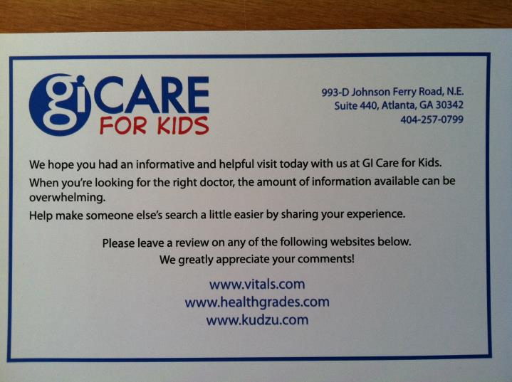
Online Reputation
Notes:
The solution to pollution is dilution.

Slide 8
Is it Hard to Start a Blog?
No –I did this without hardly any help from my teenage sons
Cost -$0 →more
Millions of blogs:
  Nate Silver
  KevinMD
  Dedicated to all Better
  Photo blogs
  Turning 50 blogs
Notes:
So I decided to start a blog. This might sound difficult but it wasn't. I didn't even need to ask my teenage sons for hardly any help. Though, in retrospect, it may have been a good idea. I found that wordpress.com provides tools for individuals to create their own blogs at no cost. Though, they definitely encourage an upgrade ($18 per year). Basically, I registered a name, picked a design type for the blog, and made a few choices about the formatting.
If you have time, you can look at some amazing blogs: photographers post pictures from all corners of the earth, professional chefs & domestic chefs provide recipes for anything you could think of eating, Nate Silver can tell you who is going to win the next presidential race, KevinMD has thoughtful posts from a huge number of health professionals, our hospital (like many others) has a blog, improvecarenow has a blog, there are blogs explaining the NEJM articles, my sister has a blog about what turning 50 means, and so many others.

Slide 9
Blog Goals
Archive journal articles with easy search
Digital footprint
Add voice to topics on drug safety, vaccines, antibiotics
Share information with colleagues and mid-level providers
Promote group’s publications
Notes:
•To create a site where I could archive the references of journal articles and have them accessible for easy searching.
•To develop a relatively non-controversial digital footprint. Truth be told, I would love to create a joke blog. However, I think that anything you put out on the internet is available for public consumption and I am certain that some of my jokes would not be well-received in some circles.
•To add my voice to topics like immunization policy, judicious use of antibiotics, and healthy nutrition choices.
•To share some of my readings with my colleagues and mid-level providers. I hoped that some of the information might help with more uniform adoption of best practices. For example, with H pylori, we have an international expert in our group (Benjamin Gold). Yet, the information that clarithromycin should not be a 1st line drug had not been brought up in any of our meetings.
•To promote some aspects of our groups' accomplishments. When one of our physicians publishes an article, I definitely want to review that for my blog.
•To remember journal articles with more clarity.

Slide 10
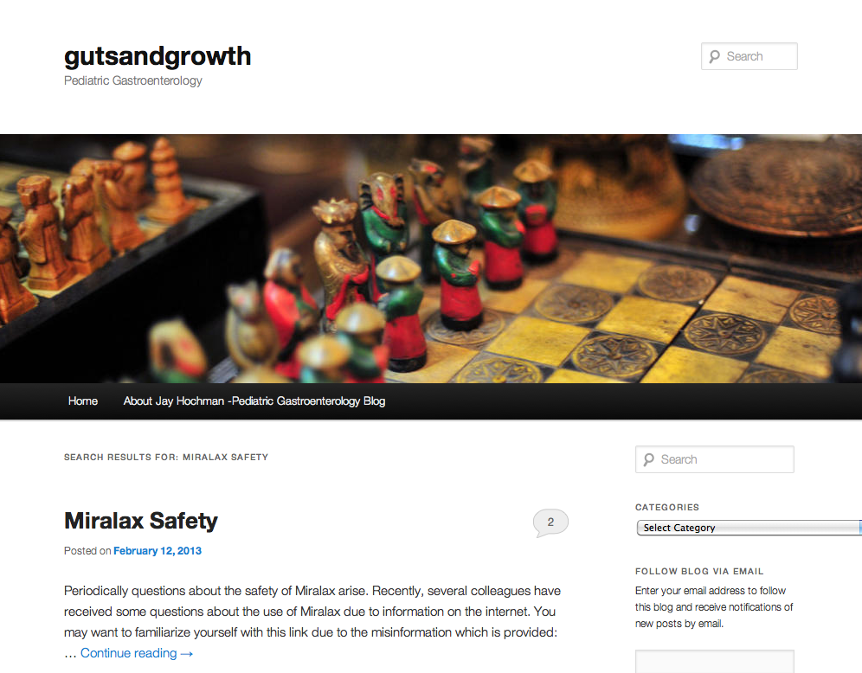
Example of Recent Post

Slide 11
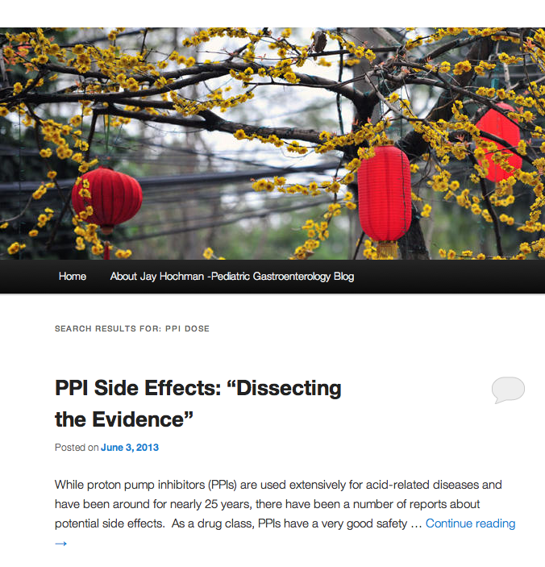
Example of Recent Post

Slide 12
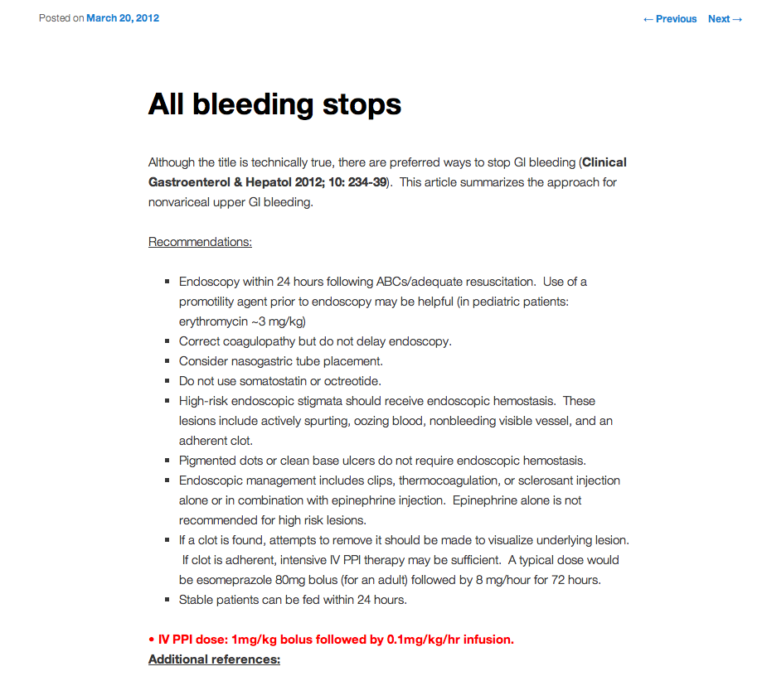

Slide 13
How I Started –Part 1
Went to Wordpress
  Blogger.com
  Squarespace.com
  TypePad.com
Picked a Template
Created a Gravatar
Started Writing

Slide 14
How I Started
Target audience –medical professionals
Notified a few select mentors and colleagues
After a few blogs, notified authors of cited articles
After a bit longer, Mike Hart asked to share with bulletin board
After a bit longer, sharing with twitter
Notes:
How I started
While many physicians might see the opportunity for patient education, I decided to target the blog to a medical professional audience. Our office website (Children's Center for Digestive Healthcare, LLC (GI care 4 kids) already has a great deal of patient-related information and links to numerous other useful sites.
When I first started the blog, I only notified a few people outside of our group. This included my mentors in Cincinnati (including Mitchell Cohen, William Balistreri, and Jim Heubi) as well as my former boss Mike Hart. All of these individuals, along with my other mentors in training (Colin Rudolph, Jorge Bezerra, Mike Farrell, and Jon Bucuvalas), could probably provide a great deal more insight.
After writing a few blogs, I decided I would send an email to authors of papers that I commented on. This would allow them to provide additional insight as well if they chose. After about a year of blogging, Mike Hart asked if I was OK with him sending an email out to the pediatric GI bulletin board listserv because he thought more people might enjoy the blog's contents. Also, now I usually will post a link on twitter so that individuals who follow me can access the blog as well.
Many physicians have avoided social media due to either time constraints or concerns of potential risk about putting out medical information. I do have to put in time and try to be careful about what I write. And, unlike medical journals, I do not have any editors.

Slide 15
Upside & Downside
No editor
Ease of media links –video, newspapers, education material
More timely
Easier to search
Notes:
same time, I have a lot of advantages.
I can provide links to media. Some of these links are just for fun. For example, in previous posts: “dont go ninjin nobody that dont need ninjin” Kung Fu Hillbilly – Training Video – YouTube or “Everybody Poops” – a bad lip reading of the Black Eyed Peas …. In addition, it is not difficult to place graphs or pictures.
I can provide links to newspaper articles and original publications.
I have the opportunity to provide more timely information.
The information on my blog is much easier to search.
Many other physicians forward me articles that they think would be of interest.
I can link previous related posts. This is a lot easier than tracking down other types of references.
I can use twitter to leverage a great deal of information. For example, Kipp Ellsworth has a twitter feed, @PedNutritionGuy, which cites a large number of relevant nutritional studies.
The blog site has a lot of tools, like widgets, which can help present useful information
Since my blog is mainly for health professionals, I have on occasion written patient-related information for our hospital blog: When a Child Swallows a Button Battery - Dedicated to All Better. I've been told that this posting has had more than a thousand views.

Slide 16
More Upside
Receive articles from other physicians
Link previous references
Twitter to leverage
Blog tools –like widgets
For patient information, I have used DedicatedtoAllBetter

Slide 17
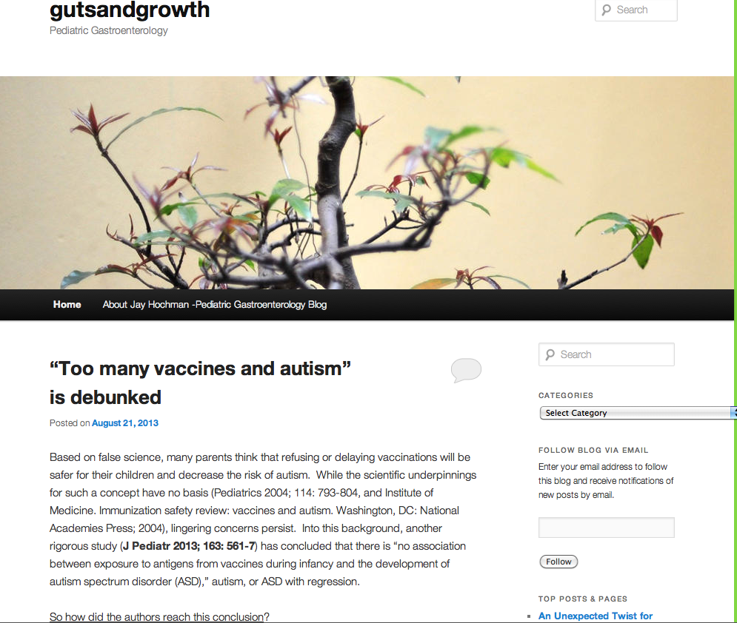
How to Follow & Search a Blog

Slide 18
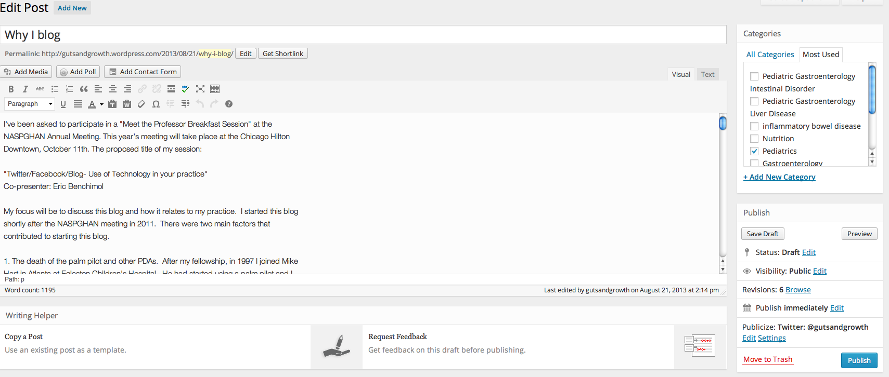
Preparation of Recent Post
Features include spellcheck, select time to publish, publicize

Slide 19
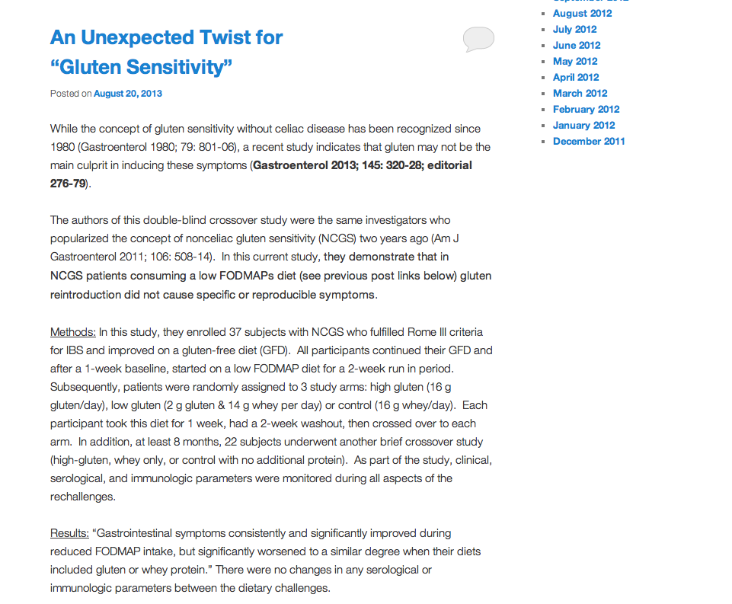
Example of Recent Post

Slide 20
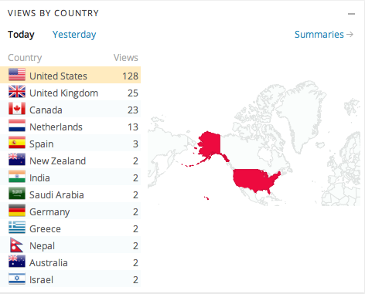
Who is Looking at Blog?

Slide 21
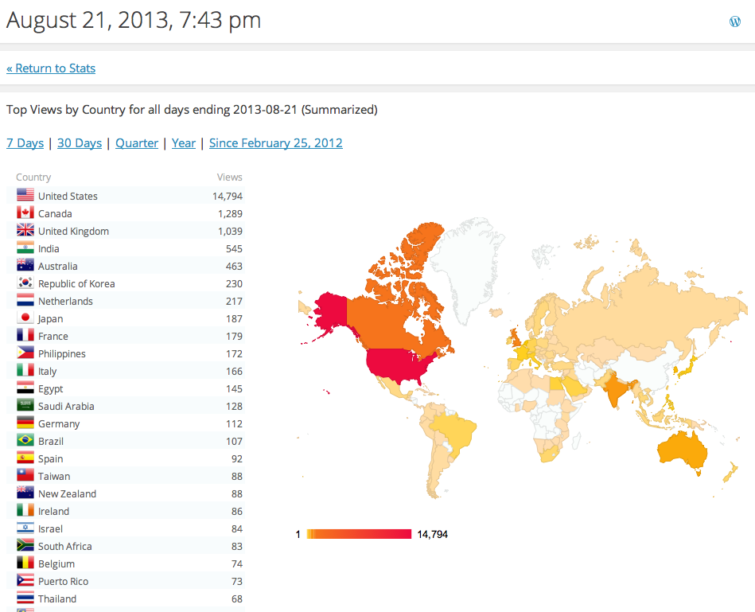
Who’s Looking At Blog?

Slide 22
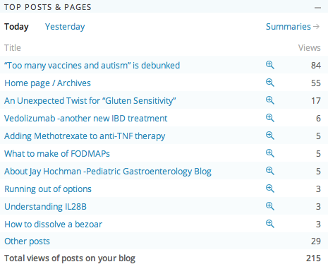
Stats –Popular Posts

Slide 23
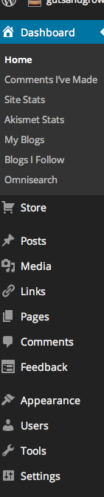
Dashboard
Stats
Posts
Media
Comments
Appearance
Tools
Settings

Slide 24
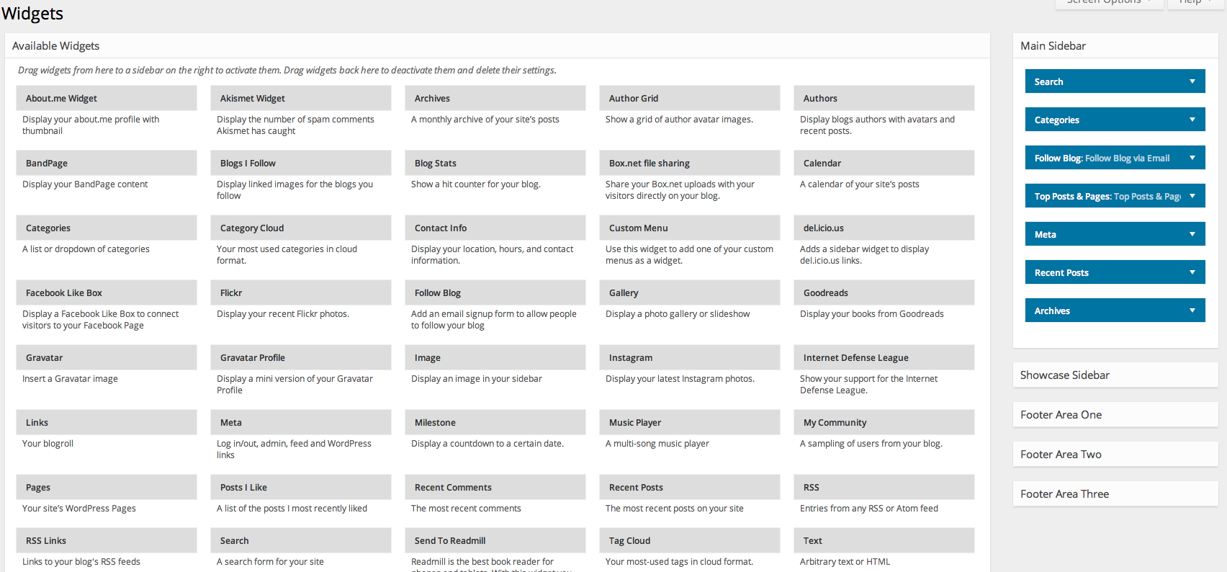
Widgets
Widgets are built in tools that can be displayed either as a sidebar or above/below blog

Slide 25
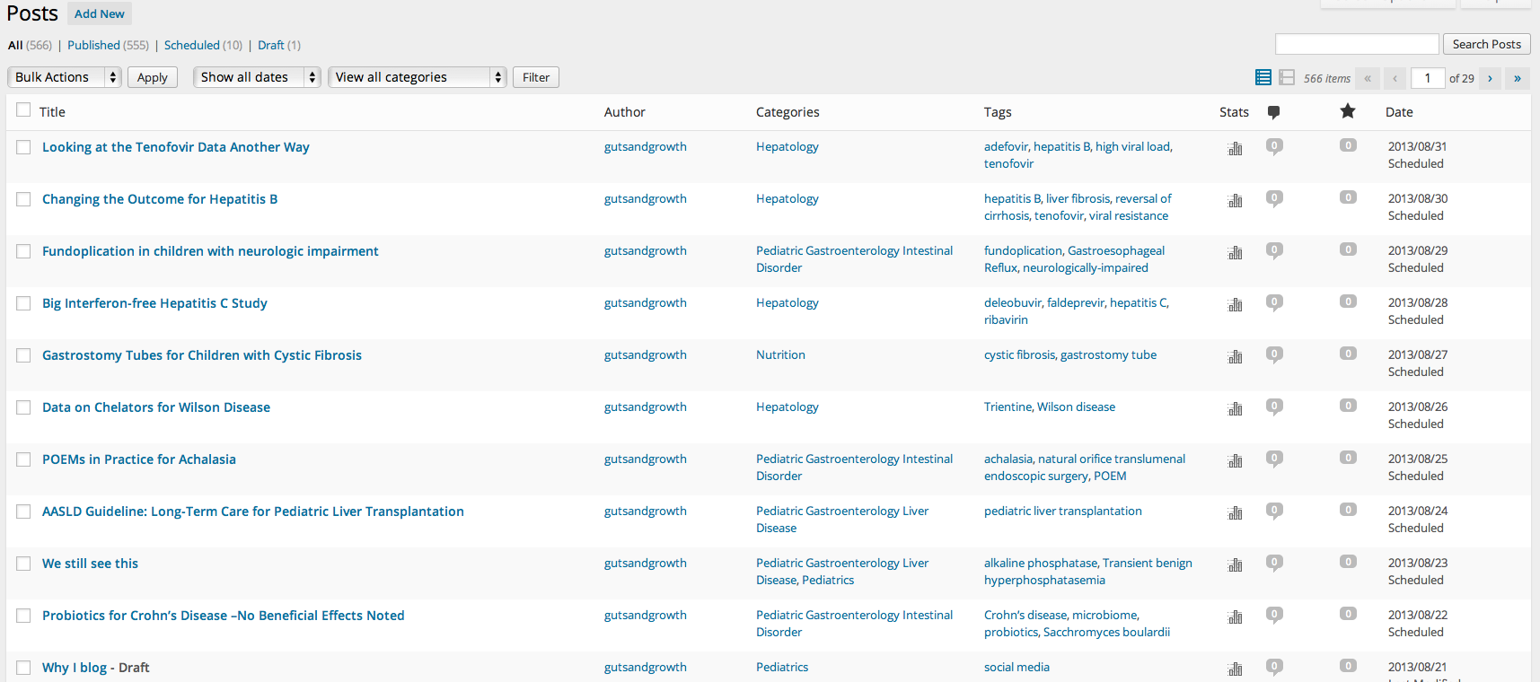
List of Posts

Slide 26
Summary
GutsandGrowth
  Has been “a see one do one”
The use of this blog has allowed me to continue “tearing out journals” that I think our important
Blogging can promote up-to-date information as well as various aspects of your group’s practice

Slide 27
Resources
gutsandgrowth | Pediatric Gastroenterology
Dedicated to All Better: The Children's Healthcare of Atlanta Blog
33 Charts — medicine. health. (social) media.

Slide 28
Questions?

