Slide 1

Staying Informed: Why Doctors Need Twitter, etc
Jay Hochman
www.gutsandgrowth.wordpress.com
@gutsandgrowth
October 24, 2014

Slide 2
Disclosures
No relevant financial disclosures
I don’t consider myself an expert on social media

Slide 3
Objectives
Describe differences in social media tools
Explain how physicians can participate in social media: passive vs active role
Understand how using Twitter and Medical blogs can leverage medical information

Slide 4
Social Media Tools
Twitter
  @NASPGHAN: #NASPGHAN14
  @GIKidsOrg
  @AmerGastroAssn
Blogs
  Wordpress.com
  Blogger.com
  Squarespace.com
  TypePad.com
Facebook
YouTube
LinkedIn

Slide 5
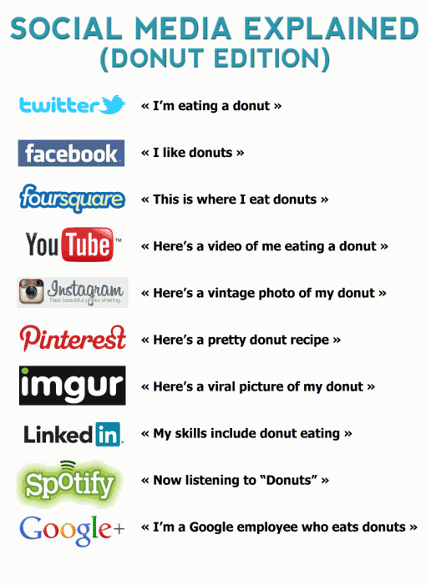
Borrowed from Eric Benchimol

Slide 6
Professional Guidelines for Social Media
Assume all content is public and difficult to remove
Legal obligations to protect patient privacy (even if unnamed) and to respect professional boundaries
Respect others –rules against defamation, copyright infringement
Avoid conflicts of interest
Avoid providing clinical advice to specific patients through social media
Don’t post “unprofessional” content
http://www.ama-assn.org/ama/pub/physician-resources/medical-ethics/code-medical-ethics/opinion9124.page?

Slide 7
Why Social Media is Not a Waste of Time
Amplify learning/Share information
  Audience in social media is >100-fold audience for local papers and scientific print media
  Disseminate information quickly
Engage audiences –more back & forth dynamic
Connect with others –can be used to facilitate research
For Support - #TipsForNewDocs
http://wishfulthinkingmedicaleducation.blogspot/2014/05/why-social-media-is-not-waste -of-time.html

Slide 8
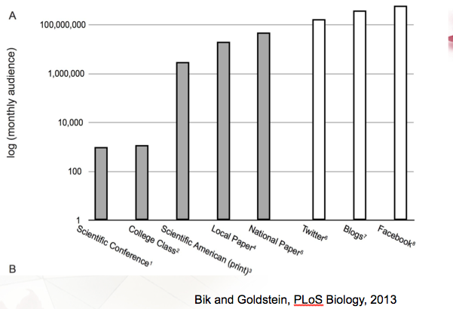
Social Media Audience
Borrowed from Eric Benchimol

Slide 9
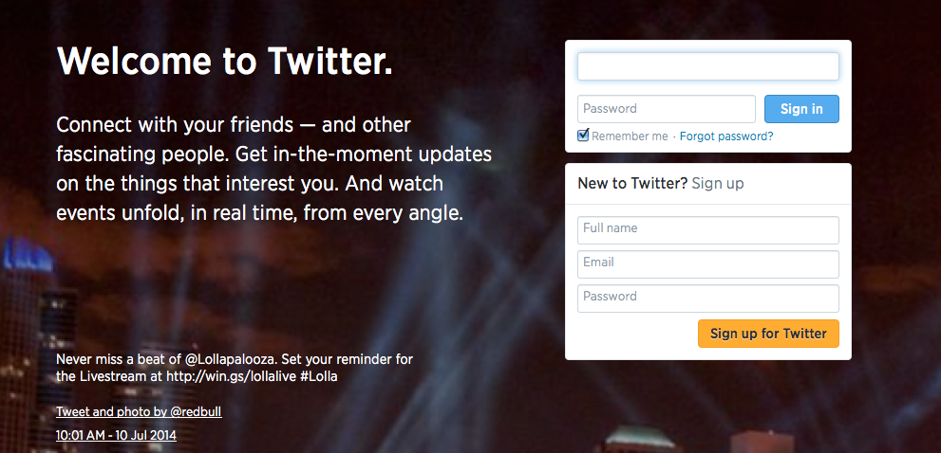
Personal Twitter Experience
Initially, I signed on to publicize my blog (gutsandgrowth.wordpress.com)
Signing on: twitter.com –It’s easy!

Slide 10
Twitter
140 characters
Most people use their name as their sign in
Some of those I follow on Twitter include the following:
  Media companies: NY Times Health, USA Today, LA Times
  Health organizations/Academic journals: NEJM, AGA, ACG, NASPGHAN, AASLD, ASPEN, APFED, ICN
  Eclectic mix: The Onion, NASPGHAN members

Slide 11
Twitter →Goldilocks
Passive: many people rarely tweet but like to see what’s going on
  Twitter is another area that is easy to use for online reputation
Too Active: many people tweet too much –it’s easy to drop them!
Goldilocks: trying to participate without overwhelming audience.
How many people to follow???

Slide 12
Why is Twitter So Popular?
Closer to a news service
  what’s going on in the world
  what are influential/non-influential people thinking
One-way forum for posting information, but opportunity for information to be amplified
  “Direct” followers pass message along
More voices & Reciprocal information –chance to “pushback” at information
24/7/365 -don’t have to wait for Brian Williams at 6:30 pm

Slide 13
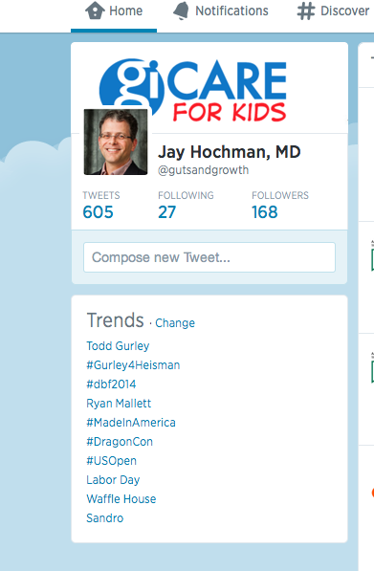
What Twitter Looks Like
Notes:
This shows the “home” button –easiest to see tweets, the “notifications” button –lets you know what others are messaging to you/about your tweets, #discover button –identifies that may interest you, hashtag trends are listed.

Slide 14
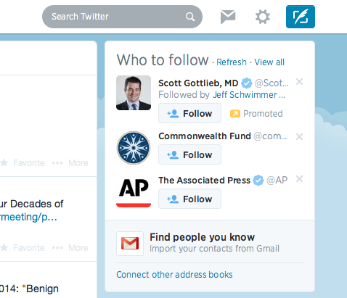
What Twitter Looks Like
Notes:
This slide shows the Search Function, the direct message function, the settings/signout button, and the “compose a tweet” button. In addition, suggestions on others to follow are listed

Slide 15
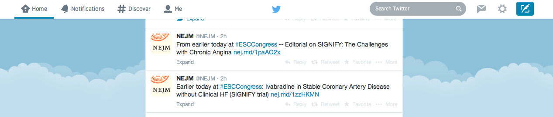
What Twitter Looks Like

Slide 16
Twitter Experience
With a finite number of those I follow, I leverage information on the following:
  gastroenterology
  hepatology
  nutrition
  politics
  humor

Slide 17
Why I Blog
Archive journal articles with easy search
  Most blog entries summarize recent studies
Digital footprint
Add voice to topics on pediatric GI (eg. PPIs), drug safety, vaccines, antibiotics
Share information with colleagues and mid-level providers
Promote group’s publications

Slide 18

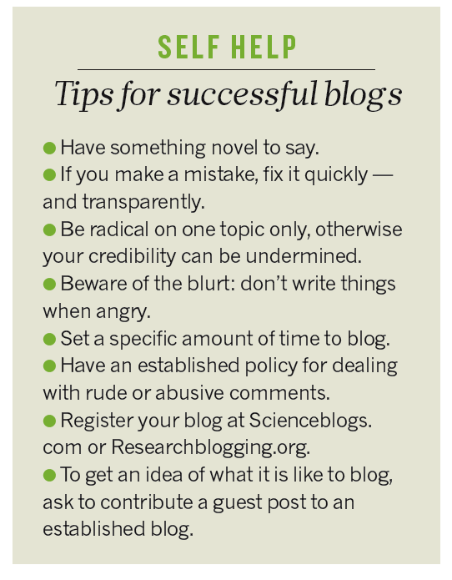
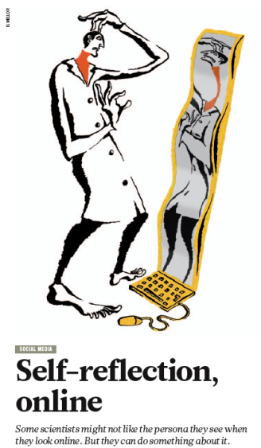
New Environment
Slide content borrowed from Eric Benchimol

Slide 19
Is it Hard to Blog?
No –I did this without hardly any help from my teenage sons
Cost -$0 →more
Millions of blogs:
  Nate Silver
  KevinMD
  Dedicated to all Better
  Photo blogs
  Turning 50 blogs

Slide 20
Blog: Upside and Downside
No editor
Ease of media links –video, newspapers, education material
More timely
Easier to search
Readers can comment in real-time

Slide 21
More Upside
Receive articles from other physicians
Link previous references
Twitter to leverage
Blog tools –like widgets
For patient information, I have used DedicatedtoAllBetter

Slide 22
Blog Experiences
Blog influenced our group’s FMT protocol –OpenBiome
Contacted by parent & lawyer regarding SimplyThick
Asked to speak at our national meeting

Slide 23
Conclusion
Social media provides valuable opportunities to learn and listen.
Information posted on social media has to respect privacy and reflects on the person posting
If used appropriately, the advantages of social media outweigh the drawbacks

