Slide 1
ERAS
Early Recovery after Surgery
Applying Effectively
What we Already Know.

Slide 2

Remember this?? The “brick”…
Notes:
Remember this?
The brick.
Gordon gecko and Wall Street.
This represents the way we communicated then…
Are wekstill doing the same ocmmunication”
When Halstead was caring for patients, or Osler, the care was simple and the personnel were few.
Maybe 3 people caring for each pt.
Now HC is complex.
There will be 16-18 people that will touch or care for your patients.
The opportunity to make mistakes or drop the ball will be huge.

Slide 3
Agenda
Traditional Surgery and ERAS
Enhanced Recovery Components.
Improved Outcomes in Adult Surgery
Possibilities in Pediatric Surgery.
Summary.

Slide 4

http://www.erassociety.org
Notes:
Not only evidence and guidelines based on the evidence, but also how to implement the protocol.

Slide 5
Traditional colorectal surgery.
Foley and NG
Epidural for 3-4 days.
PCA
MBP LOS 4-6 days
Slow feeding.
Lots of narcotics.
Fasting.
IV fluids “as needed”

Slide 6
ERAS
No tubes or MBP or Fasting
TAP or short Epidural
Immediate feeding
Minimal narcotics.
“Goal directed” fluids (less swelling)
Fewer Complications, Shorter LOS

Slide 7
2 Examples
CY 4 yr old with UC on TPN, bleeding
Albumin was 2
Lap assisted colectomy after 1 week of “optimization” on ERAS
Ate immediately, got “swollen”, ?? Albumin
Recovered after 3-4 days, ate, removed Red Rubber catheter.
Home on POD 6

Slide 8
2 Examples
DS 15 yr old w 2 yr h/o UC, unable wean steroids
Lap colectomy w ERAS DC on POD 2
Lap assisted proctecomy, J pouch, ileostomy
DC on POD 3 on ERAS
Closure of ileostomy. DC on POD 3 on ERAS

Slide 9
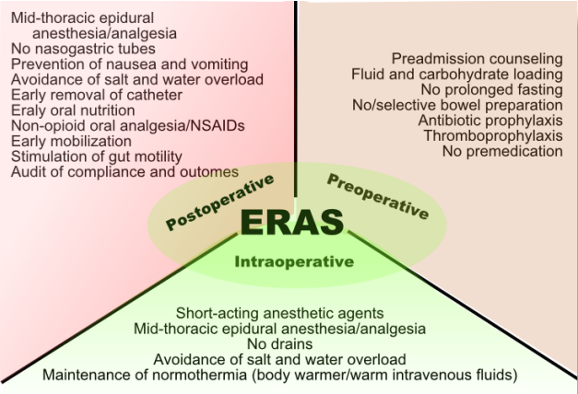
ERAS 2016

Slide 10
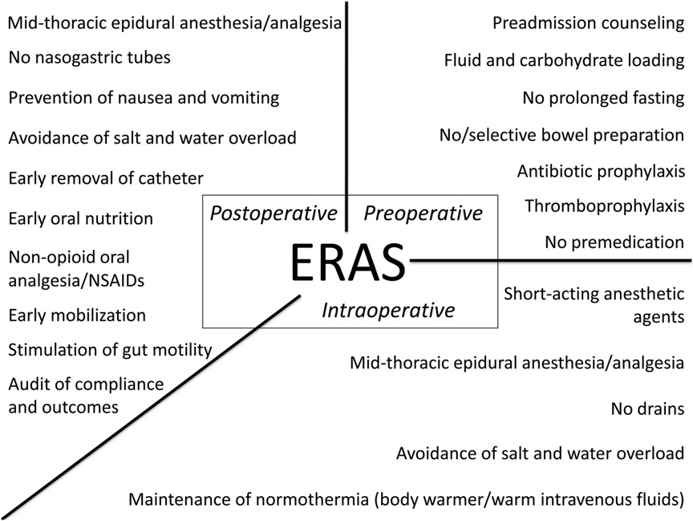
Notes:
Also add:
Preop: prehabilitation, carb loading (no NPO)
Intraop: surgical considerations (lap vs open), smaller/transverse incision, no NGT/foley
POSTOP: prevent postop ileus

Slide 11
Fluid/ electrolytes/ nutritional status
Notes:
Also add:
Preop: prehabilitation, carb loading (no NPO)
Intraop: surgical considerations (lap vs open), smaller/transverse incision, no NGT/foley
POSTOP: prevent postop ileus

Slide 12
Pain control
Notes:
Also add:
Preop: prehabilitation, carb loading (no NPO)
Intraop: surgical considerations (lap vs open), smaller/transverse incision, no NGT/foley
POSTOP: prevent postop ileus

Slide 13
Prevention of complications
Notes:
Also add:
Preop: prehabilitation, carb loading (no NPO)
Intraop: surgical considerations (lap vs open), smaller/transverse incision, no NGT/foley
POSTOP: prevent postop ileus

Slide 14
Return of function
Notes:
Also add:
Preop: prehabilitation, carb loading (no NPO)
Intraop: surgical considerations (lap vs open), smaller/transverse incision, no NGT/foley
POSTOP: prevent postop ileus

Slide 15
Notes:
Also add:
Preop: prehabilitation, carb loading (no NPO)
Intraop: surgical considerations (lap vs open), smaller/transverse incision, no NGT/foley
POSTOP: prevent postop ileus

Slide 16
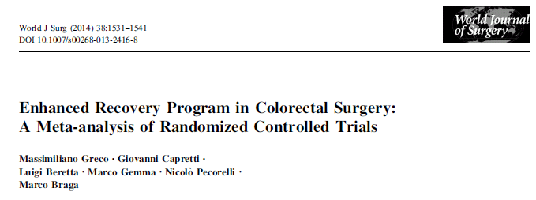

Slide 17
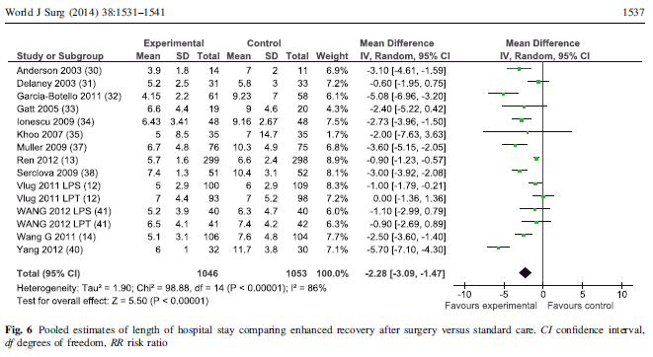
Reduced LOS

Slide 18
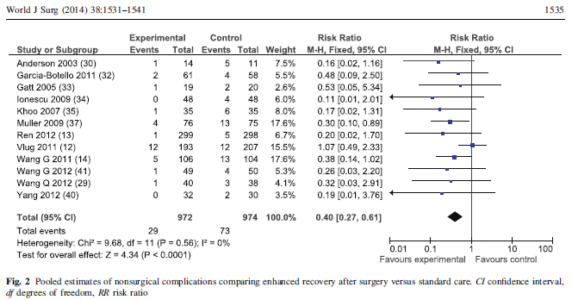
Decrease in nonsurgical complications

Slide 19
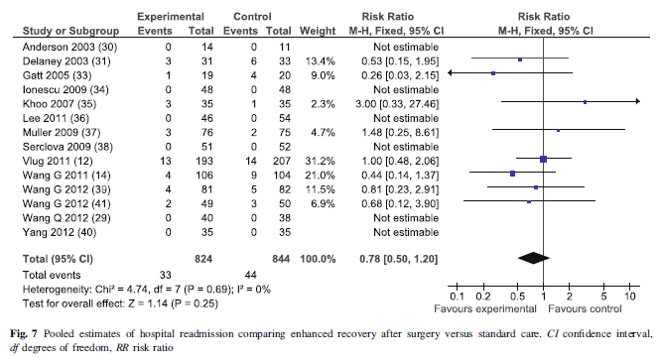
No increase in readmissions

Slide 20
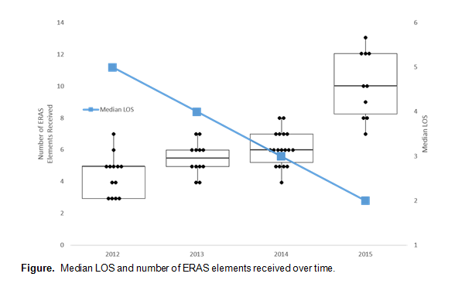
CHOA ERAS Data

Slide 21


Slide 22


Slide 23
What Next?
In-patients need to be optimized
Outpatient elective surgery is where the impact seems greatest
Opportunities exist to expand to other types besides Colorectal
Best to do this with a team that’s dedicated
Team includes nursing, Anesthesia, Surgery

Slide 24


Slide 25
Conclusions
Culture change.
Applying what we already know effectively
Reduce complications >> LOS >> RTS
Works in Peds.
Come join us with your IBD patients

