Slide 1
Feeding and nutrition:
How we work together to get kids to eat
Bonnie Boerema, MSN, CPNP
Sheila McBrayer, MS, CCC-SLP
June Ridgeway , MMSc, RD/LD, CNSC, CLC

Slide 2


Slide 3


Slide 4
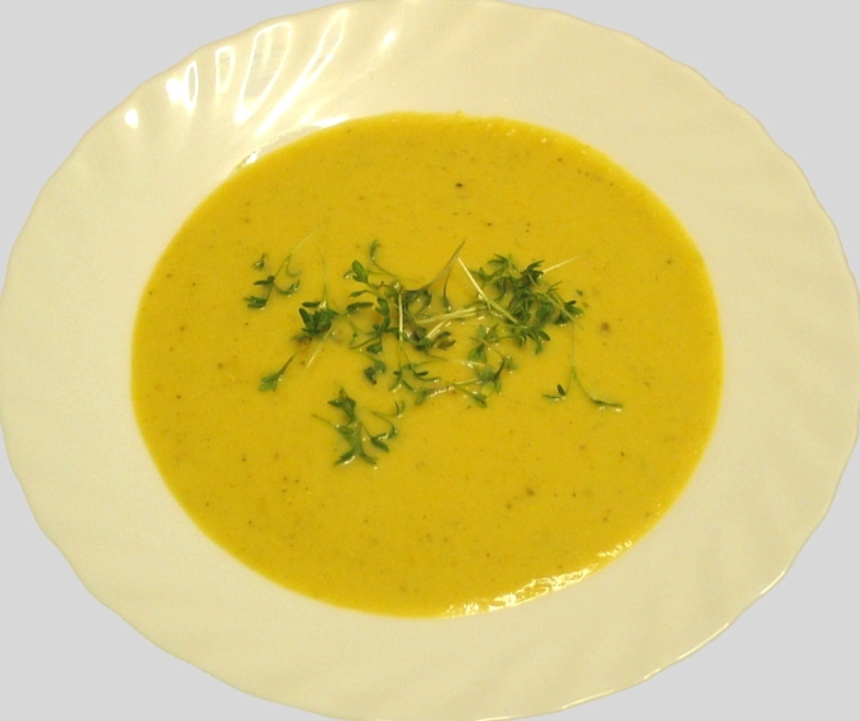

Slide 5

Feeding Evaluations

Slide 6
General Information about Therapy Referrals
Doctors must place order prior to a feeding evaluation
Inpatient orders received through Epic
  Feeding/Swallowing Eval
  Speech Therapy Consult
  OPMS/MBS
Notes:
Sheila

Slide 7

Who Needs a Feeding Evaluation?

Slide 8
Indicators for Feeding Referral for Infants
Preterm and medically complex infants have a significant risk for adverse neurodevelopmental outcomes
Risk is modified by known factors (red flags)
Infants and children with complex medical history often need more developmental supports

Slide 9
Red Flags for Infants
Birth Criteria
Gestational age < 32 weeks
Birth weight ≤ 1500 grams
Small for gestational age (SGA)
Intrauterine growth retardation (IUGR)
Infant of a diabetic mother
Congenital infection (CMV, herpes, syphilis, etc)
* Most NICU infants receive an automatic therapy order for all disciplines (OT, PT, SLP)

Slide 10
Red Flags for All Infants
Medical Conditions
Neurologic concerns (IVH, PVL, hydrocephalus, macro or microcephaly, seizures, encephalopathy)
Respiratory disorders (BPD, CDH, need for prolonged intubation/ventilation)
GI disorders (NEC, gastroschesis, omphalocele)
Cardiac disorders (CCHD, Pulmonary hypertension)
Genetic disorders (chromosomal abnormalities; diagnosed syndromes)
Hyperbilirubinemia

Slide 11
Red Flags for Infants
Environmental/Social Concerns
Parent < 17 years of age
Maternal drug/alcohol use
DFCS involvement
History of prolonged narcotic use while in NICU
Bottom Line: Any prolonged hospital stay has the potential to negatively impact neurodevelopment and require intervention

Slide 12
Indicators for Feeding Referral for All Ages- Inpatient
Poor weight gain/FTT
New onset of feeding tube use
Chronic respiratory infections without identified cause
Coughing/choking/signs of aspiration with PO intake

Slide 13
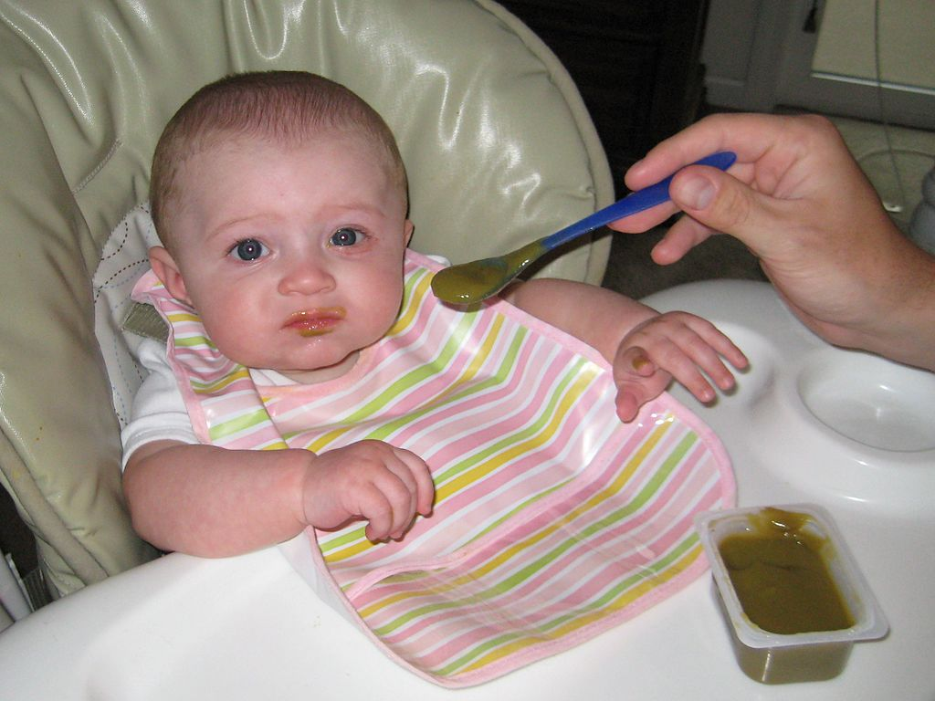
Additional Indicators for Feeding Referral for All Ages- Outpatient
Feeding tube use for > 6 weeks
Difficulty with transitions to new textures in feeding
Refusing specific foods/textures
Gagging with solids/textured foods

Slide 14
Feeding Evaluations
Performed by a licensed speech-language pathologist (inpt or outpt) or occupational therapist (outpt only) with specialty training in feeding and swallowing disorders
Integrates clinical observation with medical history, feeding history, nutrition history, and instrumental evaluations (when applicable) to provide a full clinical picture of patient’s ability to safely and efficiently consume sufficient oral intake for growth and ongoing development.

Slide 15
Goals of Feeding Evaluation for Infants
Encourage positive oral experiences
Support non-nutritive sucking
Facilitate progression of oral feeds as appropriate
Provide age appropriate communication/social stimulation
Ensure safe oral intake of age-appropriate foods

Slide 16
Goals of Feeding Evaluation for Toddlers and Older Children
Help to establish age or developmentally appropriate meal-time behavior
Encourage age or developmentally appropriate feeding and texture variety
Continued assistance in developing appropriate oral motor skills in children with delays/disorders

Slide 17
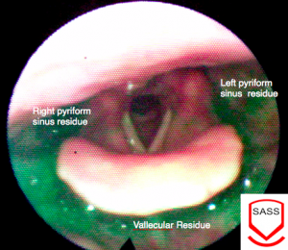
Instrumental Evaluations
Fiberoptic Endoscopic Evaluation of Swallowing (FEES)
  Performed in conjunction with Pulmonology or ENT
  Camera view of pharyngeal portion of swallow

Slide 18
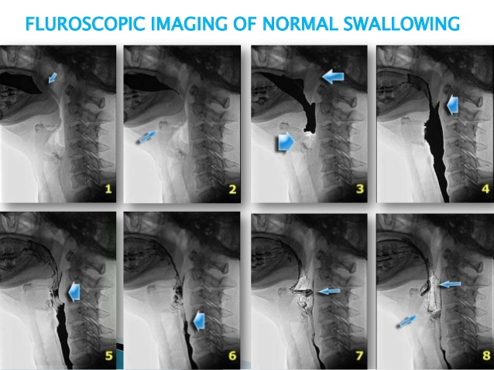
Instrumental Evaluations
Oropharyngeal Motility Study (OPMS) or Modified Barium Swallow (MBS)
  Performed in Fluoroscopy
  Requires oral intake of barium to visualize swallow
  Identifies oral and pharyngeal function that may impair swallow safety
http://www.google.com/url?sa=i&rct=j&q=&esrc=s&source=images&cd=&ved=&url=http%3A%2F%2Fwww.slideshare.net%2Fphinojkabraham%2Fdysphagia-in-pseudobulbar-palsy&bvm=bv.133700528,d.cWw&psig=AFQjCNG70wlQnAtSPtlcWqlFYN1L1z1G6A&ust=1474745323480743&cad=rjt

Slide 19
Referral Process for Outpatient Feeding Evaluation and Treatment
Doctor referral is needed
  Family can call 404-785-7100 to schedule an evaluation with outpatient therapy locations.
  A written order/prescription from your referring physician is required for all outpatient rehabilitation services.
Marcus Autism Center
  More intensive program when traditional therapy has not yielded improvement
  Registration department at 404-785-9350
  A written order/prescription from your referring physician is required for all outpatient rehabilitation services.

Slide 20
Interventions for Infants
Offer rest breaks as needed to the infant to decrease fatigue.
Offer pacing to assist with s/s/b coordination
Offer oxygen during feeding to decrease respiratory work.
Different nipples may be utilized to match the infants skills.
Changing the environment.
Changing the position of the infant.

Slide 21
General Interventions for Toddlers and Older Children
Sensory and Behavioral Feeding Strategies
  Variety of different systematic approaches to decreasing sensitivity and increasing acceptance
  Popular approaches: Food Chaining, Sequential Oral Sensory, AEIOU Systematic Approach
Oral Motor and Dysphagia Treatment Strategies
  For children with primary motor challenges affecting safety of swallowing
  Includes positional changes, feeding method changes, postural supports, oral motor “exercises”, and texture modifications.

Slide 22
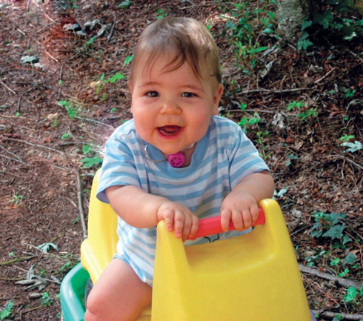
Feeding Evaluation Focus for Trach/Vent
Swallowing function is affected by placement of tracheostomy
Children with new trach placement will require feeding assessment to determine if they can return to prior oral feeding status
Use of Passy- Muir Valve
http://www.passy-muir.com/cooper

Slide 23
The Center for Craniofacial Disorders:
Who we are and what we do
Bonnie Boerema, MSN, CPNP
Clinic Coordinator
Center for Craniofacial Disorders

Slide 24
History of the Center
Founded in 1989
Multiple disciplines
Over 12,000 active patients
Team clinics held weekly
We serve Georgia, Southeast, Nation
Highest volume center in the country for treating cleft lip and palate.*
*Pediatric Health Information System (PHIS), 2008: the PHIS hospitals are 42 of the larges and most advanced children’s hospitals in America and constitute the most demanding standards of pediatric service in America.

Slide 25
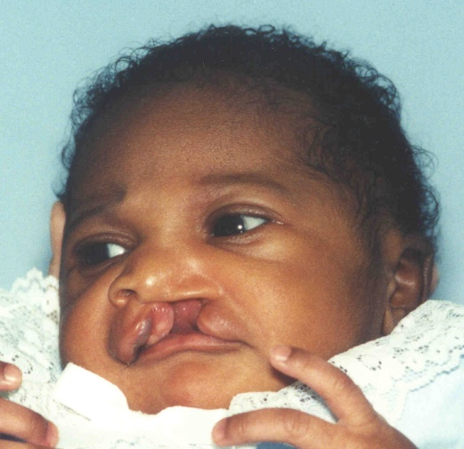
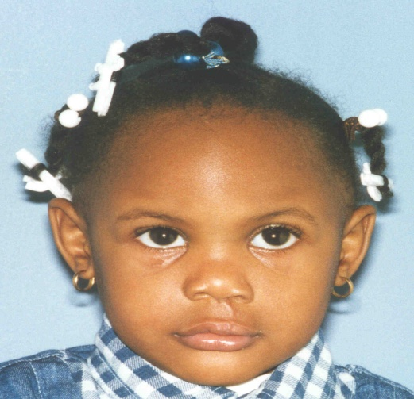
Key Features of the Center
Multi-disciplinary approach
Family centered care
Pre-natal consultation
Speech science lab
24-hour referral capability
Offsite housing
Transport services
Our goal is to make them whole!

Slide 26
Craniofacial Conditions Treated at Children’s
Cleft Lip/Cleft Palate
Craniofacial Clefts
Craniosynostosis
Hemifacial microsomia
Traumatic facial injury
Craniofacial Syndromes
Pierre Robin Sequence
Tumors
Hypertelorism
Non-cleft Hypernasality
Facial and jaw abnormalities

Slide 27
Children’s Craniofacial Center Team
The Children’s Craniofacial Center is a multidisciplinary group of experienced professionals from medical, surgical, dental, speech language pathology, and other allied health disciplines.
Craniofacial surgeon
Craniofacial NP
Speech pathologist
Audiologist
Occupational therapist
Nutritionist
Pediatric Dentist
Orthodontist
Geneticist
Psychologist
Social Worker

Slide 28
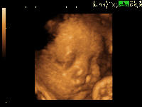
The Journey Begins:
Pre-natal or After Birth
Referrals
  Obstetrician / Perinatologist
  Primary care Physician
  Craniofacial Surgeon
  Plastic Surgeon
  Expectant Parents

Slide 29
Objectives of the Pre-natal Visit
Review obstetrical records
Discuss fetal craniofacial diagnosis
Discuss potential feeding concerns related to craniofacial diagnosis
Describe potential respiratory concerns related to craniofacial diagnosis
Prepare family for birth
Provide take-home literature

Slide 30


Cleft Lip & Palate Clinical Care Pathway:
7 Stages
Approximately 1 in every 700 children are born with a cleft lip and/or cleft palate.*
The Cleft Lip & Palate Care Pathway is a projected map of potential surgeries or treatments a child born with cleft lip & palate may require from birth through adolescence.
*Source: www.cdc.gov
Notes:
Craniofacial Clinical Care Map is only a projected map of potential surgeries or treatments a child born with cleft lip and palate may require. This map allows the parents to visually see what procedure their child may require at different developmental ages.

Slide 31
Stages 1 – 3 (Birth to <5 months)
  Stage 1: Birth to 2 weeks of life
      Feeding/Nutrition/Craniofacial evaluation with NP and Feeding Therapist and Nutritionist
  Stage 2: Weekly clinic visits for next 2-3 months
      Orthodontist for Nasal Alveolar Molding (NAM) adjustments
      Pediatric dentist for palatal pinned adjustments
      Feeding/Nutritional follow-up, weight monitoring
  Stage 3: age 4-12 weeks
      Evaluation with Craniofacial Surgeon
      Evaluation with Genetics
Notes:
If infant is born in a local hospital, Craniofacial surgeon and myself will visit infant and family at the birth hospital. This allows us to examine the infant and decide if any medical treatment is indicated at present time. This also allows us to meet with the parents and provide guidance on the plan of care for their newborn.
During the first visit with the craniofacial surgeon, he will decide if pre-surgical molding is indicated. Pre-surgical molding can be utilized with tape applied across the cleft lip. This stretches the skin and muscle tissues of the upper lip and allows the tissue to mold and align with the gum.
Other pre-surgical molding devices include a palatal Pinned Appliance and a Nasal Alveolar Molding device. Again, the pre-surgical molding is decided on the first craniofacial clinic visit with the surgeon based on the infant’s severity of cleft. Pre-surgical molding begins the process of surgical repair.

Slide 32
Stages 4 – 7 (3 months – teen years)
  Stage 4: Reconstructive Surgery
    Cleft Lip Closure 3-5 months of age
    Cleft Palate Closure 9-12 months of age
  Stage 5: Toddler Years (12-15 months)
    Annual visits to craniofacial surgeon
    Speech and dental evaluation every 6 months, possible speech surgery
  Stage 6: School Age years
    Annual visits with craniofacial surgeon
    Possible cleft lip/nasal revisions (5-6 yrs old)
    Speech, dental, audiologist, orthodontics visits and possible surgeries
  Stage 7: Teenage years
    Annual visits to craniofacial surgeon, dental and orthodontics - possible additional surgeries

Slide 33

Camp Courage
A camp for children with a facial difference
  Collaboration with Camp Twin Lakes (CTL)- Winder, GA
  Opportunity for children to build new friendships forged by the strongest of bonds—the challenges they may all have in common
  Ages 7 – 15 years
www.choa.org/campcourage

Slide 34

Coordination of Care
Multidisciplinary clinical team working together to provide care to children in one location.

Slide 35
How to Make a Referral
Clinical Information needs to be faxed to
404-785-3706 attn: Craniofacial
Include patient demographics, insurance information.
You can also call our Craniofacial Nurse
404-785-3675
After clinical/demographic information received, family will be contacted by our scheduler
3 appointments will be scheduled for new babies:
Feeding Evaluation with feeding therapist/nutritionist/NP
Surgeon
Genetics

Slide 36
The Craniofacial Team
  Joseph Williams, MD
  Magdalena Soldanska, MD
  Colin Brady, MD
  John Riski, PhD
  Michael Granger, DMD, MS
  Jack Thomas, DDS
  J.C. Shirley, DMD, MS
  Joyce Fox, MD
  Brittany Waters, DMD
  Alpesh Patel, DMD, MS
  Bonnie Boerema,CPNP
  Kim Uhas, CPNP
  Perry Bean, PsyD, SLP
  Sheila McBrayer, SLP
  Lee Hazelwood, SLP
  Emily Pilcher, SLP
  June Ridgeway RD/LD,
  Randi Downey, LCSW

Slide 37
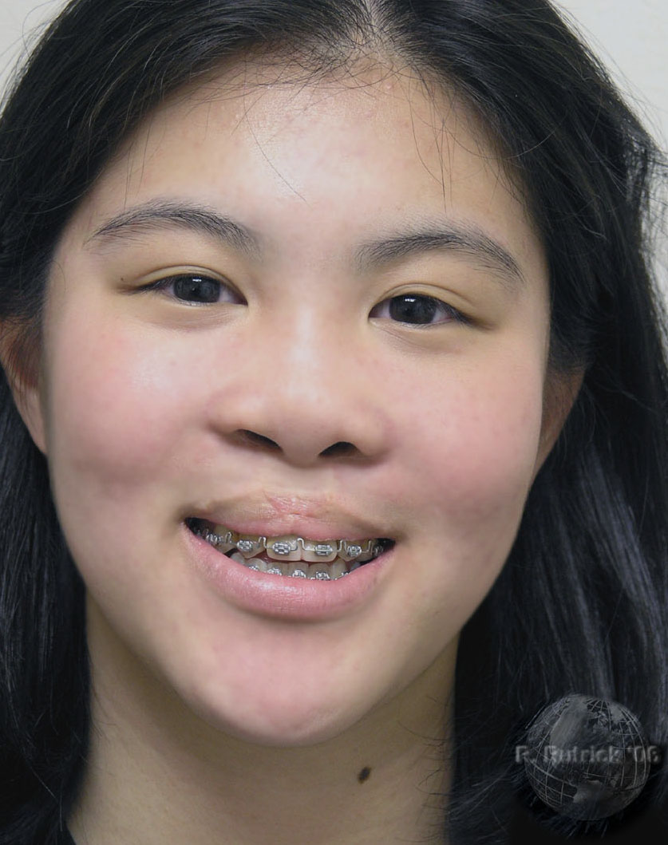
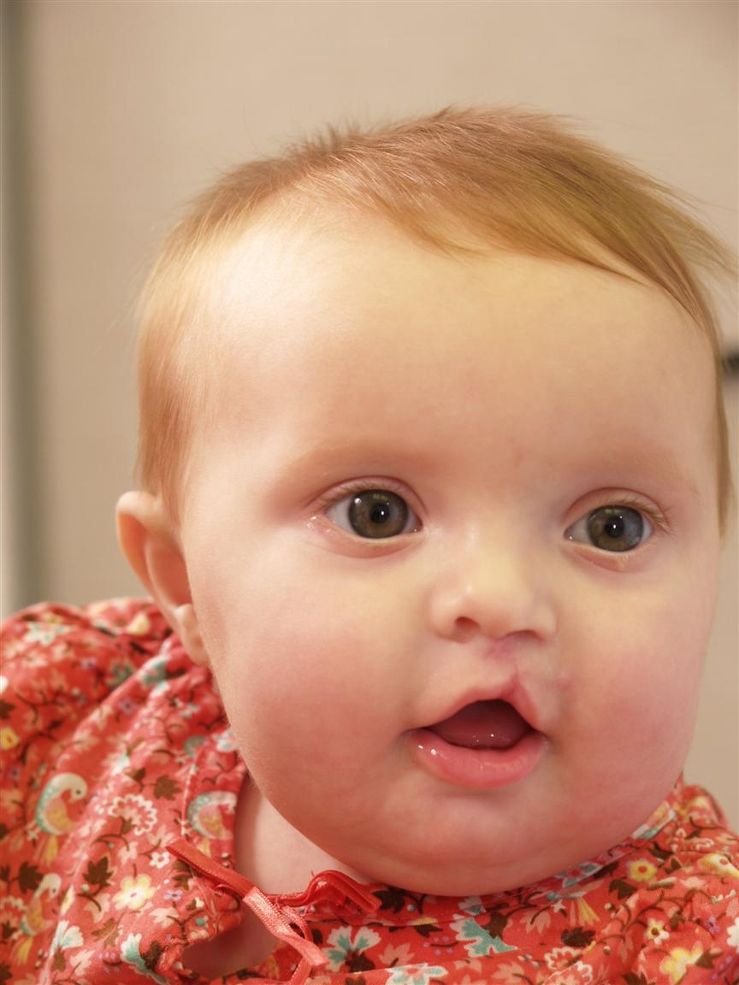
Thank you!

Slide 38
Feeding Evaluation Focus for Clefts
Evaluation of oral cavity, type of cleft
Often use additional monitoring for children with complex medical problems
Outlying counties: availability of resources
Progression of oral feeding with unrepaired cleft

Slide 39
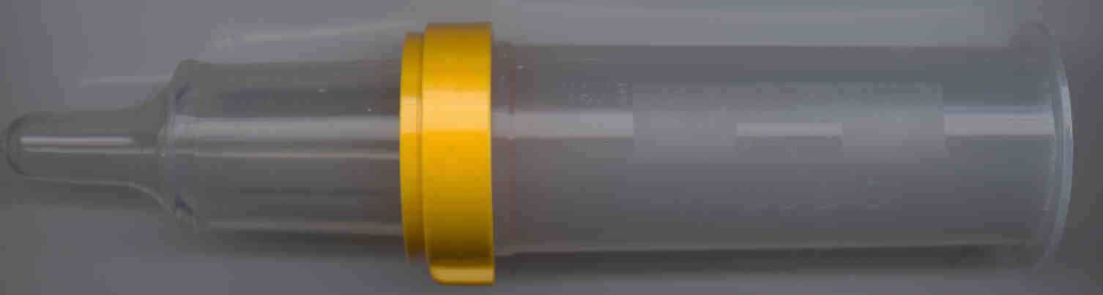
Haberman/ Special Needs Feeder
A special nipple with adjustable flow and a one way valve, fits all universal thread bottles; modification- “Soft Feeder”
Manufactured by Medela
CAUTION: ***, No Dishwasher, thickened feeds, increased energy expenditure from jaw excursion, cost prohibitive

Slide 40
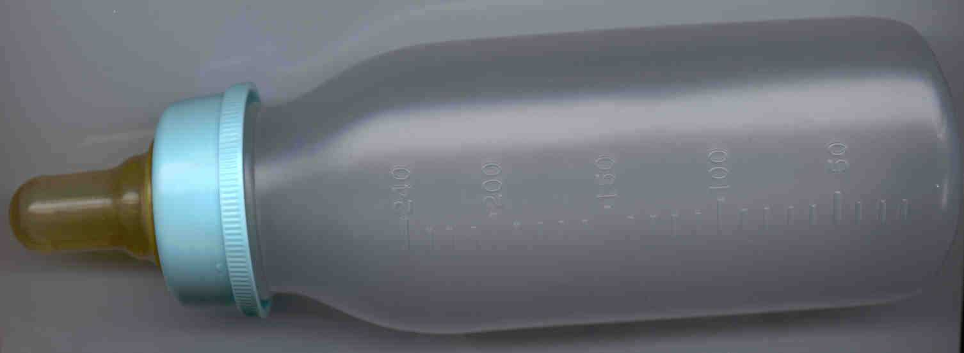
Pigeon Nipple
A larger nipple with a one way valve, fits all universal thread bottles
Small size nipple delivers smaller volume
Manufactured in Japan
CAUTION: NO Dishwasher, thickened feeds

Slide 41
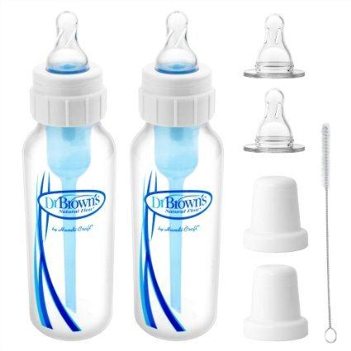
Dr. Brown’s Specialty Feeding System

Slide 42
Craniofacial Nutrition
Parents of CL/CLP infants feel that information on feeding is one of the highest priorities (Young, JL, et al 2001, Riski 2007, and Lindberg and Berglund 2013)

Slide 43
High Nutrition Risk
Small or retracted jaw
Long feedings
Poor weight gain
Multiple anomalies (syndromic )
Genetics Home Reference
Pierre Robin Sequence
22 q Deletion
Hemifacial Microsomia (Goldenhar)
Vander Woude (lip pits)
Aperts (fused fingers)
Crouzons
Treacher Collins
Stickler’s
Beckwith Wiedemann
Holoprosencephaly

Slide 44
Nutrition Assessment
Newborn Assessment to include:
Birth weight , current weight, length and HC, growth history
Regaining of birth weight by 2 weeks of age.
Kaye , et al ( 2014) retrospective 100 patients with CL, CLP, CP. Return to BW was CL=13.58 days, CLP=15.88 days and CP 21.93 days.

Slide 45
Nutrition Assessment, continued
Medical history including prematurity and other congenital anomalies: craniofacial, skeletal, cardiac, etc. Other medical history to include maternal health history, alcohol and drug use, diabetes.
Syndromes and/or underlying genetic anomalies may not be readily apparent at first.

Slide 46
Nutrition Assessment
Type of cleft lip and/or palate
Presence of retrognathia ( a condition in which either or both jaws recede with respect to the frontal plane of the forehead)

Slide 47
Nutrition Assessment
Feeding history to include : breast feeding or expressed breast milk (EBM), formula, volume per feeding, volume per day, spacing of feeding, length of feeding ; type of bottle. Check special recipes. Check formula prep. If EBM, check PNV for mom and Vit D for baby. Use of well or bottled water (fluoride)
Mothers’ desire for breast feeding; use of EBM
Spit ups, coughing , choking, history of reflux ; number of wet diapers, number of bowel movements

Slide 48
Nutrition Assessment
Ability of caretakers to care for child. Also, first time teenage mothers
Ability of family to get to appointments.
Clinical exam (nutrition focused physical findings) what does the patient look like? Also look at eyes and ears

Slide 49
Nutrition Prescription
Estimated energy needs: 102- 120 kcal/kg
Estimated protein needs:1.52 – 2 gm protein
Maintenance fluid needs: 100 ml/kg fluid
(Balluff, MA 1986)
Be mindful of realistic goals, gentle increases
Feeding therapist can give direction re: need for calorically dense EBM/formula.
Usually aim for ~115 – 120 kcal/kg, but this will put fluid load at ~170 ml/kg, unless formula and/or mother’s milk is more calorically dense.
150 ml/kg will provide ~100 kcal/kg with 20 kcal/oz

Slide 50
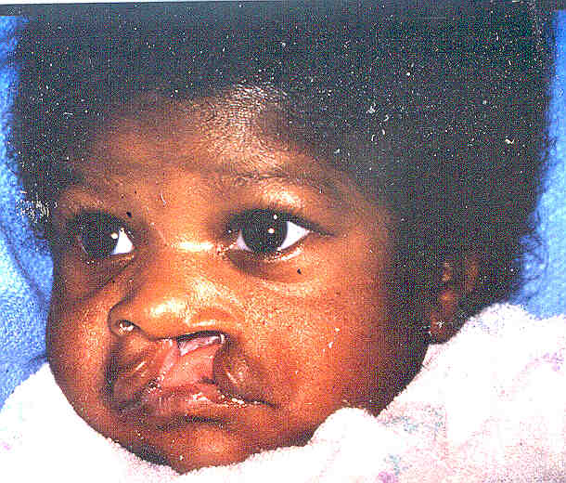
Left Unilateral Cleft Lip and Palate -Unrepaired
Photo: Evaluating Cleft Feeding, rev. 2015 CHOA power point

Slide 51
Isolated CLCP, no other concerns
Goal: Normal nutrition and feeding
Energy needs: normal for age to slightly higher if working to take bottle.
Make sure they are able to keep up with volume as needs are greater.

Slide 52
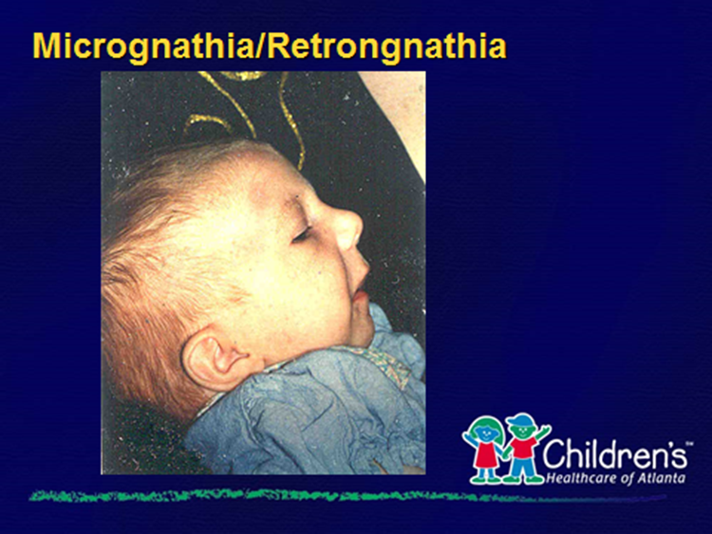
Pierre Robin Sequence
Small and/or retracted jaw
Cleft palate /high arched palate
Glossoptosis- displaced tongue; can obstruct airway
Isolated or associated with syndromes
Photo: Evaluating Cleft Feeding, rev. 2015 CHOA power point

Slide 53
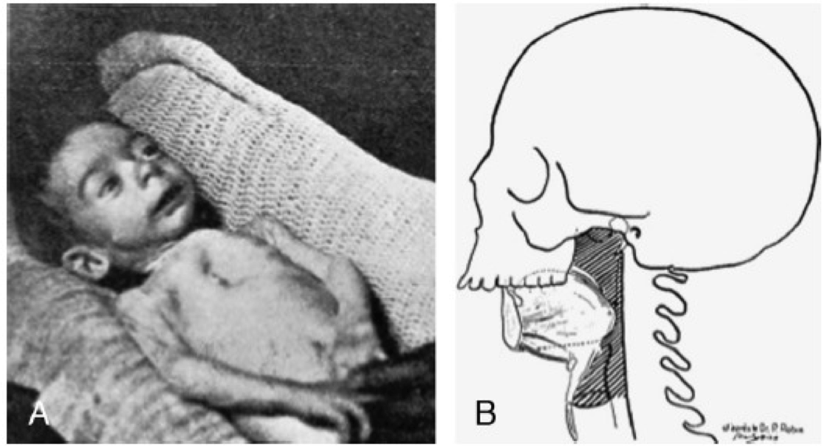
Pierre Robin Sequence
Photo: Verbal permission, Youssef Tahiri, MD, MSc, FRCSD, FAAP, FACS
From website : http://tahiriplasticsurgery.com

Slide 54
Pierre Robin Sequence
Desired Goal: normal nutrition and feeding but this may take awhile.
Energy needs: greater than normal if increased WOB; ~120 kcal/kg
May need tube feeding recommendations, with or without mandibular distraction

Slide 55
22 q 11.2 deletion syndromes
Other names: DiGeorge; velocardiofacial
May have cardiac abnormalities; GI dysfunction (abdominal pain, vomiting, gastroesophageal reflux and chronic constipation Giuliana, et al, 2013)
May have impaired immune function may be impaired
May have hypocalcemia
May have a cleft palate
Cupped ears and maxillary excess

Slide 56
22 q deletion
Can have complex issues. 22q clinic
Energy needs: may be greater than average and may involve cardiac needs

Slide 57
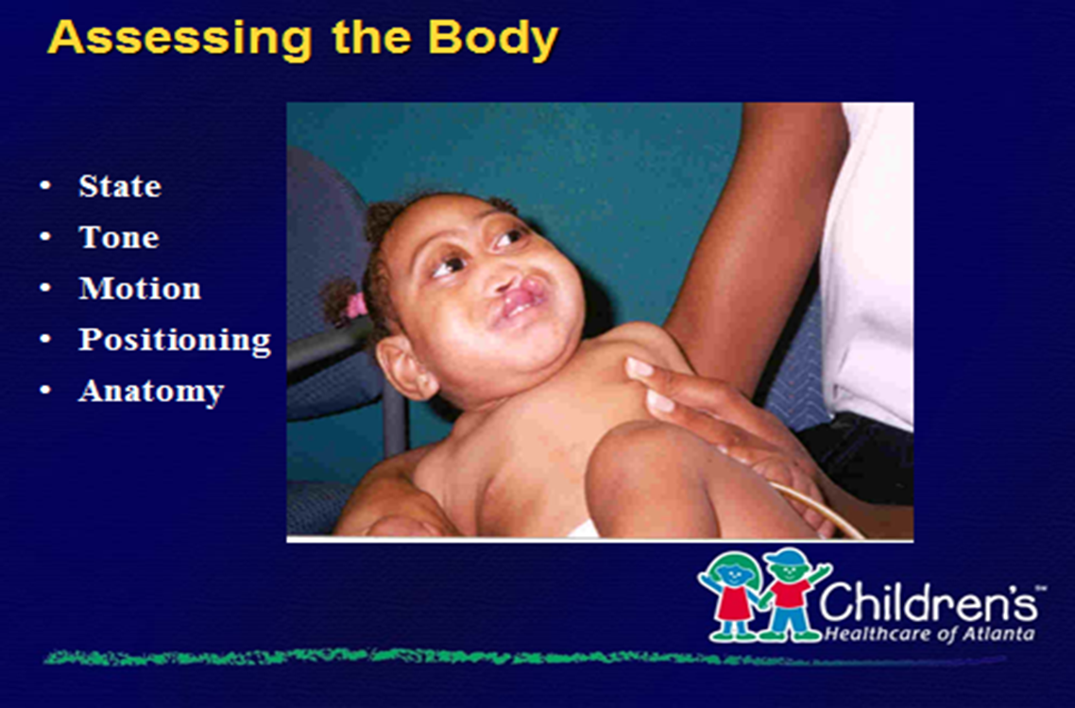
Holoproencephaly
Pituitary/Endocrine: eg. diabetes insipidus
Photo: Evaluating Cleft Feeding, rev. 2015 CHOA power point

Slide 58
Holoprosencephaly
Monitor sodium. May need endocrinology
May need GT, not only for feeding problems, but access
Weight gain is difficult

Slide 59
Volume goals
At the beginning, try to be as specific as you can with the volume. Then as baby grows well, infant led feeding.
24 hour volume: kcal/kg X weight= total calories
Total calories /kcal per oz= total volume in oz
Total volume X 30 to obtain milliliters
Total volume (either oz or mL)/number of feedings=volume per feeding
New born: at least 8 feedings. Don’t let baby sleep more than 3.5 hours; use alarm

Slide 60
Volume goal example - 1
Baby’s weight 3.03 kg /6# 10.6 oz . 7 days old.
120 kcal/kg X 3.03 kg = 363 kcal
363 kcal/GSG 20 kcal/oz = 18.15 oz/544 mL (180 mL/kg)
544 mL/8 = 68 ml/feeding
Instruct parents: 2 oz or 60 – 70 mL/feeding X 8 feedings ( every 3 hours, start to start). Lower end of range ,16 oz provides 158 mL/kg and 105 kcal/kg

Slide 61
Volume goal example - 2
Baby’s weight 3.03 kg /6# 10.6 oz . 7 days old.
120 kcal/kg X 3.03 kg = 363 kcal
363 kcal/GSG 24 kcal/oz = 15.12 oz/453 mL (150 mL/kg)
480 mL/8 = 60 ml/feeding
Instruct parents: 2 oz or mL/feeding X 8 feedings ( every 3 hours, start 16 oz provides 150mL/kg and 384 kcal or 127 kcal/kg

Slide 62
Nutrition Diagnosis
Inadequate intake related to cleft lip/cleft palate as evidenced by poor weight gain (z score) and diet history
Dysphasia related to (underlying diagnosis) as evidenced by clinical signs and symptoms and caregiver history
Pediatric malnutrition related to poor intake from (cleft diagnosis ) as evidenced by (growth parameter z score) (Mehta, NM et al 2013; Becker, PJ et al 2014)
Note: Nutrition diagnosis is not used in out patient craniofacial nutrition notes.

Slide 63
Nutrition Intervention, Monitoring, Evaluation
Goals:
1. Quantity
Evidenced by appropriate weight gain :
A. 1 oz/day ( 30 gm/day)
B. Older infant: follow own weight percentile curve.
C. Evidence of syndrome? (dropping off esp of linear growth)
2. Quality
Feedings are a pleasant experience
Longer term Feeding and nutrition goal: in most cases, normal for age.

Slide 64
Nutrition Intervention, Monitoring and Evaluation: growth in non syndromic CL, CLCP; CP patients
Two recent studies from Brazil:
Miranda, GS, et al (2016): under 2 years. Prospective; 381 children. Median weight for age and BMI growth curves below typical children, but spontaneous recovery starting 5 months of age.
Marques, IL, et al (2015) 2 – 10 years. CLCP. Longitudinal, prospective. 360 children . Growth was similar to typical children of both genders.

Slide 65
Nutrition Intervention, Monitoring, Evaluation: EBM/Breast feeding
ABM Clinical Protocol #17 (Reilly, S, et al. 2013)
Many babies with CL may be able to breast feed because the nipple tissue can help create seal. Less so if the alveolus (gum) is involved.
CLCP/CP: May have good latch, but with most CP babies, they are unable to create sufficient seal for negative pressure needed in the oral cavity. (Gallagher, E, et al 2017)
CHOA feeding clinic: try to work out plan that meets parents’ desires for breast feeding and to promote adequate wt gain, etc.
CHOA: Okay to breast feed after lip surgery. Palate repair: Depends on location of repair.

Slide 66
Nutrition Intervention, Monitoring, and Evaluation
Common interventions include:
Specific volume to meet caloric goals
Increasing calories per ounce of formula for lower volume, increased needs
EBM and/or trial of change of formula
Recommendations for tube feedings
Normal nutrition interventions for age group
GI referral (call PCP for referral; print website home site; call GI if work in)

Slide 67
Nutrition Intervention, Monitoring and Evaluation
Be specific in 24 hour volume goals, volume/feeding, number of feedings/day, weight gain goals, keeping feeding diaries, weight checks, follow up appointments, contact phone numbers.
Other disciplines/team approach: Nurse Practitioner, Clinical Coordinators (nurses), Administrative Assistant, Feeding therapists (OT and SLP ), Geneticists, Nutritionists, Social Workers, Schedulers, Interpreters, Dentists, Orthodontists, Dental Hygienists, Plastic Surgeons (Nahai, FR, et al, 2005; Crockett, DJ and Goudy, SL 2014)

Slide 68
Frequently Asked Questions
When to start solids? Per PCP, generally 4 – 6 months. Okay to use spoon even with open palate
Cleft pacifier available? No pacifier will stay in mouth without assistance
When to start introducing a cup? Encourage cup use after spoon foods established, in preparation for alternative means of intake after surgery. Surgeons do not allow bottle feeding after palate surgery.
What about feeding after surgery? After palate surgery, it may take up to 10 days to return to normal feeding. Pain control. Cup feeding

Slide 69
Frequently Asked Questions
Feeding plates ( oral appliances) have not shown to be more effective (Hooper, BA, et al 2011)
Are there special nutrition reminders as the infant grows? As table foods increase, limit contact time of simple sugars. (Chapple, JR, and Nunn, JH ,2001) Encourage a dental home (J. Thomas, DDS)
Role of Folic Acid (Hartridge, 1999) . Reviewed the protective effects of folic acid on reducing the incidence of clefts
Our geneticists recommend 4 mg folic acid if the mother had a previously affected pregnancy.

Slide 70
Nutrition References
Alperovich, M., Frey, J. D., Shetye, P. R., Grayson, B. H., & Vyas, R. M. (2016). Breast milk feeding rates in patients with cleft lip and palate at a North American Craniofacial Center. The Cleft Palate-Craniofacial Journal : Official Publication of the American Cleft Palate-Craniofacial Association, 0(0), 0–3. https://doi.org/10.1597/15-241
Balluff MA. (1986). Nutritional needs of an infant or child with a cleft lip or palate. Ear Nose and Throat Journal, 65(7), 311–315.
Becker, P. J., Nieman Carney, L., Corkins, M. R., Monczka, J., Smith, E., Smith, S. E., … White, J. V. (2014). Consensus statement of the academy of nutrition and dietetics/american society for parenteral and enteral nutrition: Indicators recommended for the identification and documentation of pediatric malnutrition (Undernutrition). Journal of the Academy of Nutrition and Dietetics, 114(12), 1988–2000. https://doi.org/10.1016/j.jand.2014.08.026
Bessell, A., Hooper, L., Wc, S., Reilly, S., Reid, J., & Am, G. (2011). Feeding interventions for growth and development in infants with cleft lip , cleft palate or cleft lip and palate ( Review ), (2). Retrieved from http://www.ncbi.nlm.nih.gov/pubmed/21328261

Slide 71
Nutrition References
Chapple, J. R., & Nunn, J. H. (2001). The oral health of children with clefts of the lip, palate, or both. The Cleft Palate-Craniofacial Journal : Official Publication of the American Cleft Palate-Craniofacial Association, 38(5), 525–528. https://doi.org/10.1597/1545-1569(2001)038<0525:TOHOCW>2.0.CO;2
Crockett, D. J., & Goudy, S. L. (2014). Cleft lip and palate. Facial Plastic Surgery Clinics of North America. https://doi.org/10.1016/j.fsc.2014.07.002
Foundation, C. (2009). Feeding your Baby Cleft Palate Foundation.pdf.
Fox-Lewis, A. (2011). A technique for nurses to use when educating families about cleft nutrition. Nursing Children and Young People, 23(4), 28–9. https://doi.org/10.7748/ncyp2011.05.23.4.28.c8489
Gallagher, Emily; Mckinney, Christy; Glass, R. (2017). Promoting Breast Milk Nutrition in Infants with Cleft Lip and/or Palate Letter to the Editor. Advances in Neonatal Care, 17(No 2), pp 79-80.
Genetics Home Reference https://ghr.nlm.nih.gov/
Giardino, G., Cirillo, E., Maio, F., Gallo, V., Esposito, T., Naddei, R., … Pignata, C. (2014). Gastrointestinal involvement in patients affected with 22q11.2 deletion syndrome. Scandinavian Journal of Gastroenterology, 49(3), 274–279 abstract. https://doi.org/10.3109/00365521.2013.855814

Slide 72
Nutrition References
Hartridge, T., Illing, H. M., & Sandy, J. R. (1999). The role of folic acid in oral clefting. British Journal of Orthodontics. https://doi.org/10.1093/ortho/26.2.115
Kaye, A., Thaete, K., Snell, A., Chesser, C., Goldak, C., & Huff, H. (2017). Initial nutritional assessment of infants with cleft lip and/or palate: Interventions and return to birth weight. Cleft Palate-Craniofacial Journal, 54(2), 127–136. https://doi.org/10.1597/15-163
Marques, I. L., Nackashi, J. A., Borgo, H. C., Martinelli, A. P. M. C., Pegoraro-Krook, M. I., Williams, W. N., … Shuster, J. (2009). Longitudinal study of growth of children with unilateral cleft-lip palate from birth to two years of age. The Cleft Palate-Craniofacial Journal : Official Publication of the American Cleft Palate-Craniofacial Association, 46(6), 603–9. https://doi.org/10.1597/08-105.1
Mehta, N. M., Corkins, M. R., Lyman, B., Malone, A., Goday, P. S., Carney, L., … Schwenk, W. F. (2013). Defining pediatric malnutrition: A paradigm shift toward etiology-related definitions. Journal of Parenteral and Enteral Nutrition, 37(4), 460–481. https://doi.org/10.1177/0148607113479972
Miranda, G. S., Marques, I. L., de Barros, S. P., Arena, E. P., & de Souza, L. (2016). Weight, Length, and Body Mass Index Growth of Children Under 2 Years of Age With Cleft Lip and Palate. The Cleft Palate-Craniofacial Journal : Official Publication of the American Cleft Palate-Craniofacial Association, 53(3), 264–71. https://doi.org/10.1597/14-003

Slide 73
Nutrition References
Nahai, F. R., Williams, J. K., Burstein, F. D., Martin, J., & Thomas, J. (2005). The Management of Cleft Lip and Palate: Pathways for Treatment and Longitudinal Assessment. Seminars in Plastic Surgery, 19(4), 275–285. https://doi.org/10.1055/s-2005-925900
Reilly, S., Reid, J., Skeat, J., Cahir, P., Mei, C., & Bunik, and the Academy of Breastfee, M. (2013). ABM Clinical Protocol #17: Guidelines for Breastfeeding Infants with Cleft Lip, Cleft Palate, or Cleft Lip and Palate, Revised 2013. Breastfeeding Medicine, 8(4), 349–353. https://doi.org/10.1089/bfm.2013.9988
Riski, J. E. (2007). Feeding the Infant Born With Cleft Lip / Palate : A Literature Review. Perspectives on Swallowing and Swallowing Disorders, (October), 12–17.

Slide 74
Screening Tool
Regain birth weight?
Gaining appropriately?
Looks good- arms, thighs
1/10/100: Gain 1 oz/day, 10# for surgery, 100 ml/kg or 100 kcal/kg
Bottle resources
Transportation access
Presence of reflux
Length of feedings, number of wet diapers, bowel movements

Slide 75
Screening Tool, continued
Plugged into a craniofacial center?
Quality of feedings?
Teenage mom/immature mom/special needs mom
Call PCP if weight poor or quality of feedings are poor

