Slide 1

The Evolution of EoE

Slide 2
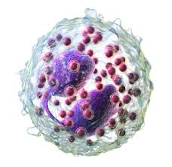
Objectives
What’s new in EoE?
  Definition
  Epidemiology
  Pathogenesis
  Diagnostic Pathway
  Treatment
  Natural History

Slide 3

Definition of EoE
2006-2007
FIGERS (NASPGHAN 2006)
  “EE” is a clinicopathological disease characterized by:
    Symptoms including food impaction and dysphagia in adults, and feeding intolerance and GERD symptoms in children
    ≥ 15 eosinophils / hpf
    Exclusion of other disorders associated with similar clinical, histological, or endoscopic features, especially GERD (lack of response to high dose PPIs or normal pH monitoring)
Gastroenterology 2007;133:1342
Premise that GERD was the only esophageal disorder that
could respond to the acid suppressing ability of PPI therapy

Slide 4
2006-2007
GERD
EoE
<15 eos/hpf
≥15 eos/hpf

Slide 5
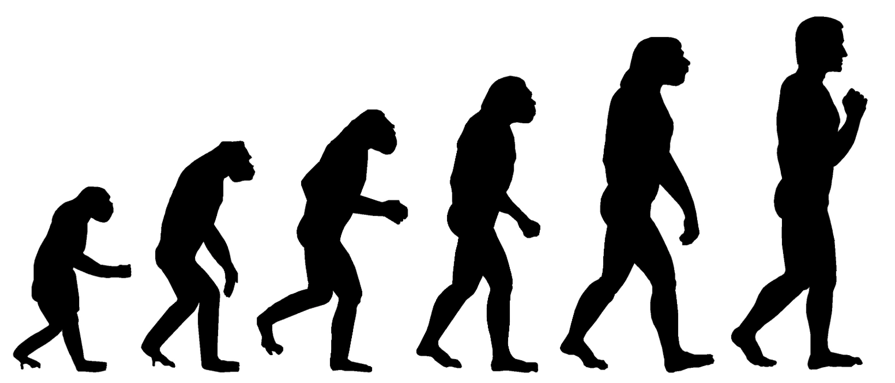
Definition of EoE
2011
Updated Consensus Recommendations
  Changed “EE” to “EoE” to differentiate from erosive esophagitis
  Added that EoE is a chronic immune mediated condition
  Stronger emphasis on excluding other causes of esophageal eosinophilia beyond GERD (Crohn’s, Infections, Achalasia, etc)
  Recognized that patients with >15 eos/hpf can respond to PPI therapy
    → Introduction of “PPI-responsive esophageal eosinophilia” (PPI-REE)
J Allergy Clin Immunol 2011;128:3-20

Slide 6
2011
?
?
GERD ←→ PPI-REE ←→ EoE

Slide 7
Definitions of EoE
2013-14
2013 (US guidelines)
  Retained PPI-REE classification
2014 (Pediatric guidelines, ESPGHAN)
  “…other causes of esophageal eosinophilia should be excluded, specifically proton pump inhibitor-responsive esophageal eosinophilia”
  Required 8w PPI trial prior to diagnosing EoE
    Responders to PPI therapy classified as PPI-REE
Dellon et al. Am J Gastroenterol 2013;108:679-692
Papadopoulou et al. JPGN 2014;58:107-118

Slide 8
Is PPI-REE a subtype of EoE?
Similar presenting symptoms (dysphagia)
Similar endoscopic and histologic findings
Similar inflammatory cytokines and tissue biomarkers
Substantial overlap in gene expression for eosinophil chemotaxis, barrier function and tissue remodeling
Kim and Dellon. Gastroenterology & Hepatology 2018;14:358-366
EoE and PPI-REE are virtually indistinguishable from one another, at the clinical,
molecular and even at the genetic level, and are very different from GERD

Slide 9
Definition of EoE
2017
European guidelines
  “EoE is a chronic, local, immune-mediated esophageal disease, characterized clinically by symptoms related to esophageal dysfunction and histologically by eosinophil-predominant inflammation. Other systemic and local causes of esophageal eosinophilia should be excluded”
    Abandons the term “PPI-REE”
    Considers PPI-REE same as EoE
Lucendo et al. UEGJournal 2017;5:335-358

Slide 10

Definition of EoE
2018
EoE
PPI-REE
AGREE (“A Working Group on PPI-REE”), DDW 2017
  Pediatric and Adult GI, Allergists, Pathologists and Researchers representing 14 countries
  Developed an updated diagnostic algorithm for EoE
    No longer requires a PPI trial before diagnosing EoE
    Recommends considering PPIs as a treatment for EoE
Gastroenterology 2018, ahead of print

Slide 11
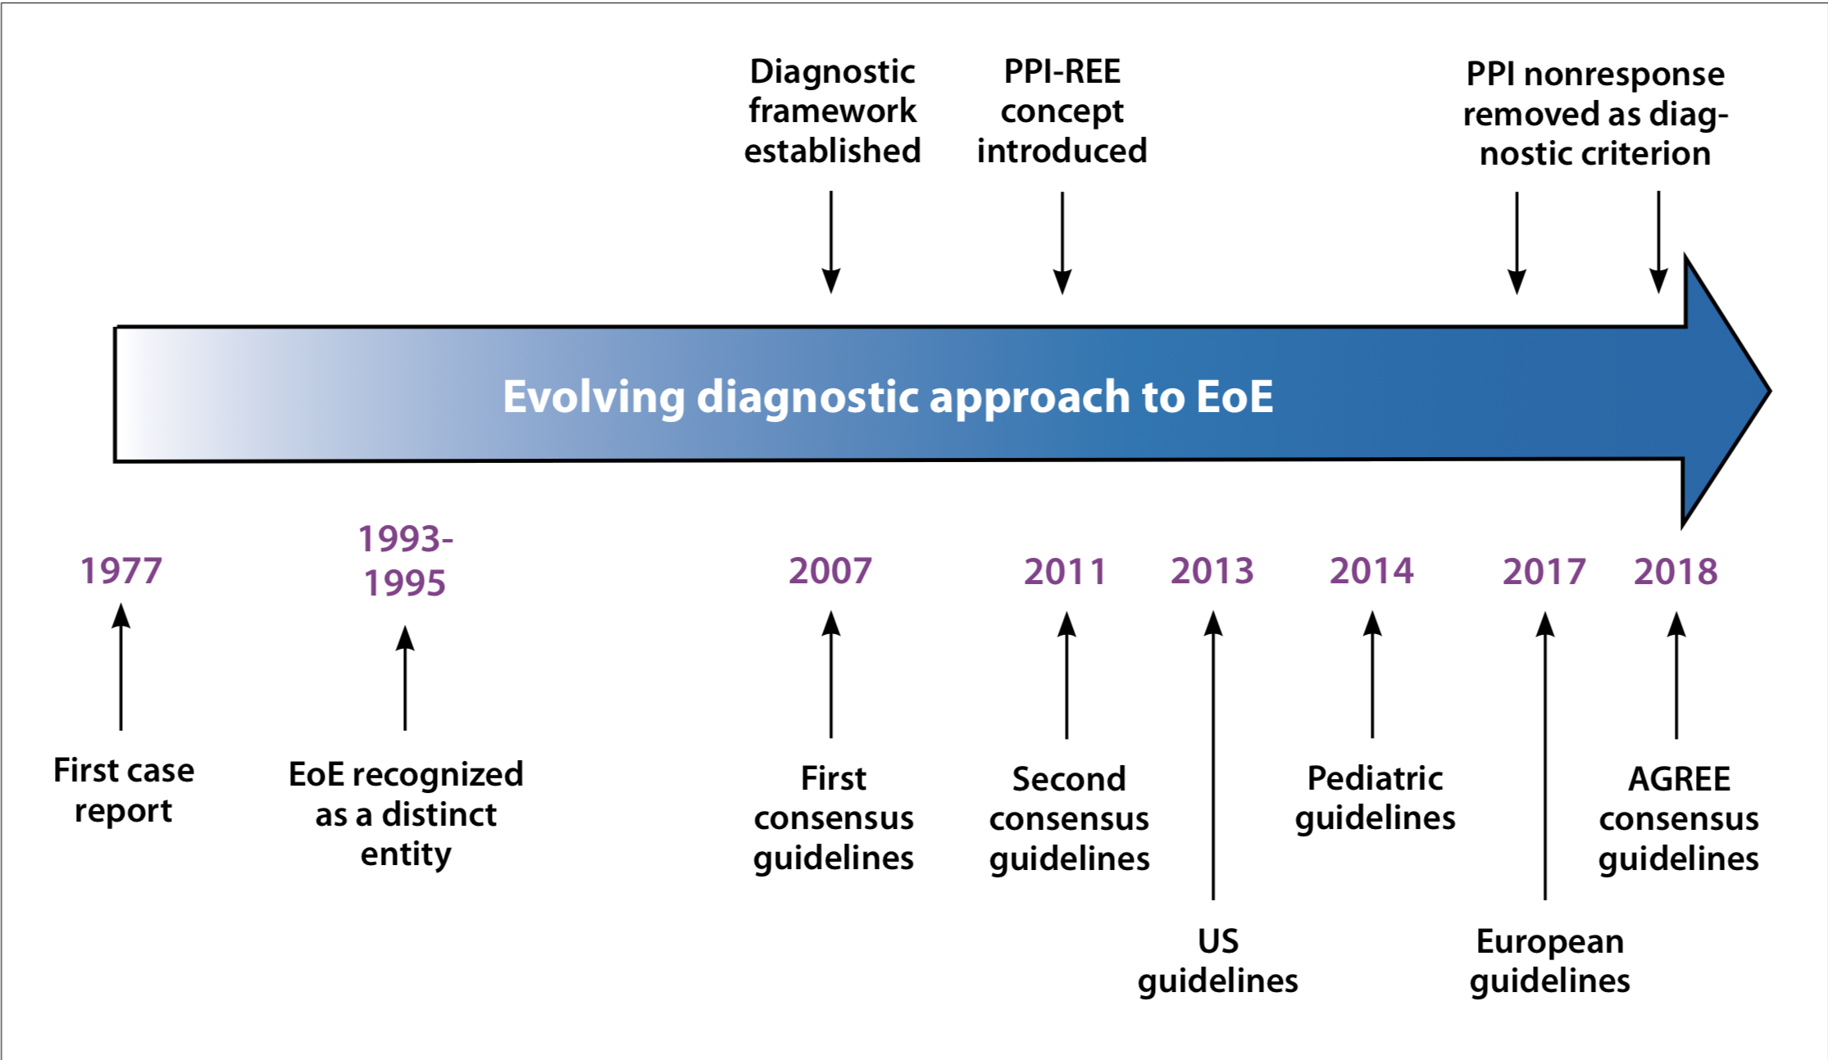

“PPI-REE”
Kim and Dellon. Gastroenterology & Hepatology 2018;14:358-366

Slide 12
2018 (Current)
GERD
EoE (May respond to PPIs)
~0-5 eos/hpf
≥15 eos/hpf

Slide 13
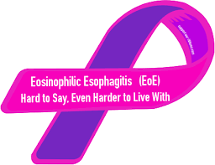
Epidemiology of EoE
Meta-analysis (2016)
  Pooled incidence: 3.7/100,000/year (95% CI, 1.7-6.5)
    Increasing (5 - 27 fold over past 10 years)
    Adults > Children
  Pooled prevalence: 22.7/100,000 (95% CI, 12.4-36.0)
    Increasing (chronic, non-fatal disease)
    Adults > Children
    American > European studies
US: 57/100,000
Arias et al. Aliment Pharmacol Ther 2016;43:3-15
Dellon et al. Clinical Gastro Hepatology 2014;12:589-96
IBD
  Incidence 7/100,000/year
  Prevalence 400/100,000

Slide 14
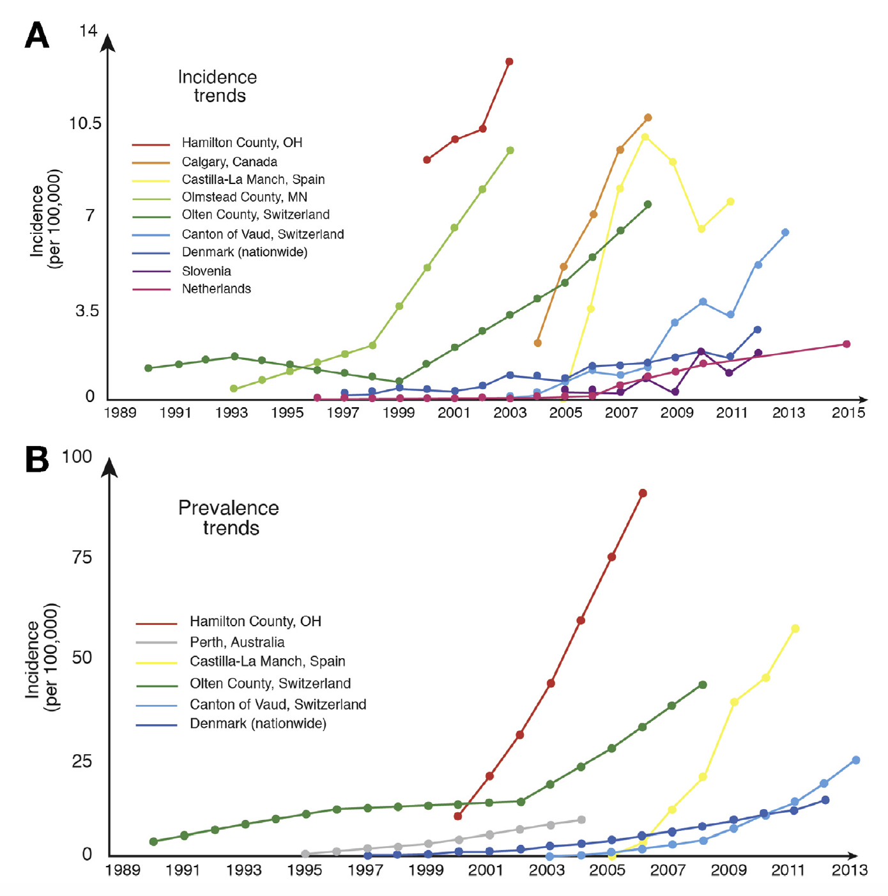
Dellon and Hirano. Gastroenterology 2018;154:319-332

Slide 15

Eosinophilic Esophagitis
GI Care For Kids
(2012):
  590 patients with EoE
(2018):
  1325 patients with EoE

Slide 16
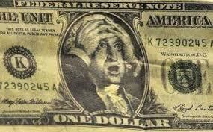
EoE: Healthcare Utilization
Patients with EoE in the US have an estimated annual healthcare cost as high as $1.4 billion
  $3,304 / person / year (vs $1,001 for controls)
Similar to acute appendicitis ($1.4 billion), C.Diff ($1.1 billion) and IBD ($1 billion)
Jesen et al. Am J Gastroenterol 2015;110:626-632

Slide 17
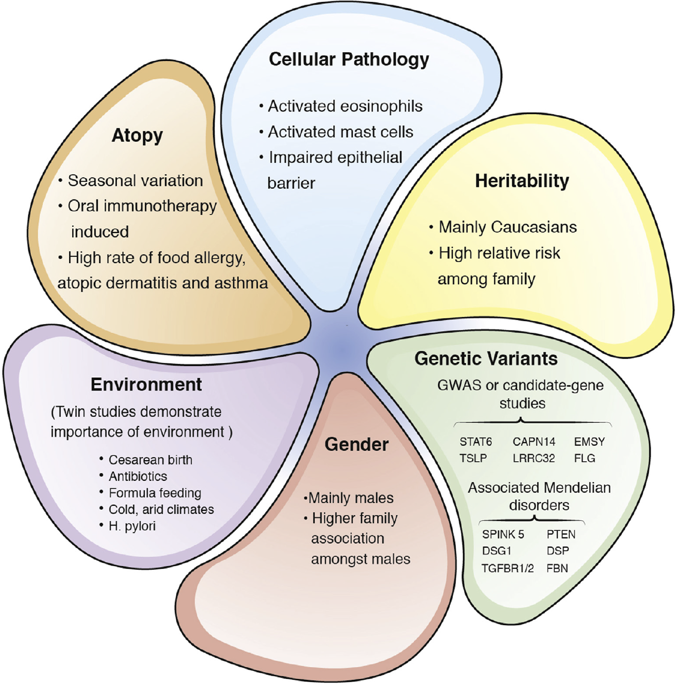
Etiopathogenesis:
Factors Contributing to EoE
O’Shea et al. Gastroenterology 2018;154:333-345

Slide 18
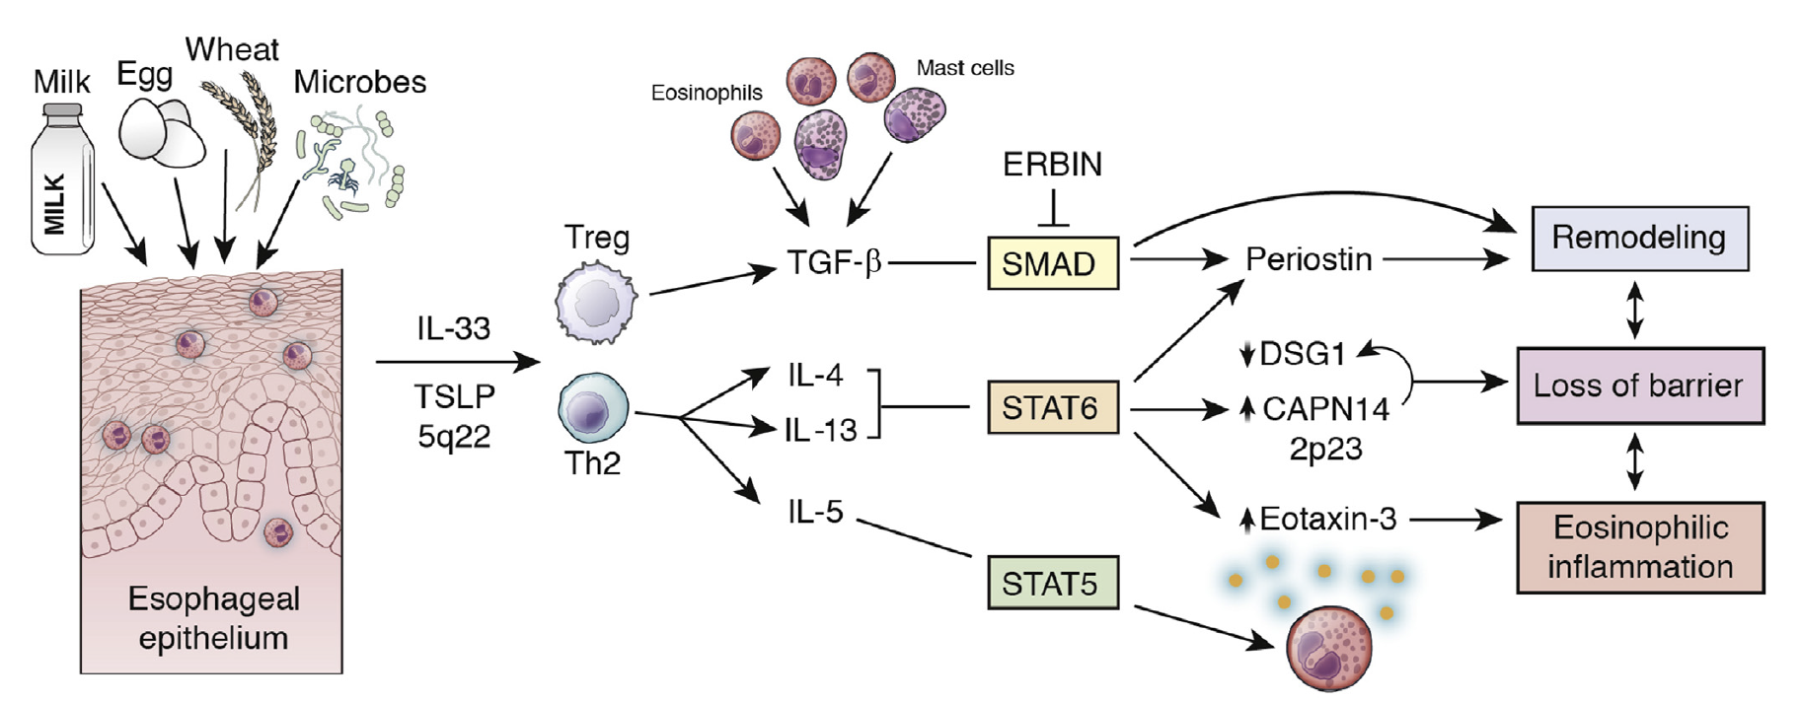
Cellular Pathology of EoE
1. Increased CHEMOTAXIS / TRAFFICKING of eosinophils
2. Impaired BARRIER FUNCTION of esophageal mucosa
3. REMODELING / FIBROSIS of esophageal submucosa
Rothenberg. Gastroenterology 2015;148:1143-1157

Slide 19
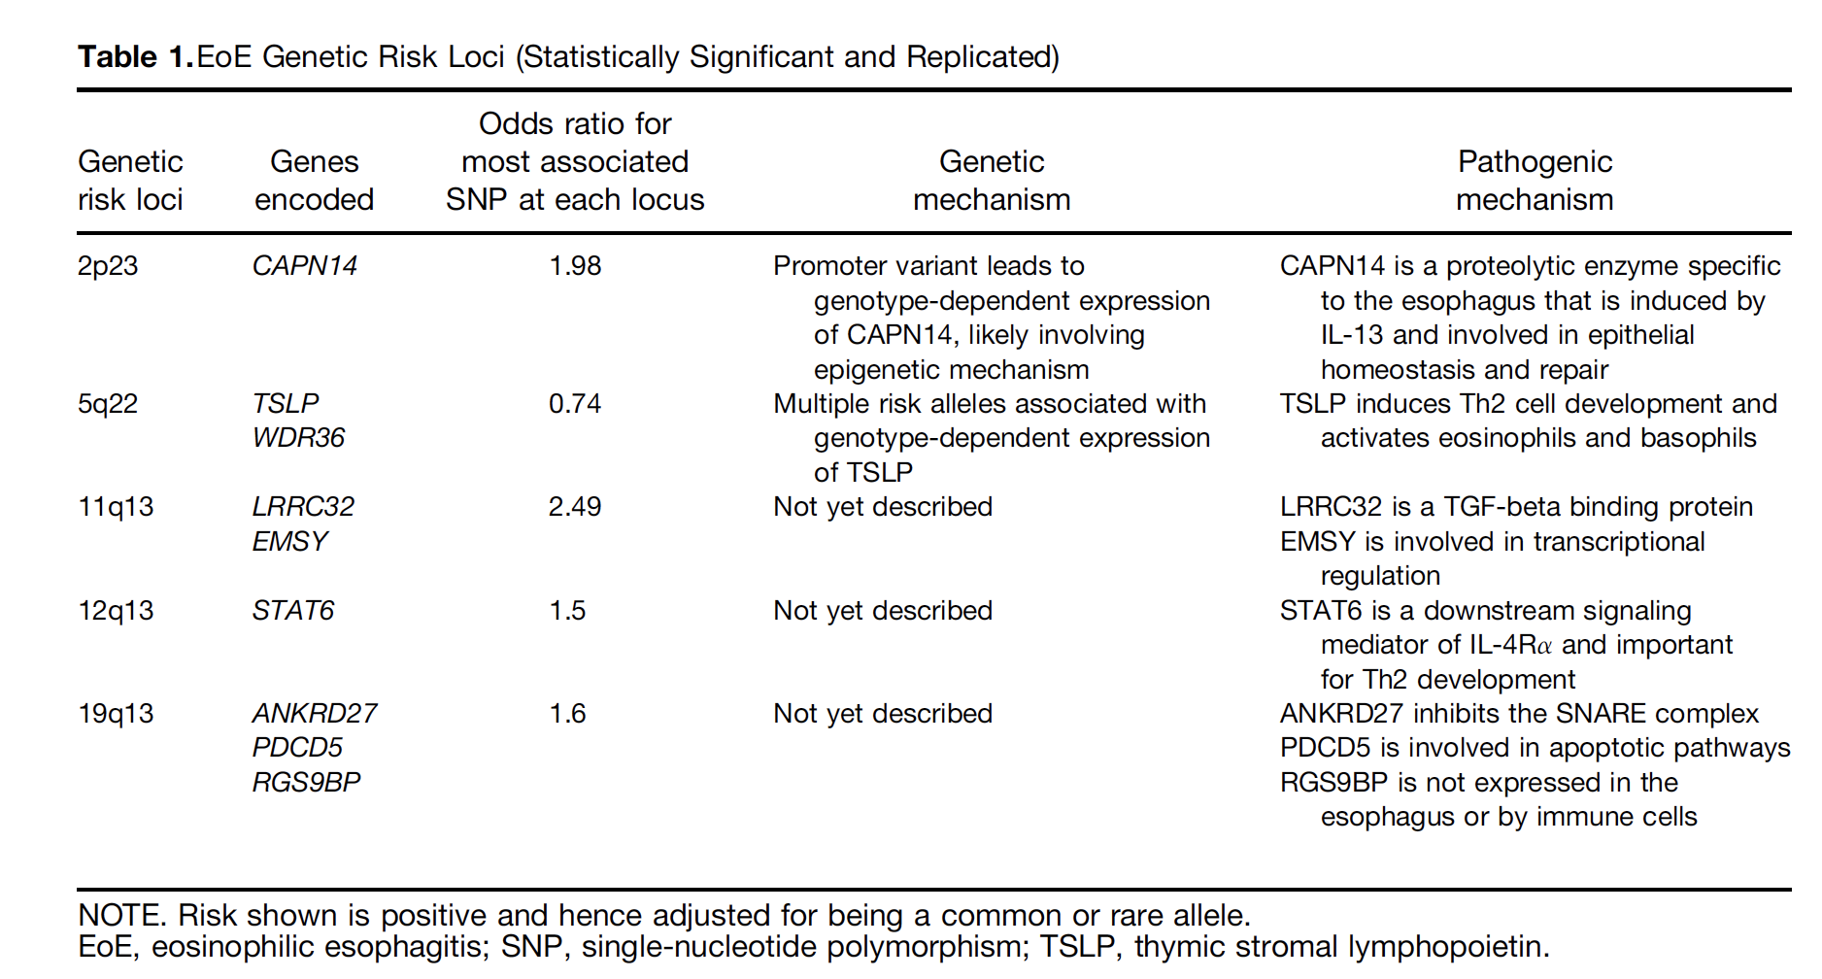
Candidate Genes in EoE
Rothenberg. Gastroenterology 2015;148:1143-1157

Slide 20
Heritability of EoE
Family associations have RR as high as 64-fold amongst brothers
Proband Concordance:
  Monozygotic twins: 58%
  Dizygotic twins: 35%
  Non-twin siblings: 2.4%
Collins et al. Gastroenterol Clin North Am 2014;43:257-268
Alexander et al. J Allergy Clin Immunol 2014;134:1084-1092

Slide 21
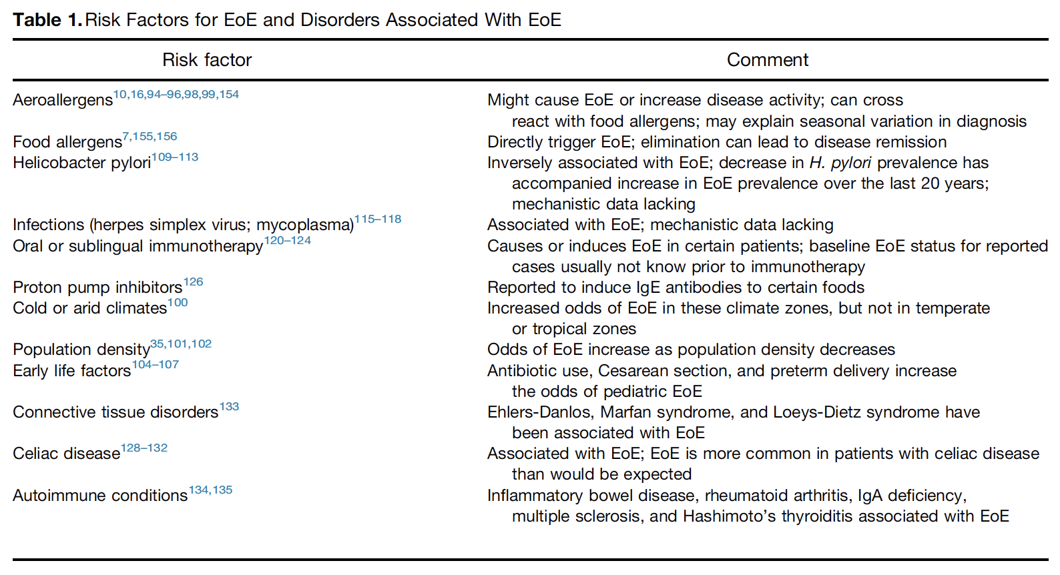
Environmental Risk factors for EoE
Dellon and Hirano. Gastroenterology 2018;154:319-332

Slide 22
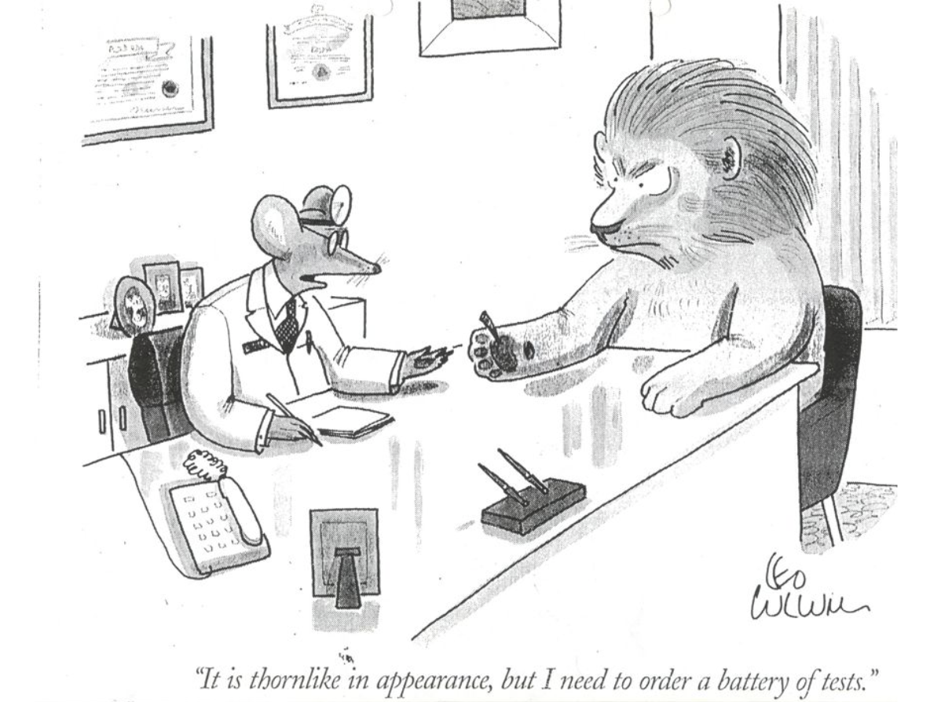
EoE: Diagnostic Pathway

Slide 23
Suggested Pathway for Diagnosing Eosinophilic Esophagitis
Suspected EoE
(Food aversion, Abd Pain,
Vomiting, Dysphagia*, other)
2007
+/- UGI
PPI x 4-8 weeks
EGD
with pH monitoring
Improved
Not improved
Probable GERD
EGD (on PPI)
Normal pH monitoring
Biopsies: ≥15eos/hpf
= EoE
Notes:
23

Slide 24
Suggested Pathway for Diagnosing Eosinophilic Esophagitis
2011 - 2017
Suspected EoE
(Food aversion, Abd Pain,
Vomiting, Dysphagia*, other)
+/- UGI
PPI x 4-8 weeks
EGD
with pH monitoring
Improved
Not improved
GERD / PPI-REE
EGD (on PPI)
Normal pH monitoring
Remained the same despite
knowing about PPI-REE
Biopsies: ≥15eos/hpf
= EoE
Notes:
24

Slide 25

2018
First EGD off PPI therapy
to capture
PPI responders
EoE: New
Diagnostic Pathway

Slide 26
Suggested Pathway for Diagnosing Eosinophilic Esophagitis
Suspected EoE
Esophageal Dysfunction +/- Atopy
Food aversion, Abd Pain, Vomiting, Dysphagia, other
2018
EGD
Endoscopic signs of EoE
Biopsies: ≥15eos/hpf
= EoE
Exclude other etiologies of
esophageal eosinophilia
PPI Therapy
Dietary Therapy
Topical Corticosteroid
Therapy
Notes:
26

Slide 27
EoE: Diagnostic Pathway
Atopic toddler with picky eating
    → EGD off PPI therapy
      Pro: Will identify all EoE (including PPI-responders)
      Con: 2 EGDs for initial diagnosis, often 3 EGDs to demonstrate remission (could be 6mo).
    → EGD on PPI therapy
      Pro: 1 EGD for diagnosis
      Con: Will miss PPI-responders (up to 50% with EoE?)
Obese, non-atopic teen with vomiting
  PPI trial x 2-3 months
  Then stop PPI x 1 month. If vomiting recurs, then EGD

Slide 28
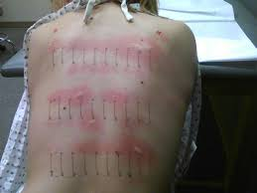
EoE: Other Studies
Allergy Consultation?
  SPT / APT
Notes:
Routinely to Allergist?

Slide 29
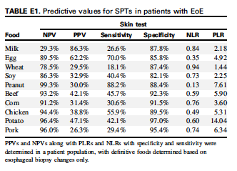
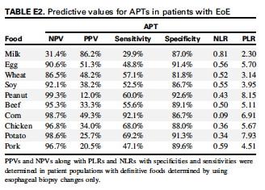
Allergy Testing in EoE
Allergy testing still recommended:
IgE Food Allergy
EoE: 20%
General Population: 6%
Spergel JM et al. J Allergy Clin Immunol 2012;130:461-467

Slide 30
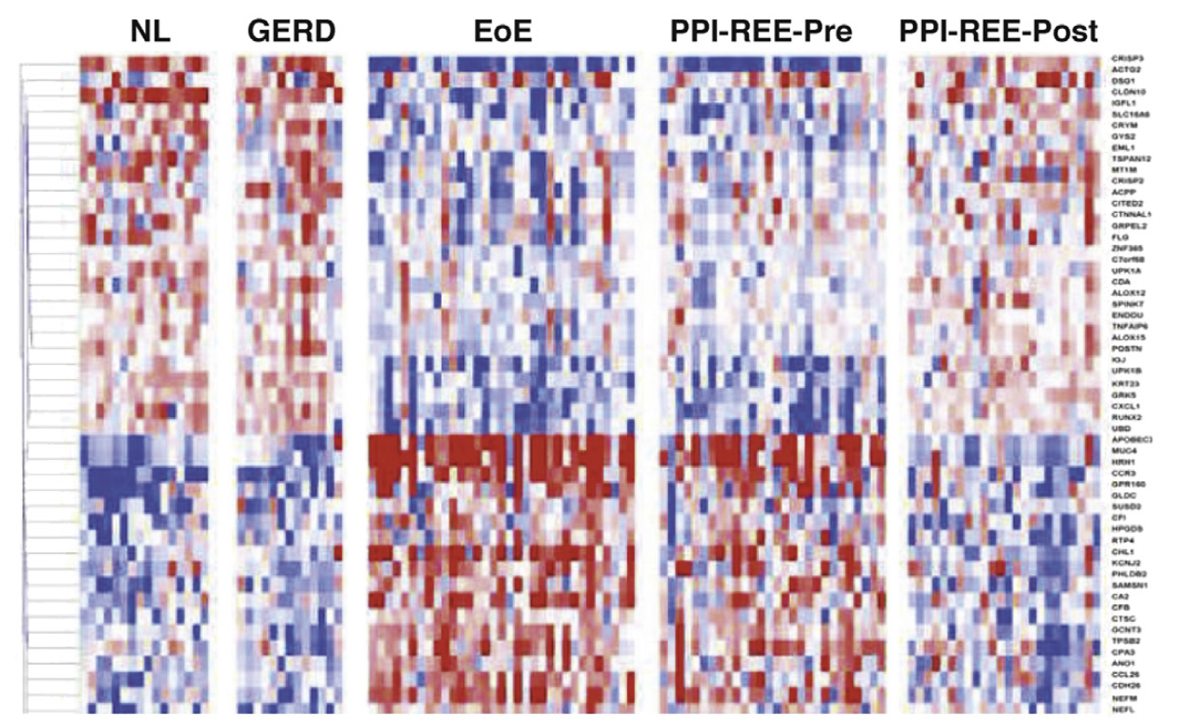
EoE: Diagnosis
EoE Diagnostic Panel (EDP)
  Gene expression panel
    Includes 96 genes
      Detects EoE with 96% sensitivity and 98% specificity
      EoE Remission vs Controls / GERD
      EoE Remission vs Active EoE
        Scores improve with TCS and PPI treatment response
Rothenberg. Gastroenterology 2015;148:1143-57
High diagnostic utility: distinguishes EoE patients from controls / GERD
May be useful to monitor treatment response
✖ Still requires EGD / biopsy
Wen et al. Gastroenterology 2013;145:1289-1299

Slide 31
EoE Diagnosis: Less Invasive Tests
  Transnasal / Transgastrostomy endoscopy
    Office based, no sedation, esophageal visualization and biopsies
  Mucosal Impedance (EGD, measures degree of spongiosis)
    GERD vs EoE (84% sensitivity and 70% specificity)
    Active vs Inactive EoE (JPGN August 2018)
  Esophageal String Test (dissolvable capsule with string)
    Captures eos / TH2 secretions and cytokines, correlates with biopsies
  Cytosponge (dissolvable capsule with sponge)
    Captures epithelial sample, analyzed with standard histopathology
  Pipeline: salivary IL-4 and IL-5, urine 3-bromotyrosine and stool eosinophil-derived neurotoxin

Slide 32
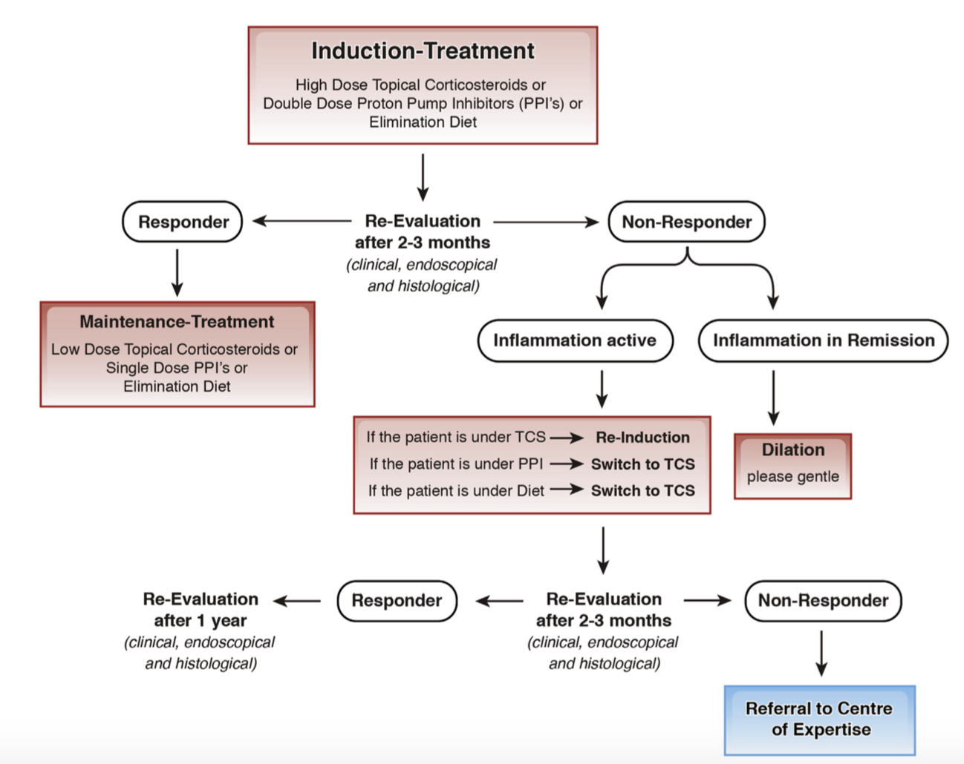
EoE: Treatment
Straumann and Katzka. Gastroenterology 2018;154:346-359

Slide 33
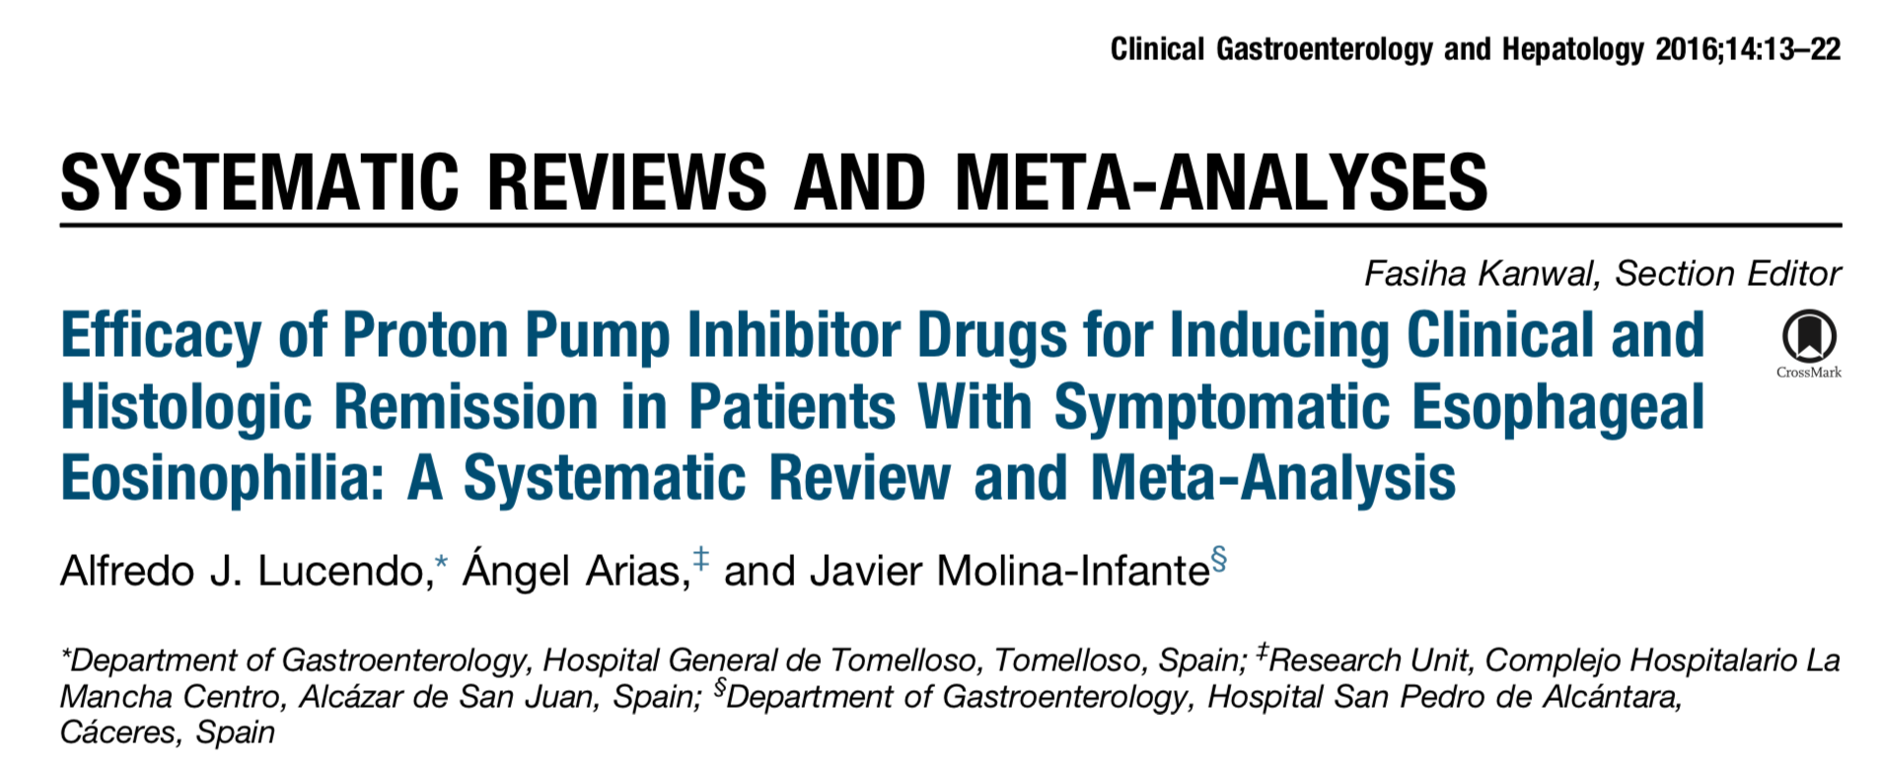
Treatment: PPI
Meta-analysis (2016)
  33 studies, 188 children / 431 adults
  Clinical response in 60.8% (95% CI 48.4-72.2%)
  Histologic remission in 50.5% (95% CI 42.2-58.7%)
  No difference children vs adults
  No difference between BID and QD (55.9% vs 49.7%)
  Limitations:
    Case reports and retrospective studies
    Publication bias in favor of positive studies
    Variable definitions of “response” and “remission”

Slide 34
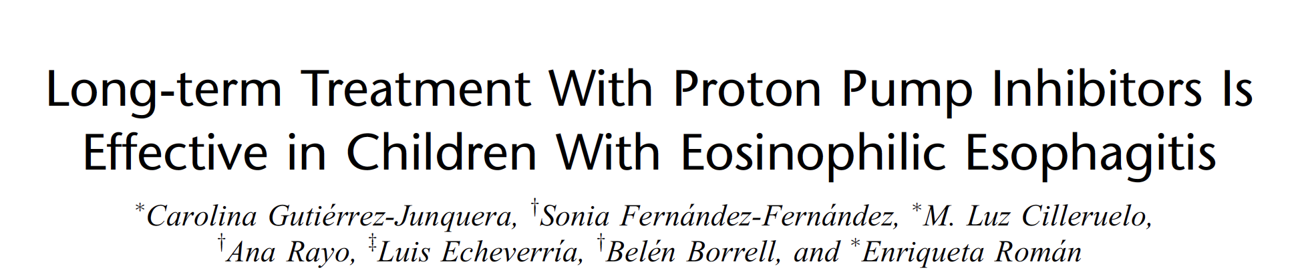
Longterm PPI maintenance
Prospective study with esomeprazole
  First 8w: 1mg/kg BID
  Long-term (remainder of 1 year): 1mg/kg QD
Results:
  8w: 66% (72/109) initially responded (≤ 15 eos/hpf)
  1 year: 70% (40/57) maintained remission (≤ 15 eos/hpf)
    If ≤5 eos/hpf initially (1mg/kg BID): 81% maintained remission
    If 5-15 eos/hpf initially (1mg/kg BID): 50% maintained remission
C Gutierrez-Junquera et al. JPGN 2018; 67:210-6

Slide 35
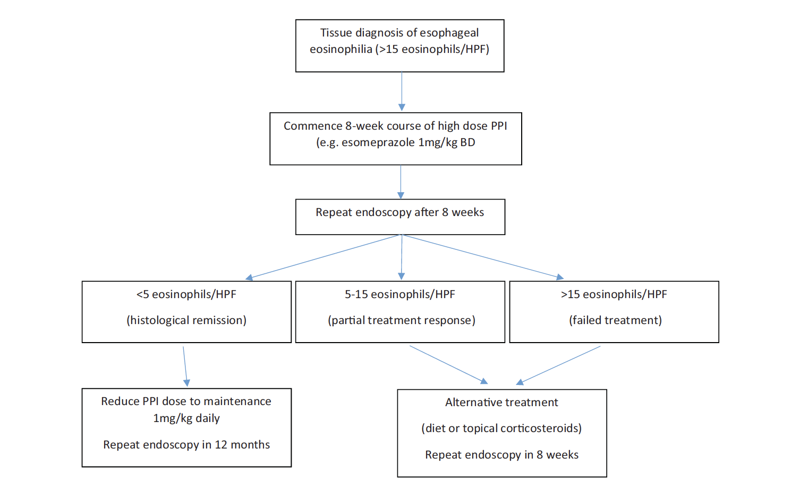
PPIs: First line therapy?
Ellison et al. JPGN 2018;67:146-7

Slide 36
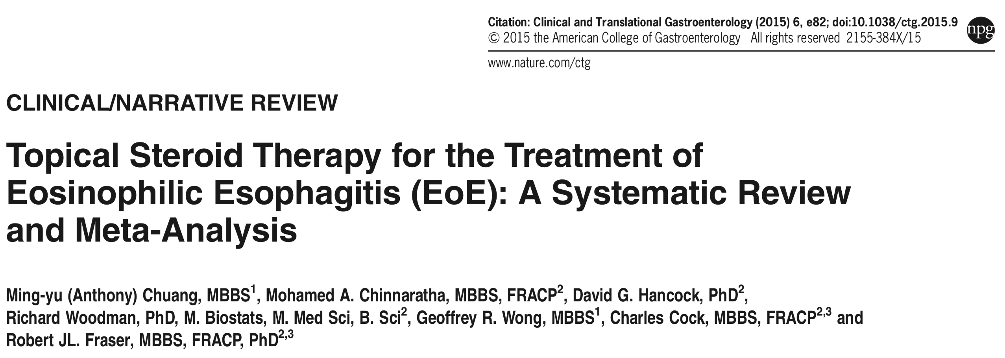
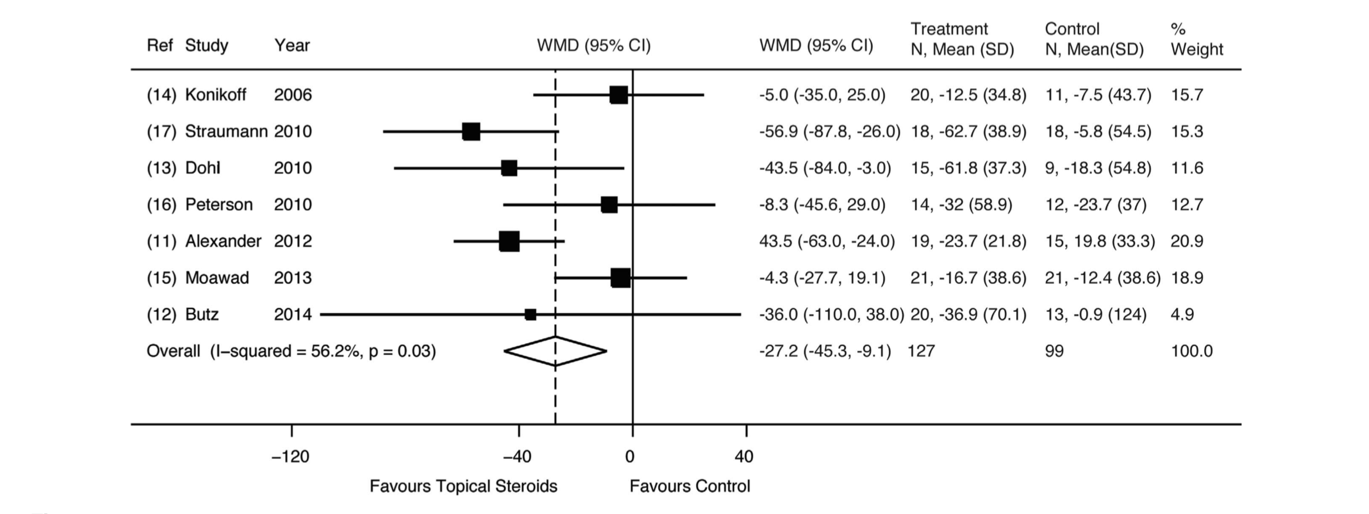
Treatment: Topical Corticosteroids
Histologic Remission
50%
72%
87%
WMD (Weighted Mean Difference) =
Change in eos count following treatment (TCS) – Change in eos count following placebo

Slide 37
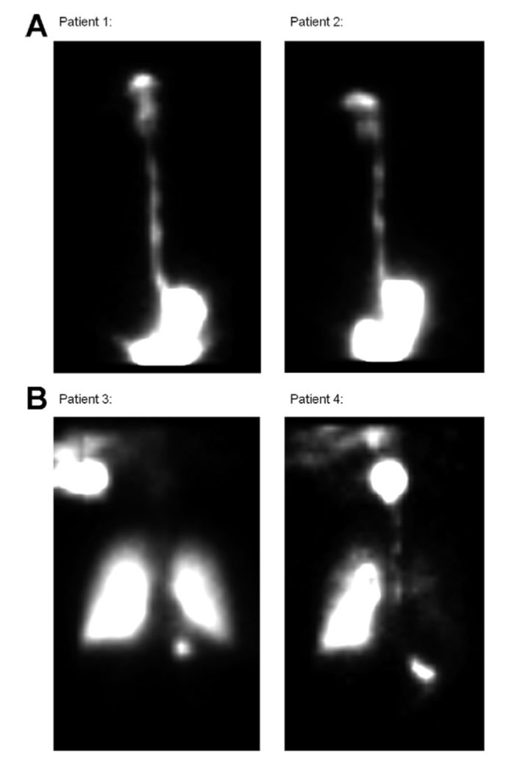
Oral vs Nebulized Budesonide
Budesonide 1mg BID x 8 weeks
  Nebulized (NEB) vs Oral Viscous (OVB)
  n = 25
  NEB: 101 → 89 eos/hpf (p=0.62)
  OVB: 83→ 11 eos/hpf (p=0.02)
  Mucosal medication contact time (measured by scintigraphy) was higher for OVB (A) than NEB (B), (p<0.005)
Dellon et al. Gastroenterology 2012;143:321-324

Slide 38
Other forms of Budesonide
Pre-made Budesonide Oral Suspension
  1mg Budesonide BID (BOS) vs Placebo x 12w
  Histologic Response (<6 eos/hpf)
    39% (BOS) vs 3% (Placebo), p<0.0001
  Adverse events were similar between groups
Oro-dispersible Budesonide Tablets
  1mg Budesonide BID (ODB) vs Placebo x 6w
  Clinicohistologic remission
    58% (ODB) vs 0% (Placebo), p<0.0001
  5% local fungal infections (none with placebo)
Dellon et al. Gastroenterology 2017;152:776-786
Lucendo et al. Gastroenterology 2017;152:S207

Slide 39
Topical Corticosteroids
(GI Care for Kids)
Duration of TCS therapy? Indefinite?
How low do you go? 500mcg QD / 440mcg QD?
Continue PPI therapy on maintenance TCS?
Low dose maintenance TCS therapy (Adults)
Budesonide 250mcg BID
Maintained complete remission in only 35.7% (1 year)
Straumann et al. Clin Gastroenterol Hepatol 2011;9:400-409 e1

Slide 40
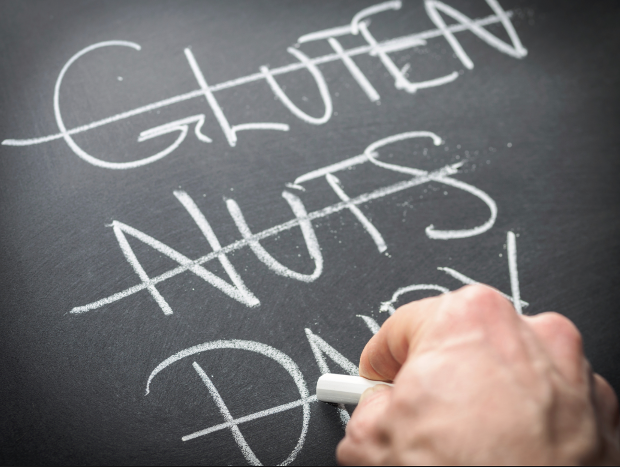
Dietary Therapy
Targeted elimination diet
Milk elimination diet
2-4-6 Step up diet
4-Food elimination diet (4FED)
6-Food elimination diet (SFED)
Elemental diet

Slide 41
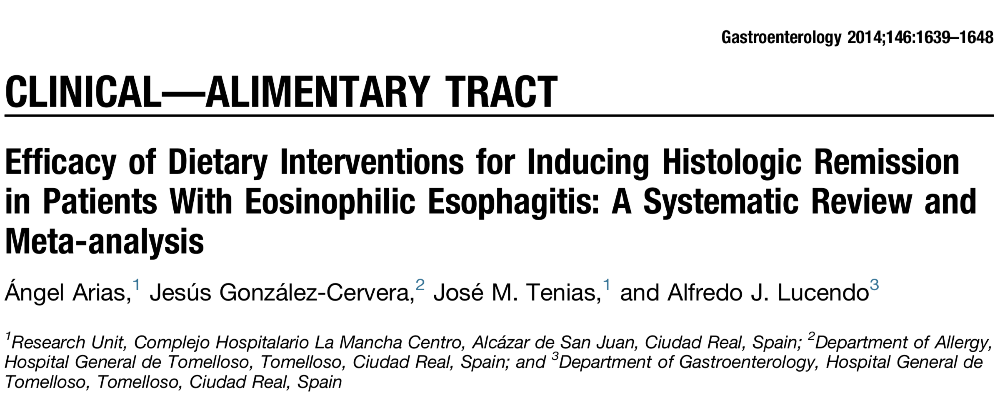
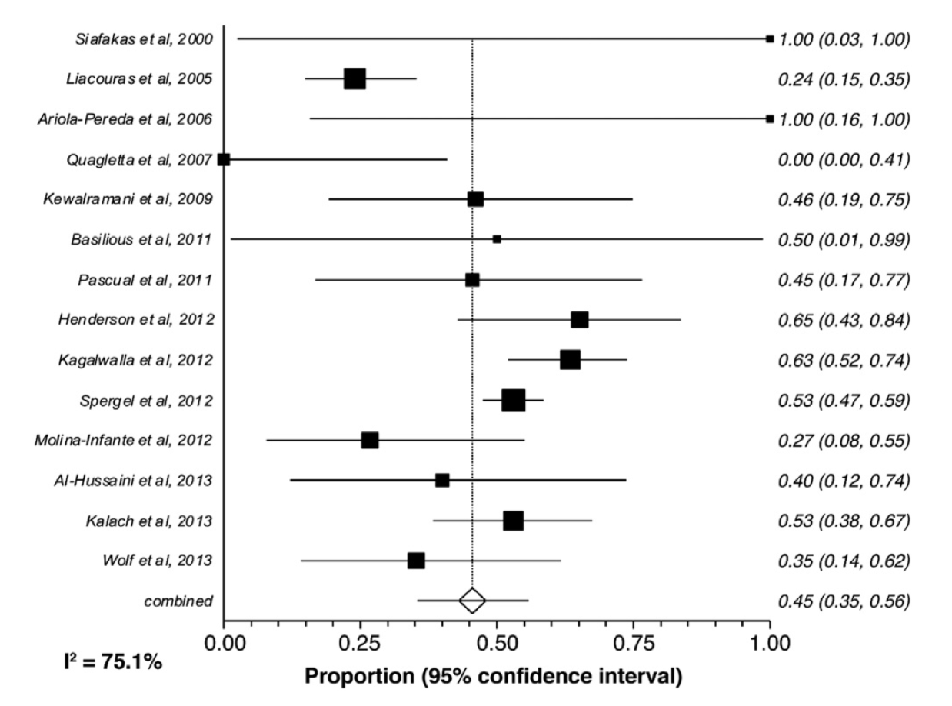
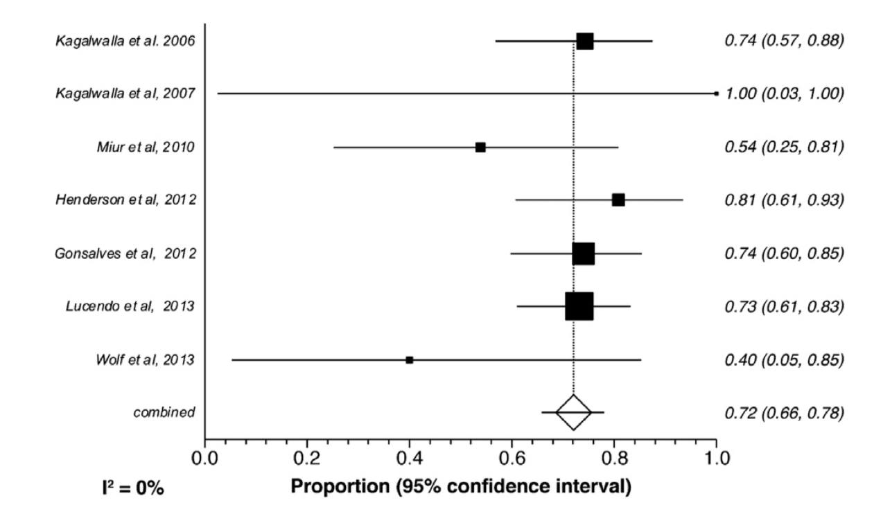
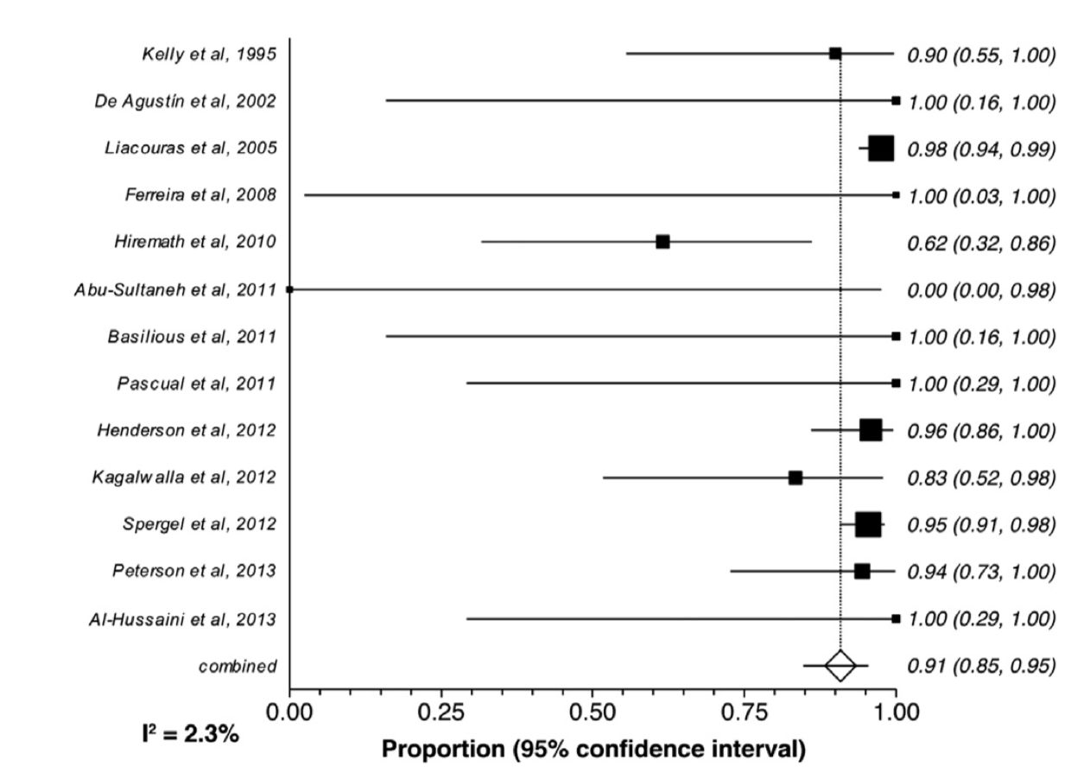
Treatment: Dietary
Targeted Elim Diet: Effect Size 45%
SFED: Effect Size 72%
Elemental Diet: Effect Size: 91%

Slide 42
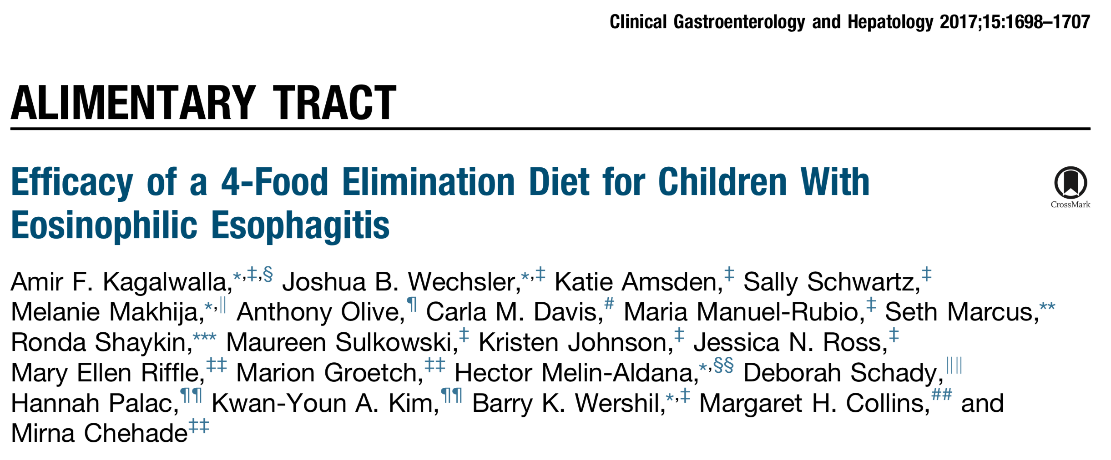
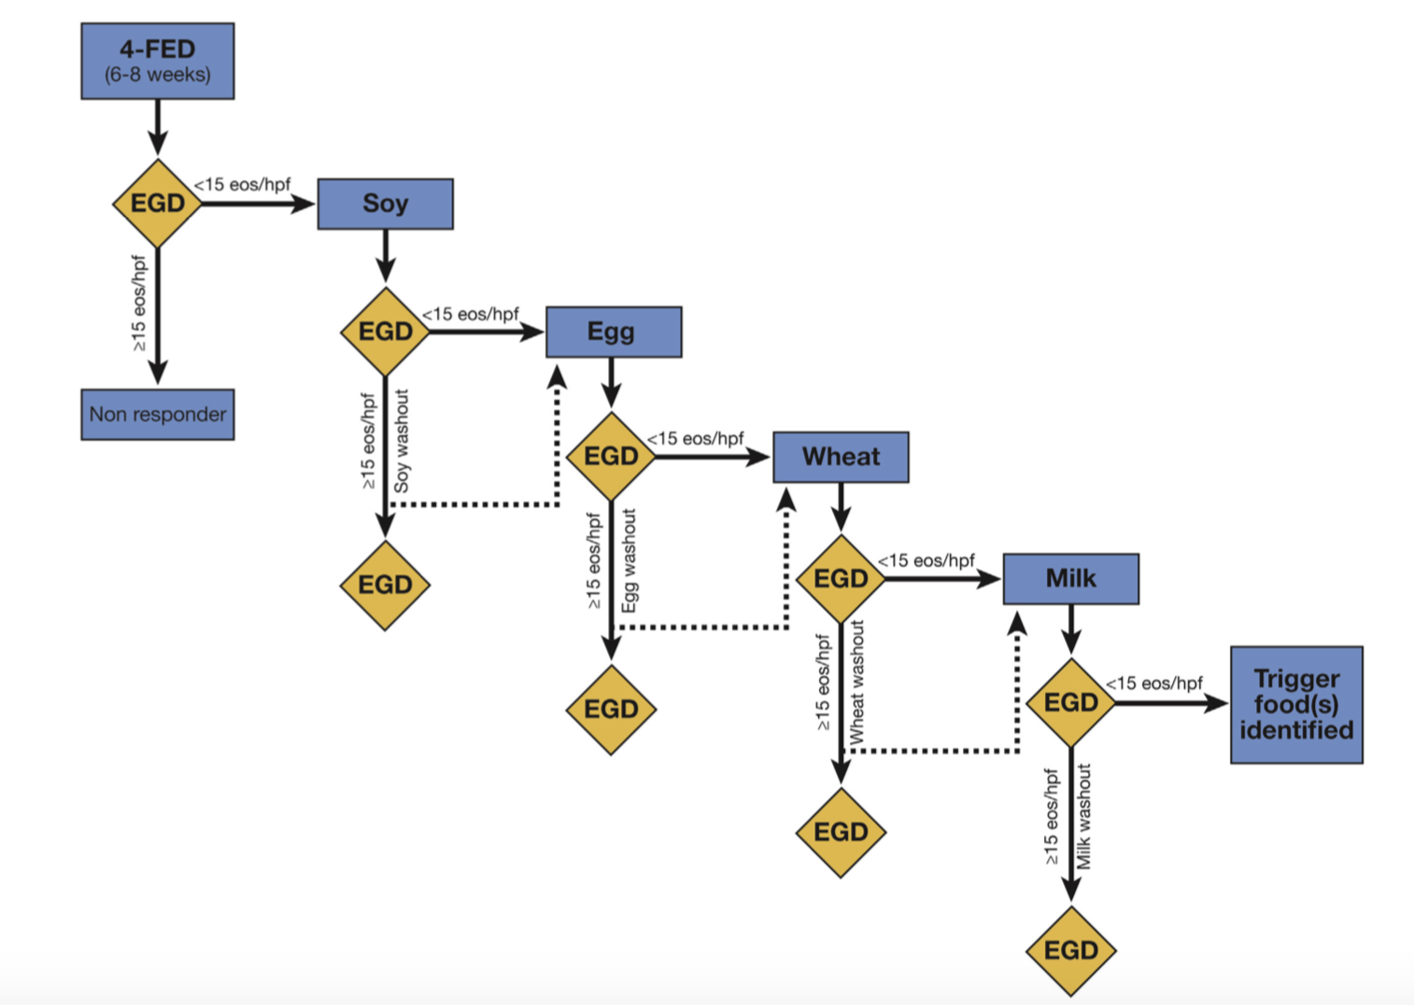
78 subjects (~40% atopic)
  4FED x 8 weeks
  Assisted by RD
  Continued PPI daily
  20-30% SPT (+) for milk, soy, egg or wheat
Results:
  Histologic Remission (all 4 foods x 8w): 64% (50/78)
  Most common food triggers: Milk (85%), egg (35%), wheat (33%), soy (19%)
  1 food trigger (62%)

Slide 43
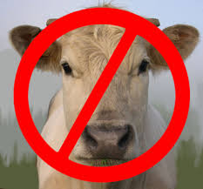
Empiric Milk Elimination
Combined effectiveness of 68.2%
  Small sample sizes and heterogenous results
Kagalwalla et al (Northwestern)
  46 patients recruited, results pending
Kagalwalla et al. J Pediatr Gastroenterol Nutr 2012; 55:711–716
Maggadottir et al. Ann Allergy Asthma Immunol 2012;109(Suppl):A114.
Alonso-Llamazares et al. Allergy 2010;65(Suppl s92):419.

Slide 44
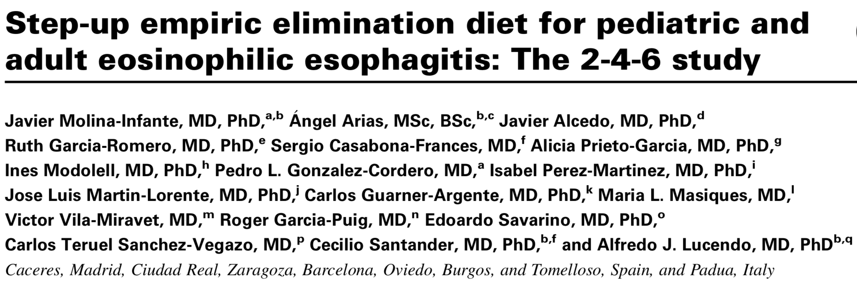
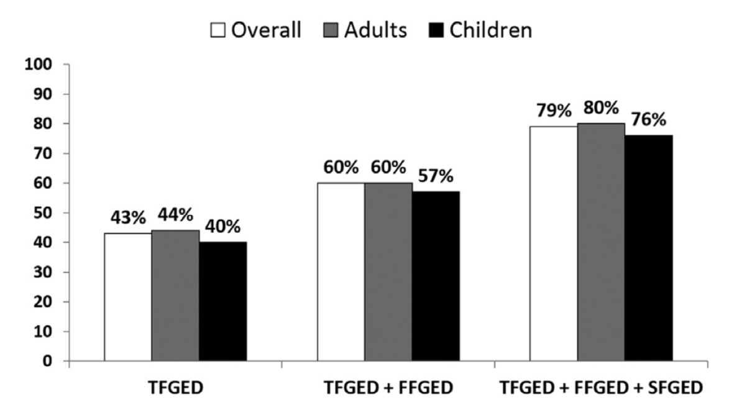
Multicenter and Prospective
2-FED: Milk and Gluten (wheat) elimination
2-FED (n=130) → 4-FED (n=54) → 6-FED (n=27)
43%
60%
79%
J Allergy Clin Immunol 2018;141:1365-72

Slide 45

Biologics in EoE
Anti-IL5
  Mepolizumab¹
    Reduced esophageal eosinophilia by ~50%
    Minimal clinical improvement (dysphagia)
  Reslizumab² (n=10, open label extension trial over 9 years)
    Reduced median eosinophil count from 35 to 3
    Demonstrated clinical improvement (dysphagia and vomiting)
  Benralizumab (Fasenra)
    Anti-IL5(R) on eosinophils, leads to apoptosis by NK cells (Asthma)
Anti-TNFa (Infliximab)
  Not effective for symptoms or esophageal eosinophilia
Anti-IL13 (QAX576)
  3 infusions (over 8w) reduced esophageal eosinophils by 60% (placebo increased by 23%)
  Trend toward reduced symptoms
  Effect sustained 6 months
Anti-IL4Ra (Dupilumab, inhibits IL4 and IL13, subcutaneous)
  Pilot study: 93% reduction in peak eosinophils and symptom scores at week 12
  Double blind placebo controlled RCT beginning soon
¹Straumann et al Gut 2010;59:21-30
²Markowitz et al. JPGN 2018;66:893-897

Slide 46
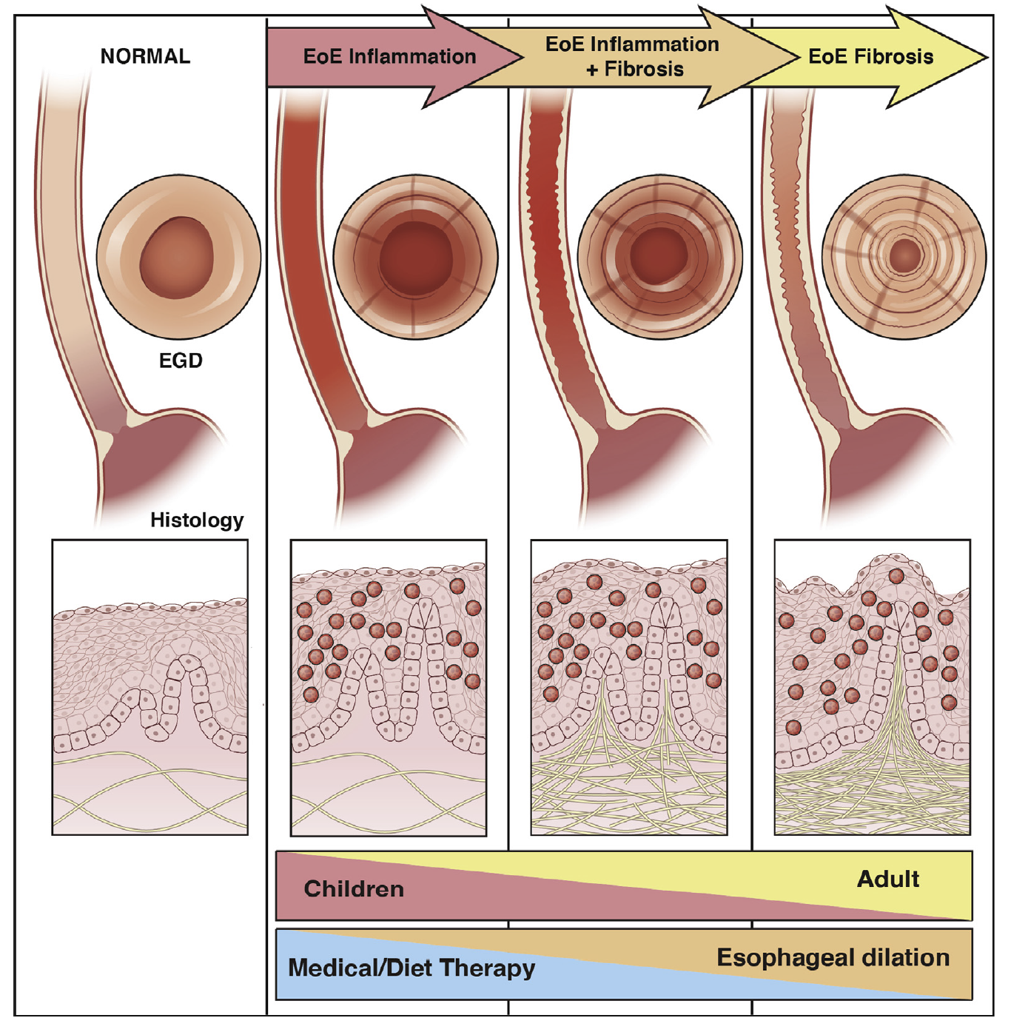
EoE: Natural History
Dellon and Hirano. Gastroenterology 2018;154:319-332

Slide 47
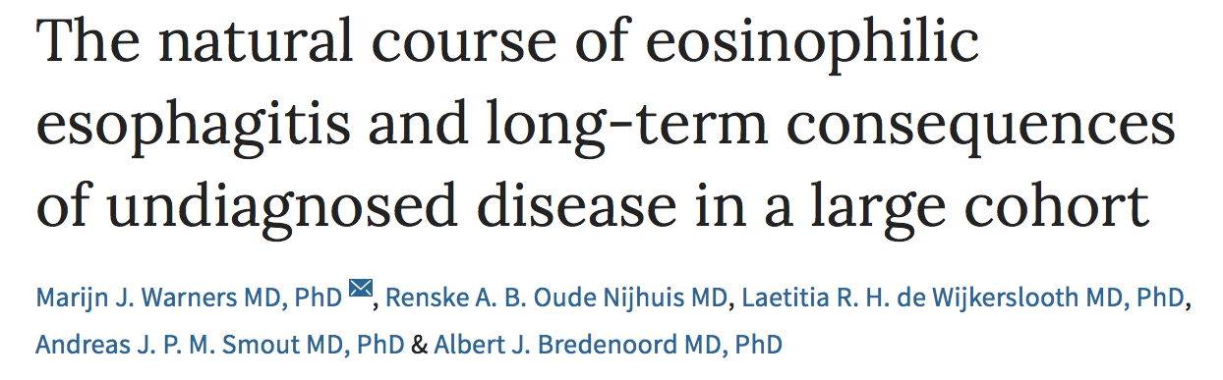
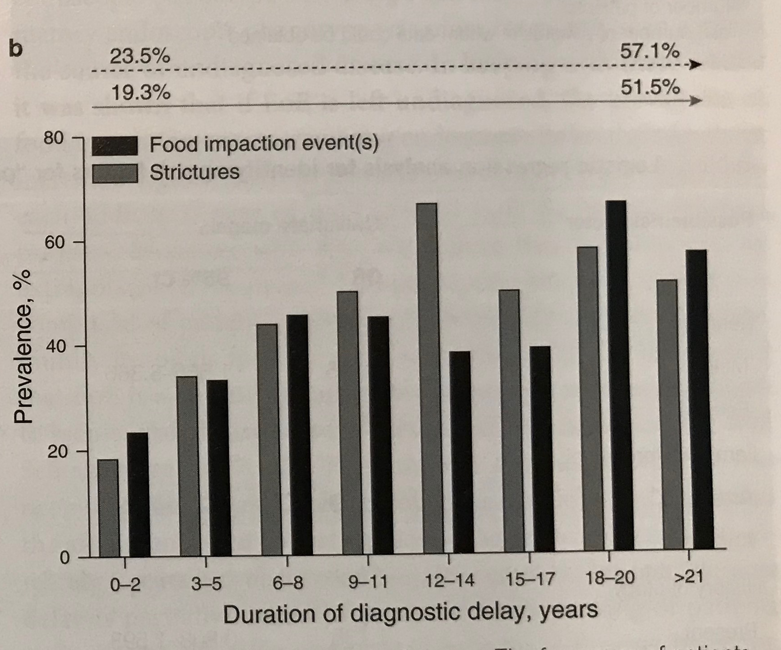
  Retrospective chart review
  613 EoE patients (1996-2015)
  DxDelay (DD): Onset symptoms to diagnosis
  Fibrostenotic features
    56% (DD < 2yrs) → 92% (DD >21 years, p<0.001)
  Strictures
    19% (DD < 2 yrs) → 52% (DD > 21 years, p<0.001)
Warners et al. Am J Gastroenterol 2018;113:836-844

Slide 48
EoE: Natural History
No cases of esophageal neoplasia
Effective treatment can normalize transcriptome, reduce remodeling and dec risk of strictures / food impactions
  Unknown for dietary therapy
Most patients do not “outgrow” their EoE food triggers
  2 children at CHOP (2/24) had evidence of tolerance to foods previously identified as triggers of their EoE. Longer followup needed

Slide 49
Key Points
PPI-REE = EoE
  No longer called PPI-REE
No longer need a PPI trial to diagnose EoE
  First EGD should be off PPI therapy
  PPIs should be considered as primary therapy for EoE
Dietary therapy can be effective and realistic
  Milk still most common food
  Often only 1 food trigger, making diet therapy sustainable
Up to 50% of untreated EoE will develop strictures
Lots of biologics in pipeline

Slide 50
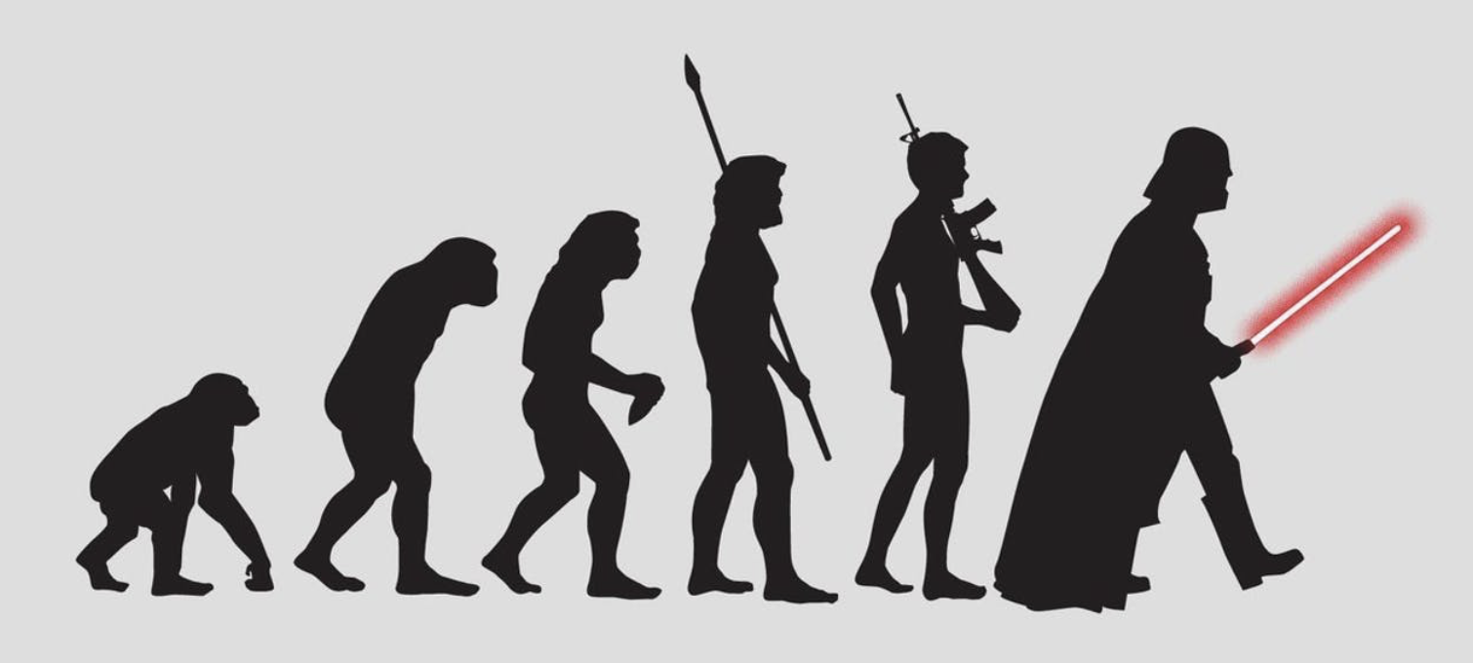
The Evolution of EoE

