Slide 1
Nutritional therapies for IBD
What have we learned from clinical research?
Lindsey Albenberg, DO
Center for Pediatric IBD, Children’s Hospital of Philadelphia

Slide 2
Objectives
Review the limitations of clinical data for dietary trials
Discuss the data for exclusive enteral nutrition therapy in Crohn’s disease
Discuss the data for exclusion diets in IBD

Slide 3
Global Burden of IBD: Prediction in 2020
IBD is a global disease
~5 million affected worldwide
0.5% of the population in highest prevalence regions
Rate in the rise of incidence is steep in
newly industrialized countries and in adolescents in industrialized countries
Even if the prevalence plateaus at 0.1%, China may have over 1.5 million cases of IBD by 2025
Kaplan G. Nat Rev Gastroenterol Hepatol 2015

Slide 4
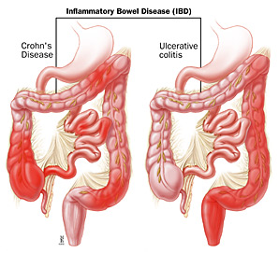
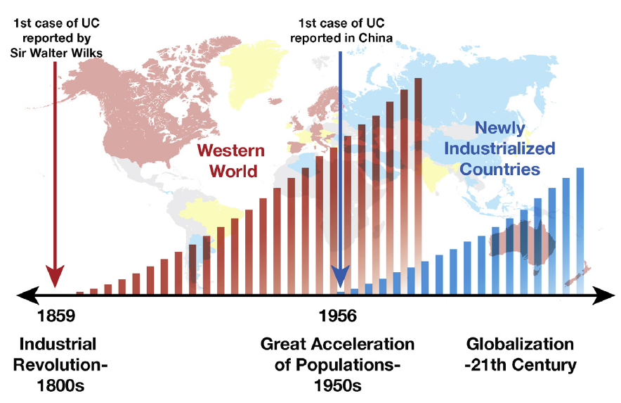
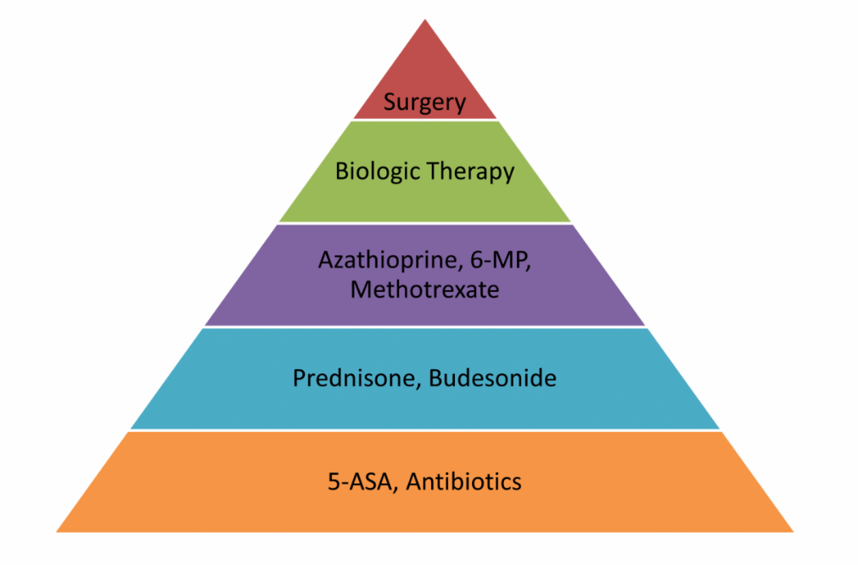
Inflammatory Bowel Disease (IBD) Affects Approximately 1.5 Million People in the U.S. Alone
The genetic contribution to the development of Crohn’s disease is at most 30-40%
In total, the contribution of all 163 IBD associated genetic loci account for only 13% of Crohn’s disease variance
Thus environmental factors are the largest contributor to the pathogenesis of IBD
Notes:
This is too fast to be explained by human genetics!
This is important because the genetic…
Suggesting that these are really environmental diseases in most cases and clearly something is changing fundamentally in our environment.
Despite this, the mainstays of IBD therapy is immune suppression when the environment is the bigger problem

Slide 5
Targets in IBD Pathogenesis
Hypothesis: diet triggered changes in the intestinal microbiome might cause a proinflammatory state preceding the development of IBD
Diet
???
Gut
Microbiome
Immune
system
Immunosuppressive
medications
-Antibiotics
-Fecal transplant
Notes:
Thus far, our therapeutic approach has focused on immunosuppressive medications, but increasingly, attention is being placed on the environment – the gut microbiome, and diet.

Slide 6
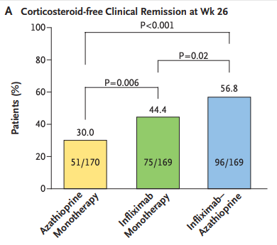
Why Focus on Diet?
Patient interest and belief
Our medications are not good enough
Risks with immunosuppression
    Infection
    Cancer
Data supports efficacy of dietary therapy
    Primary and adjunctive therapy
SONIC trial
Colombel JF. NEJM 2010.
Notes:
And I think this is appropriate because…
Our medications are not good enough. For example in the SONIC trial which was RCT of azathioprine monotherapy, infliximab monotherapy, and the two drugs combined in patients with moderate to severe Crohn disease, even with combination therapy which was superior, there is a big gap here. Corticosteroid free clinical remission at week 26 occurred in 56.8% and mucosal healing in less than 50%.

Slide 7
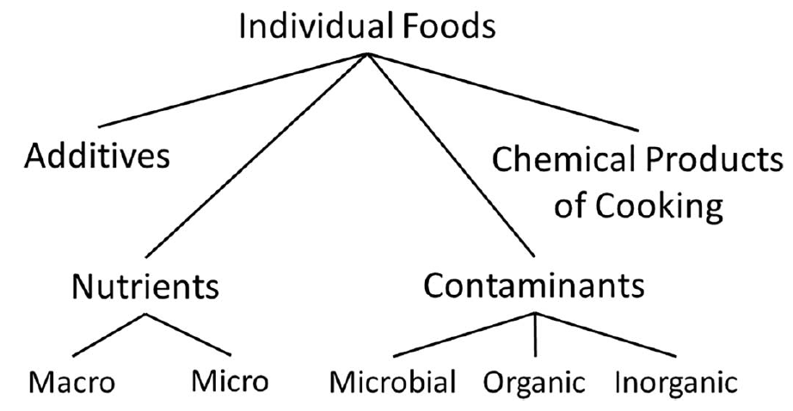
Challenges of dietary trials
Lifestyle change
  Difficulty with adherence
Broad variability in food
Interactions
Substitution effect
Blinding
Lewis, JD. Inflamm Bowel Dis 2017.
Willett, W. Nutr Epidemiology. Oxford Univ Press 1998.

Slide 8
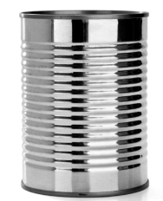
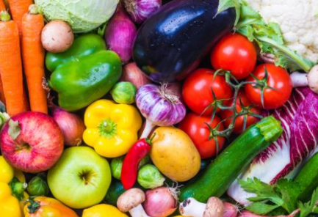
Dietary Approaches for Treating IBD
Exclusive Enteral Nutrition (EEN)
Exclusion diets:
  Specific carbohydrate diet (SCD)
  Crohn’s disease exclusion diet
  Semi-vegetarian diet
  CD-TREAT
  “Anti-inflammatory” diet
Notes:
Despite this, research has focused on 2 specific areas --

Slide 9
Defined Formula Diets for CD: Background
Enteral nutrition (EN) is a term used to describe the use of a liquid nutrition formula administered orally or through nasogastric tube for the treatment of CD
  Replacing all or the majority of daily calories with formula and excluding or limiting food
Dates back to the 1970’s when the use of TPN and elemental formula diets were reported as potential treatments for CD

Slide 10
In whom?
Age

Slide 11
Defined Formula Diets for CD: Children
Ruemmele et al. Consensus guidelines of ECCO/ESPGHAN on the medical management of pediatric Crohn’s disease. JCC. 2014.
  96% agreement among experts that exclusive enteral nutrition is recommended as first line therapy to induce remission in children with active luminal CD (including with colonic involvement)
  Overall combined remission rate for EEN in pediatric CD of 73%
Notes:
Many studies have shown positive outcomes with EN use in children with CD, and it has, therefore, been recommended as first-line therapy for induction of remission in children.
Overall combined remission rate for EEN in pediatric CD of 73% based on 3 meta-analyses of RCTs comparing EEN in pediatric CD to standard treatment
96% agreement including with colonic involvement

Slide 12
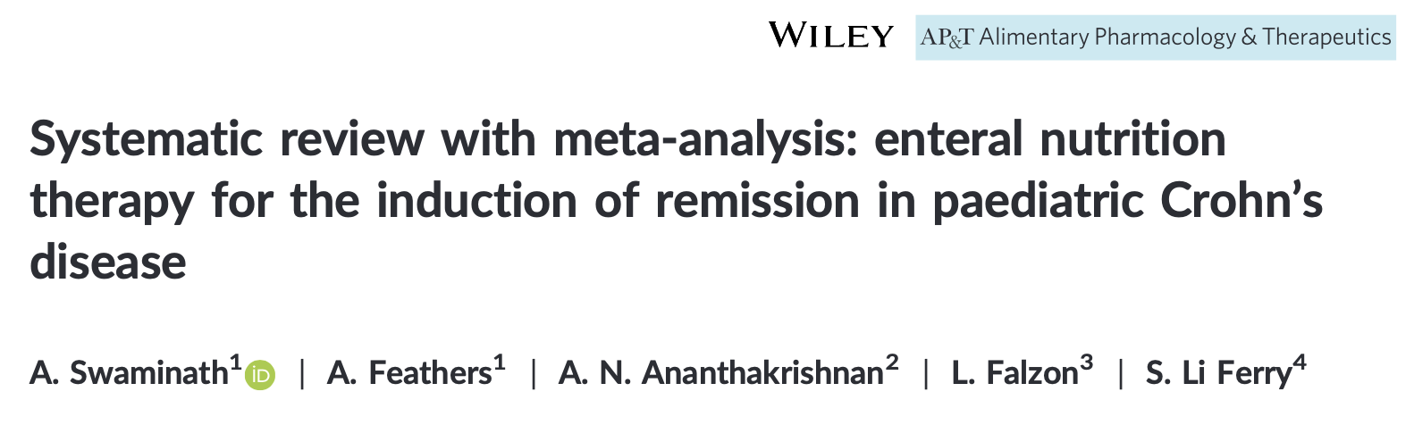
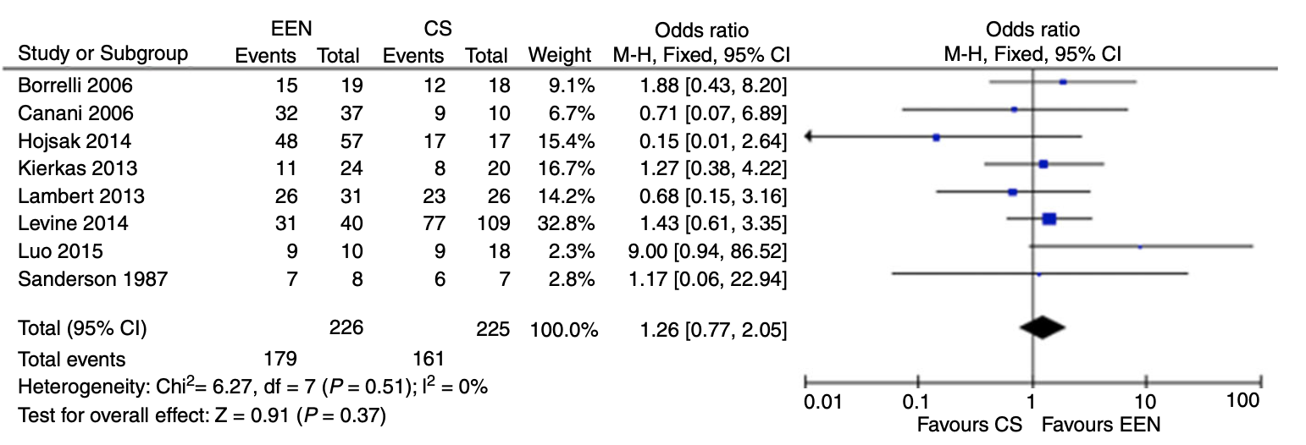
Defined Formula Diets for CD: Children
Notes:
Exclusive enteral nutrition was as effective as corticosteroids in inducing remission (OR=1.26 [95% CI 0.77, 2.05]) in pediatric Crohn’s disease. There was no difference between exclusive enteral nutrition and corticosteroids efficacy when comparing newly diagnosed Crohn’s (OR=1.61 [95% CI .87, 2.98]) or relapsed (OR=0.76 [95% CI .29-1.98]). Intestinal healing was significantly more likely among patients receiving Exclusive enteral nutrition compared to corticosteroids (OR=4.5 [95% CI 1.64,12.32])

Slide 13
Defined Formula Diets for CD: Children
* P<0.05 for Pre vs. Post
Borrelli O. CGH 2006;4:744-53
Notes:
Intestinal healing was significantly more likely among patients receiving Exclusive enteral nutrition compared to corticosteroids (OR=4.5 [95% CI 1.64,12.32])
Borrelli et al. found 26 of 37 patients in the EEN group achieved mucosal healing, where only four of 10 in the steroid group achieved the same end point. Berni Canani et al. found 14 of 19 patients induced with EEN achieved mucosal healing whereas only six of 18 patients treated with CS achieved the same endpoint. Overall, patients who received EEN were 4.5 times more likely to demonstrate mucosal healing (OR 4.50, [95% Cl 1.64, 12.32]; Figure 6) compared to those who received CS. This result was statistically significant.

Slide 14
Defined Formula Diets for CD: Adults
Adult studies demonstrate considerably more variability in efficacy
Remission rates overall lower than in children (40-71%)¹
Corticosteroids possibly more effective than enteral nutritional therapy to induce remission in adults with CD²
  Original Zachos/Griffiths Cochrane review in 2007, EEN 60% vs corticosteroids 80%
Non-adherence limiting factor in many studies
Definition of remission variable
1.Wall C. WJG. 2013. November 21; 19(43):76527660.
2.Narula N. Cochrane Database Sys Rev. 2018. April 1;4:CD000542.

Slide 15
In whom?
Disease Location, Phenotype

Slide 16
Anatomic Location of Disease and Efficacy of EN
Prospective trial of children with active (PCDAI >20) CD
  Exclusive EN x 8 weeks
  Ileocolonoscopy at baseline and 8 weeks
  Remission: PCDAI <20, no escalation of therapy
Colonic (n=14), Ileal (n=12), Ileocolonic (n=39)
Clinical remission at week 8 lower and endoscopic activity score higher at week 8 in colonic disease group compared to ileal and ileocolonic groups
Afzal NA et al. Dig Dis Sci. 2005.

Slide 17
Anatomic Location of Disease and Efficacy of EN
Observational study of children with CD (n=110)
  Exclusive EEN x 8 weeks
Remission: PGA (symptoms, inflammatory markers, weight gain)
80% achieved clinical remission
  Inflammatory markers improved, good weight gain
Colonic disease not less likely to achieve remission
Stricturing disease lower rates of response than inflammatory disease (Grover et al.)
Buchanan E et al. Aliment Pharmacol Ther 2009
Notes:
Both the ECCO and NASPGHAN guidelines recommend EN for all CD patients with an
inflammatory luminal phenotype, regardless of the site(s) of involvement. ECCO guidelines report that there are no data to support use of EN in penetrating CD or for treatment of extra-intestinal manifestations of CD.
No firm data severe, isolated pancolitis

Slide 18
How?
Type of formula, method of administration

Slide 19
Elemental vs. Nonelemental
Response to Dietary Therapy
No difference
Adapted from Zachos M. Cochrane Review 2007
Notes:
Although some clinicians and investigators initially assumed that elemental formula may be more efficacious than polymeric formula, research suggests that elemental formulas are no more effective than polymeric formulas in either children or adults. Because polymeric formula
is more palatable, its use has been shown to reduce the need for NG tube feeding. The ECCO and NASPGHAN guidelines both recommend starting with polymeric formula by mouth.

Slide 20
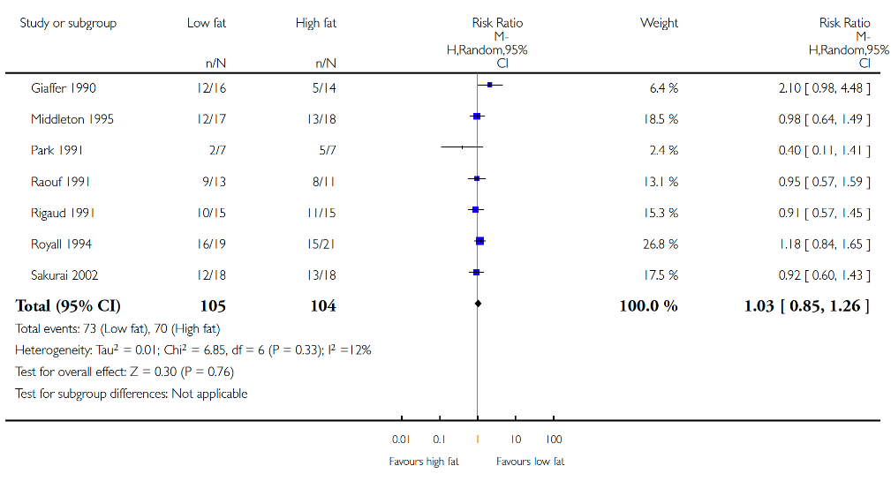
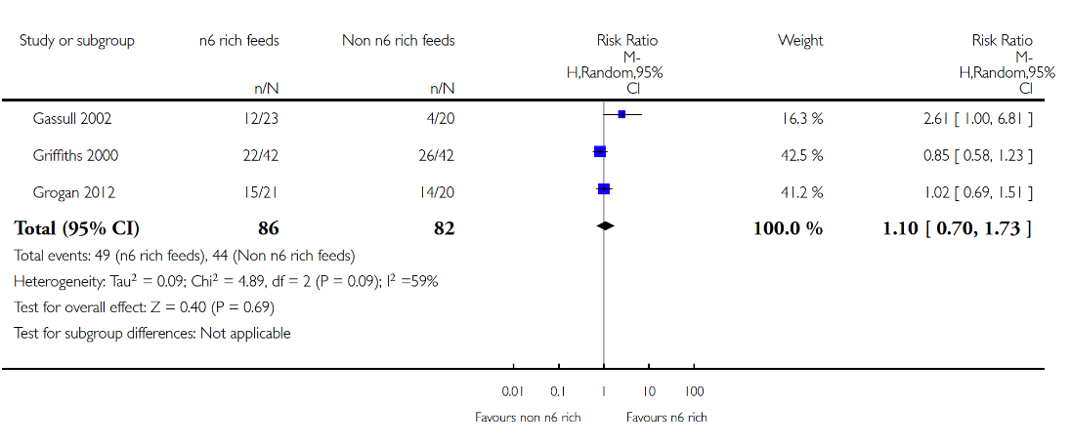
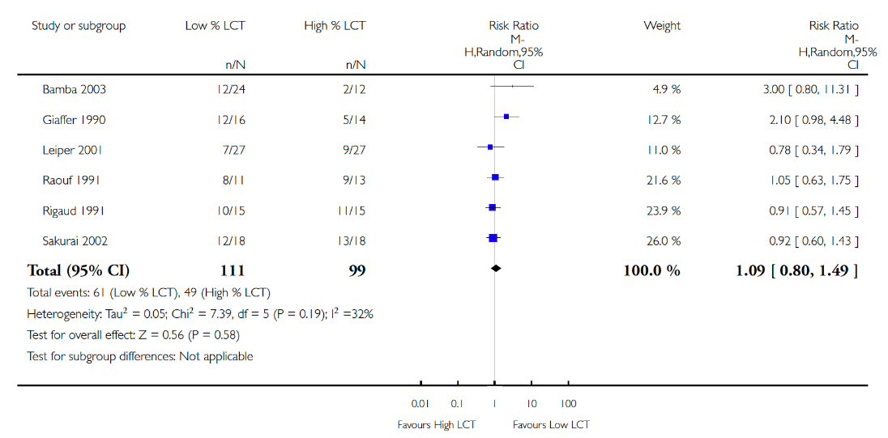
Low fat versus high fat
n6 rich versus non-n6 rich
Low LCT versus high LCT
No befefits with TGF-beta or glutamine containing formulas
Narula N. Cochrane Database Sys Rev. 2018.
Notes:
Several studies have hypothesized that the proportion or type of fat in an enteral feeding can affect the production of pro or anti-inflammatory mediators (Bamba 2003; Gassull 2002; Leiper
2001; Sakurai 2002). The possibility that fat composition influences immunomodulatory or anti-inflammatory effect in active Crohn’s disease warrants further exploration with larger trials.
No benefits TGF-beta, glutamine containing formulas

Slide 21
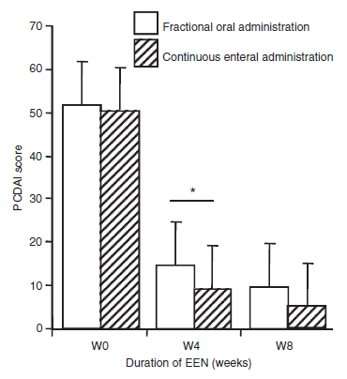
Oral vs. Nasogastric EN in Pediatric CD
Retrospective review of EEN by oral route (n=45) or overnight continuous feeds (n=61)
Remission rates (PCDAI) similar at 8 weeks
  Continuous>oral at 4 weeks
All patients had improvement in:
  Growth and weight gain
  Laboratory indices
Similar compliance rates
  87% vs. 90%
Efficacy of oral vs. continuous EN
Rubio A et al. Aliment Pharmacol Ther 2011
Notes:
Poor palatability or lack of acceptance of a nasogastric tube is a limitation that may be overcome with use of palatable oral polymeric formulations.
Initially offering EN by mouth and only introducing NG tube feeding if patients are unable to drink the required amounts of formula.

Slide 22
How?
Duration (induction of remission)

Slide 23
EN for Induction of Remission in CD: Duration of Therapy
6-8weeks most common in the literature (range 4-12 weeks)
Clinical response seen at 4 weeks (Rubio et al. 2011, PCDAI and Guo at al. 2013., CDAI)
PLEASE Study: Prospective cohort study of children with Crohn disease from Philadelphia (used Peptamen), Toronto (used Modulen) and Halifax (used Osmolite); (n=90)
  Enteral therapy with defined formula diet (38) vs. anti-TNFα therapy (52)
  PCDAI measured at baseline and 8 weeks
  Stool for calprotectin (FCP) and microbiome
    measured at baseline, 1 week, 4 weeks, and 8 weeks
Lewis JD, et al. Cell Host & Microbe 2015; 18, 489

Slide 24
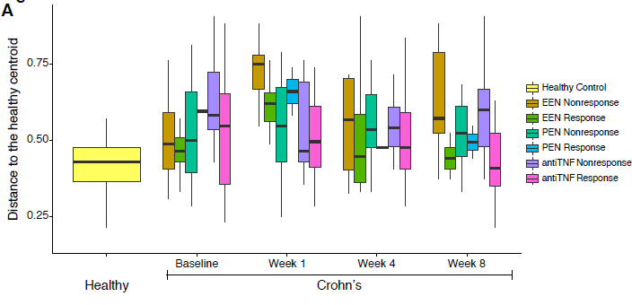
EN for Induction of Remission in CD: Duration of Therapy: PLEASE study
The microbiota composition among the EEN-treated group changed within 1 week of therapy
Significant reduction in FCP by week 4
Lewis JD, et al. Cell Host & Microbe 2015; 18, 489

Slide 25
How?
Exclusive versus partial (induction of remission)

Slide 26
Exclusive versus Partial EN
Johnson et al. Gut. 2006.
  50 children with active CD randomized to exclusive EN (100% calories) versus partial (50% calories) EN with elemental formula x 6 weeks
  Primary outcome was clinical remission (PCDAI <10)
  Remission rate lower in partial (15%) compared to total (42%), p=0.035
  Improvements in both groups related to abdominal pain, sense of well being, nutritional status
  Reduction in diarrhea and improvements in Hgb, albumin, ESR, platelets only in exclusive EN
Notes:
Partial EN group: unrestricted diet
Multiple studies with similar definitions of remission had higher rates of response,

Slide 27
Exclusive versus Partial EN
Johnson et al. Gut. 2006.
  50 children with active CD randomized to exclusive EN (100% calories) versus partial (50% calories) EN with elemental formula x 6 weeks
  Primary outcome was clinical remission (PCDAI <10)
  Remission rate lower in partial (15%) compared to total (42%), p=0.035
  Improvements in both groups related to abdominal pain, sense of well being, nutritional status
  Reduction in diarrhea and improvements in Hgb, albumin, ESR, platelets only in exclusive EN
50% EN does not work
Notes:
Partial EN group: unrestricted diet
Multiple studies with similar definitions of remission had higher rates of response,

Slide 28
Greater Mucosal Healing with More Restrictive Diet During Induction Phase
**
**
*
  Similar amounts of formula intake for the Partial EN and Exclusive EN groups
*p< 0.05 EEN vs. anti-TNF
** p<0.05 PEN vs. EEN and PEN vs. anti-TNF
Lee, et al. Inflamm Bowel dis 2015;21:1786-92

Slide 29
How?
Induction of Remission – CHOP protocol

Slide 30
Exclusive versus Partial EN
CHOP protocol
8-12 weeks
80-90% of estimated needs from formula
10-20% food
  Pediatric anti-inflammatory diet pyramid
NG tube/oral/combo
WHO’s REE multiplied by activity factor
  REE x 1.5 for no malnutrition
  REE x 1.7-1.8 if moderately malnourished or more than 2 hours/day high intensity physical activity
REE | Males | Females
0-3 | 60.9W - 54 | 61.0W - 51
3-10 | 22.7W + 495 | 22.5W + 499
10-18 | 17.5W + 651 | 12.2W + 746
18-30 | 15.3W + 679 | 14.7W + 496
Notes:
AI diet is based on two traditional healthy patterns of eating: the Japanese and the Mediterranean.

Slide 31
10-20% Estimated Needs from Solid Foods
Example: 2000 calorie diet
Fruits/Vegetables | Protein | Mini Meals
1/2 cup blueberries + 2 Tbsp. whipped cream 1/2 sliced apple dipped into 1/2 Tbsp. natural peanut butter Grilled veggie kabobs | 1 cup broccoli or 3 stalks celery with 3 Tbsp. yogurt dip or hummus 1 hardboiled egg + mustard | 2 light laughing cow cheese wedge + 1 cracker + 1/4 cup cucumber slices 1 slice of whole wheat bread with 2 egg whites
80% of calories from formula
1600 calories
~4-5 cans of concentrated (1.5 kcal/mL) formula
20 % of calories from food
400 calories
3-4 snacks or mini meals

Slide 32
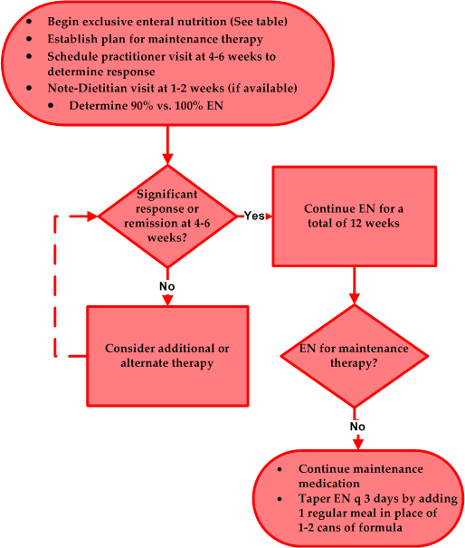
Start with polymeric formula (better taste, decreased need for NG tube, less expensive)
Active luminal Crohn’s disease, independent of location
Courtesy of Jen Smith MS RD, Nationwide Children’s

Slide 33
How?
Choice of Therapy after EN?

Slide 34
Choice of Therapy after EN for Induction
Most common placement of EN observed in the literature: alternative to corticosteroid as a bridge to thiopurine
No consensus regarding how to reintroduce solid foods when bridging to maintenance medication
Scarce data evaluating combination of EN with other therapies (1 study with anti-TNF)
Bridge to exclusion diets?
Notes:
Thiopurine implemented shortly after initiation of EN

Slide 35
How?
EN for Maintenance of Remission?

Slide 36
EN for Maintenance of Remission
Literature very heterogenous, difficult to assess systematically
Systematic review of 12 studies (3 RCTs, only 1 evaluated to be low risk of bias) of EN for inactive CD (children and adults) concluded EN more effective than regular diet and as effective as some medications in maintaining remission (El-Matary et al. Journal of Parenteral and Enteral Nutrition. 2017.)
  Could not perform metaanalysis
Notes:
The existing literature on use of EN in maintenance of remission is heterogeneous in nature (regarding length of follow up, presence of and type of adjunct medical therapies, and outcome measures
As the included studies demonstrated significant clinical heterogeneity, a meta-analysis was not performed.

Slide 37
EN for Maintenance of Remission
CHOP protocol
8-12 weeks
80-90% of estimated needs from formula
10-20% food
  Pediatric anti-inflammatory diet pyramid
NG tube/oral/combo
Post induction to . . . ?
Lower % calories from formula by 10-15%
  ↓ # of days
  ↓ volume
Simultaneously increase % of calories from food
Closely monitor!

Slide 38
How?
Getting Started

Slide 39
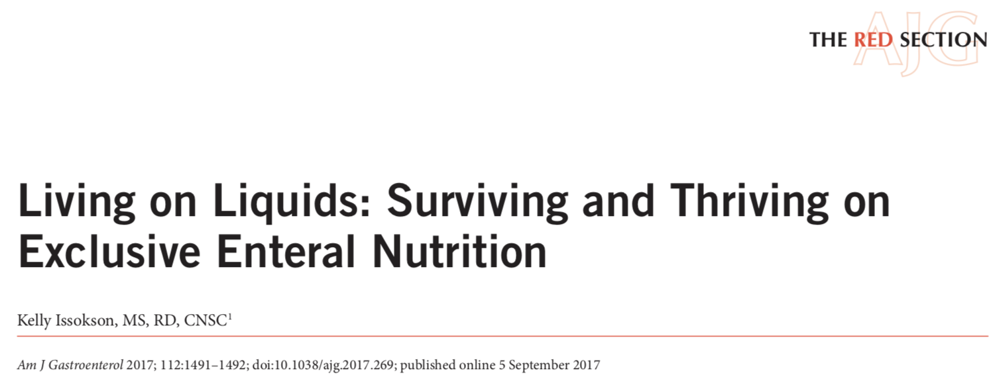
Defined Formula Diets for CD: Barriers
Enteral nutritional therapy is an effective, but underutilized therapy with multiple real and perceived barriers
Major reason North American physicians do not prescribe EN is the perception that compliance is difficult for patients to maintain
Other barriers: lack of experience, lack of support from insurance carriers, lack of support from nursing staff, lack of support from dietician, cost
Shaikhkhalil and Crandall. Nutrition in Clinical Practice. 2018.
Stewart et al. J Pediatr Gastroenterol Nutr. 2011
Notes:
Experience and her recommendations based on her experience is really enlightening

Slide 40
EN: Getting Started
Templates for letters of medical necessity
Develop/borrow protocols, patient education materials
Provide support: involve dieticians, nurses, social workers, psychologists
Practice your pitch: discuss early, be enthusiastic, establish expectations
Consider quick start program
Notes:
Having templates available for letters of medical necessity which outline the literature on EN and summarize the guidelines recommending EN as first-line therapy in children with CD can be helpful.

Slide 41
When?

Slide 42
EN is effective, safe, and has added benefits
Minimal adverse events
  Nausea, early satiety, bloating, loose stools
  Nocturnal awakenings with overnight NG tube feeds
  Refeeding syndrome: case reports
  No associated nutritional deficiencies
Positive effects on weight gain and linear growth
  Height velocity and height z-score improve in children
  Lean mass improves in children
Positive effects on bone health
  Lower markers of bone resorption, higher markers of bone turnover, improvement in vitamin D level
Improvements in IBDQ
Cost??
Gupta K et al. Inflamm Bowel Dis. 2013
Gerasimidis K et al. Inflamm Bowel Dis. 2012.
Whitten et al. J Gastroenterol. 2010.

Slide 43
Food-based dietary therapy for IBD
Specific carbohydrate diet (SCD)
Crohn’s disease exclusion diet
Semi-vegetarian diet
CD-TREAT
CD-AID
“Anti-inflammatory” diets
Each of these diets involves the restriction of specific foods
  Commonly: bread/gluten, “processed foods”
  Home cooked food is necessary
  Some variance: dairy, sugar, animal fat

Slide 44
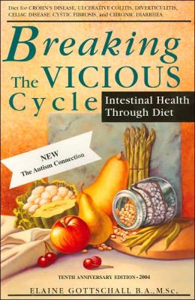
The specific carbohydrate diet (SCD)
Restricted foods on the SCD:
  All grains
  Refined sugars
  Cow’s milk products (fully fermented yogurt ok)
  “Processed foods”
Popular following in the community for variety of GI illnesses
  Anecdotal evidence plentiful
Concerns: Elimination of whole food groups from the diet, inadequate calories, emotional well-being
Notes:
Concerns:
Elimination of whole food groups from diet
Inadequate calories
Emotional well-being

Slide 45
Author | Study design | n | Summary
Two ongoing multicenter trials: 1) n-of-1 study of SCD and modified SCD (120 participants) 2) SCD vs. Mediterranean diet (194 participants)
Suskind DL, J Clin Gastro (2018) | Prospective case series | 13 | Clinical + laboratory improvements; significant microbiome shifts
Braly K, J Ped Gastro Nut (2017) | Prospective diet eval | 9 | Nutrient intake comparable to 2012 NHANES reference group for protein, vitamins, minerals
Obih C, Nutrition (2016) | Retrospective case series | 26 | Improved clinical and laboratory parameters for Crohn’s disease and UC
Suskind DL, Dig Dis Sci (2016) | Patient survey | 417 | Majority of respondents perceive clinical benefit to SCD
Burgis JC, World J Gastro (2016) | Retrospective case series | 11 | Improved labs, growth parameters
Kakodkar S, J Acad Nut Diet (2015) | Retrospective case series | 50 | SCD is effective for some adults with IBD; High quality of life reported
Suskind DL, JPGN (2014) | Retrospective case series | 7 | Improvement in clinical + lab parameters (Hct, CRP)
Cohen SA, JPGN (2014) | Prospective case series | 16 | Clinical and mucosal improvements seen
Notes:
-Two large national trials on the SCD ongoing:
-Suskind: Produce 120 subjects: n of 1 study: 34 week duration
-Lewis: 194 subjects randomized 1:1; 6 week duration; food delivered to home, 36 sites, 139 patients enrolled

Slide 46
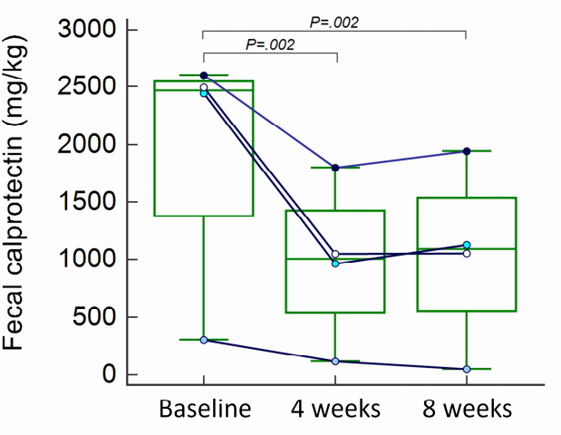
CD-TREAT: Emulating EEN with food
Hypothesis: Ordinary food diet based on composition of Modulen formula can achieve similar efficacy as EEN for treatment of Crohn’s
Diet:
  Avoid gluten, lactose
  Match macronutrients, vitamins,
  minerals, and fiber
  Food delivered by catering company
Results:
  28 Healthy adults: similar effects on microbiome and metabolome
  5 children with Crohn’s: 4 improved, 1
  discontinued because of symptom exacerbation
Svolos V. Gastroenterology 2018.
Notes:
Gerasimidis group
Mean baseline FCP 1960, week 4--981, and week 8–1042.
-4/5 children with Crohn’s on immunosuppressive medications
-Diet varies by study participant – choose preferred items from a food list

Slide 47
CD-TREAT
Mean baseline FCP– 1960, week 4– 981, and week 8–1042.
4/5 children with Crohn’s on immunosuppressive medications
Diet varies by study participant – choose preferred items from a food list

Slide 48
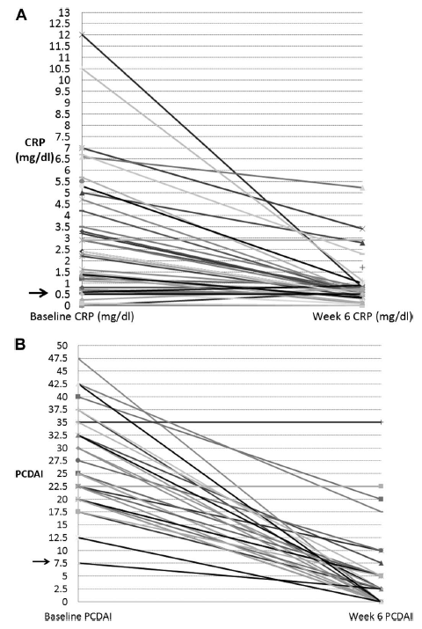
Crohn’s Disease Exclusion Diet + PEN
Prospective study: 37 children and young adults with active Crohn’s disease
Diet: Polymeric formula 50% daily kcal
Excluded foods:
  Gluten, Gluten-free baked goods
  Dairy
  Animal fat
  Processed meat
  Emulsifiers
  Canned goods
  All foods with an “expiration date”
CRP
PCDAI
Week 0
Week 6
Sigall-Boneh, R. Inflamm Bowel Dis 2014.
Notes:
Ave disease duration was 2.2 years; 34 children, 3 adults
Research dieticians available for phone consultation 5d/week

Slide 49
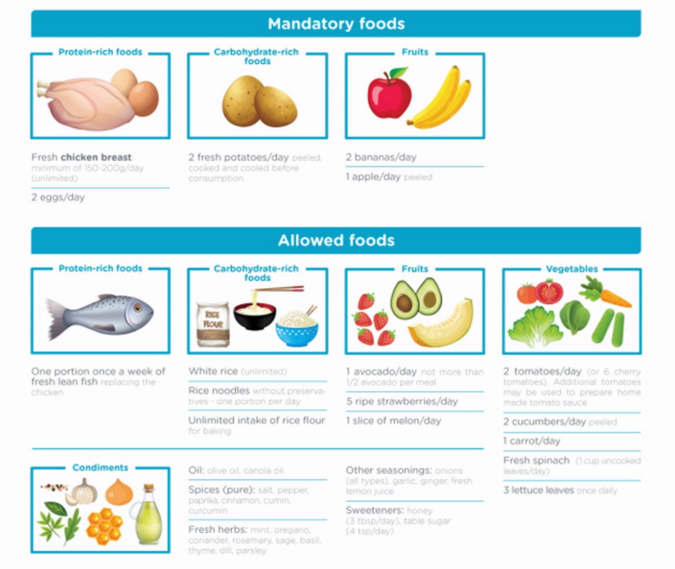
CDED Phase I (weeks 0-6)
Inclusions:
Soluble fiber
Apple pectin
Resistant starch
Exclusions:
High fat, animal fat
Taurine
Red meat
Dairy
Wheat
Alcohol
Yeast
Carrageenan
Maltodextrin
Sulfites
Titanium dioxide
Levine A, Gastro. 2019.

Slide 50

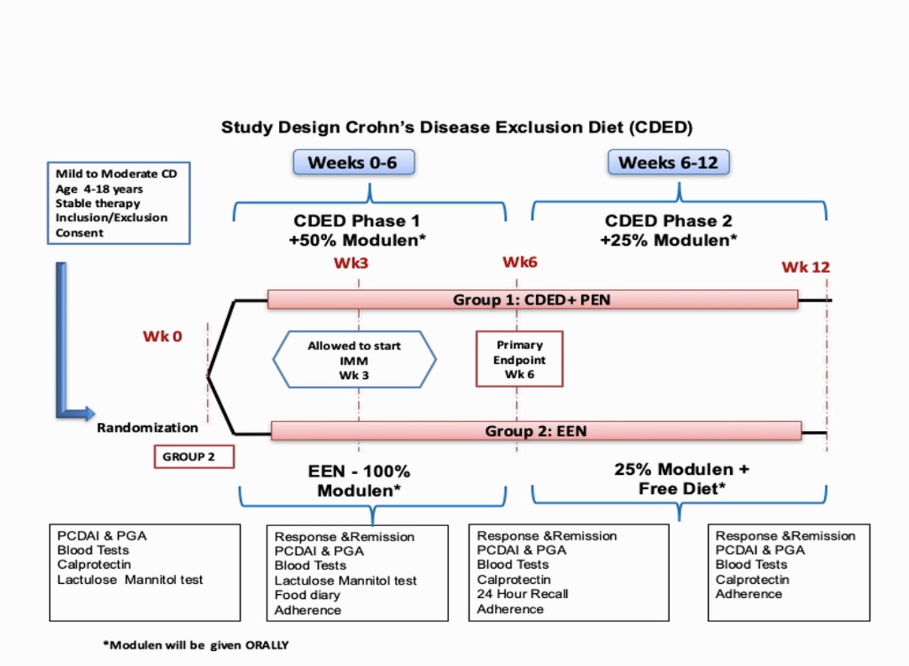
CDED RCT Design
Levine A, Gastro. 2019.
Notes:
Patients were allowed to receive a stable dose
of immunomodulator or start thiopurines at or after week 3 or
methotrexate at week 6, because the effect of thiopurine is not
thought to start until after week 8, which would not affect the
week 6 (or even week 12) endpoints.

Slide 51
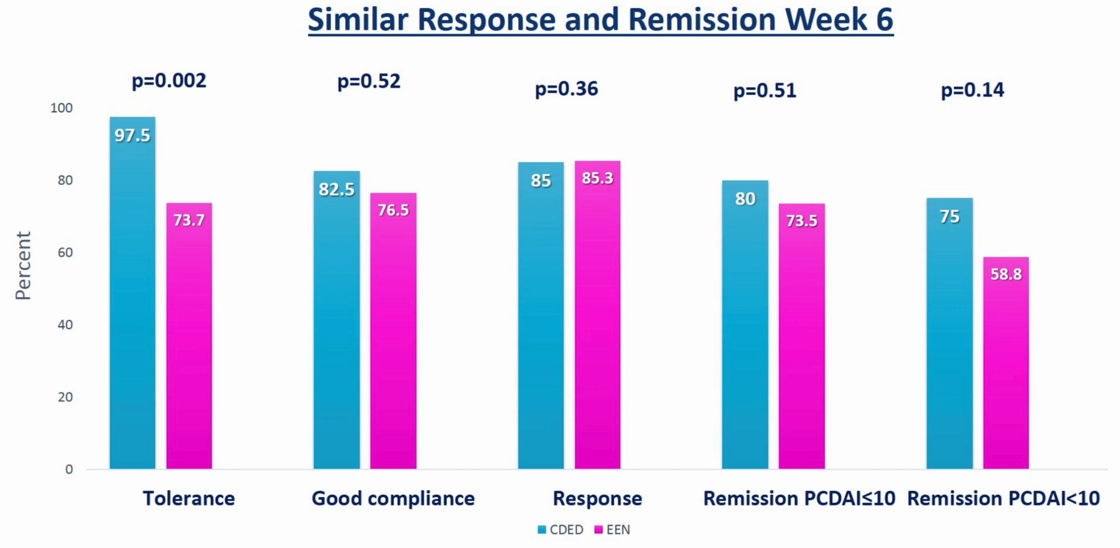
Week 6: Comparison EEN vs CDED + PEN (50% calories from formula)
Levine A, Gastro. 2019.

Slide 52
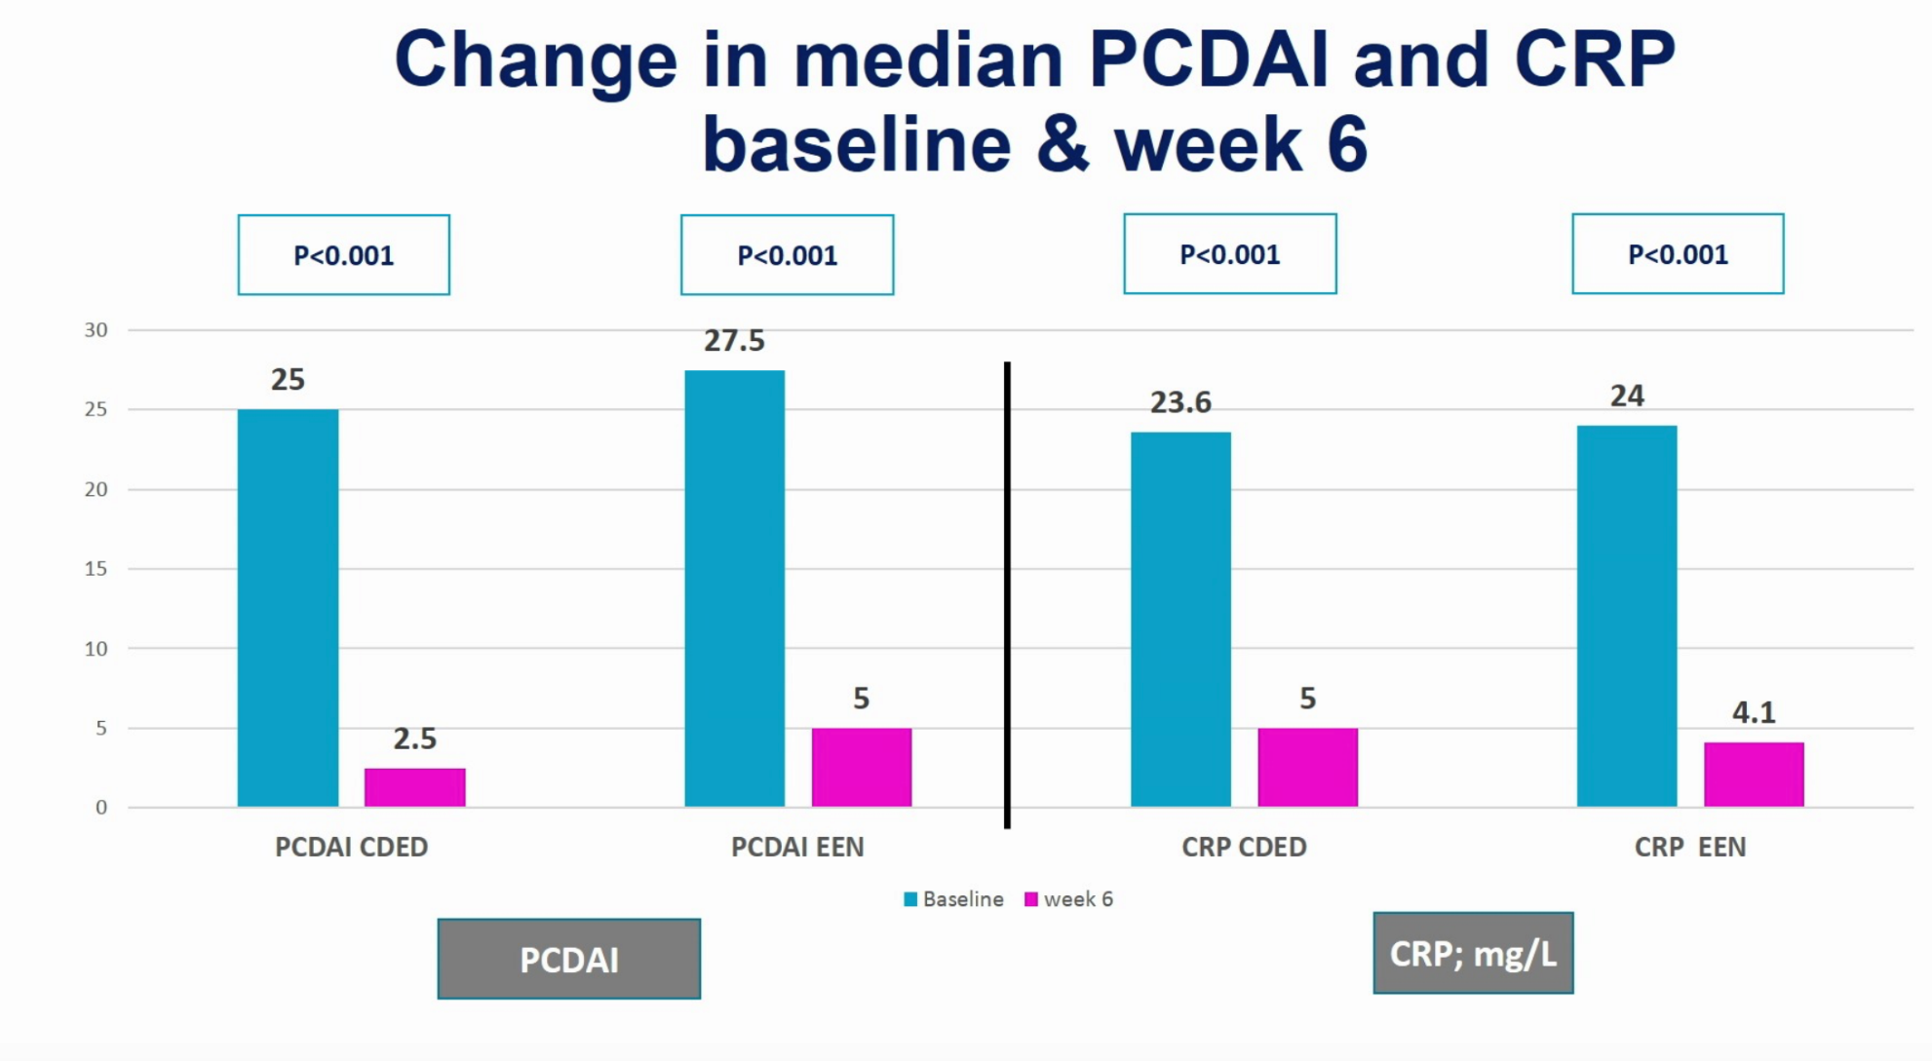
Week 6 PCDAI and CRP
Levine A, Gastro. 2019.

Slide 53
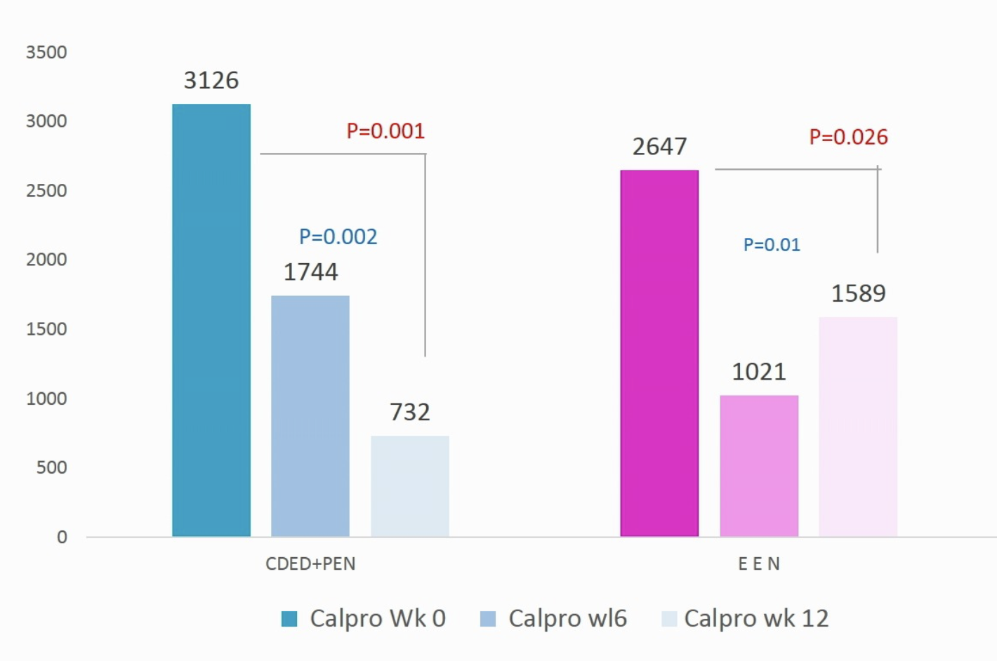
Median FCP weeks 6 and 12
Levine A, Gastro. 2019.
Notes:
Mirroring the rebound in calprotectin
and CRP levels and loss of sustained remission in the EEN
group between week 6 and week 12, the microbiome data
demonstrated a rebound effect in which the composition of
the microbiome (particularly Proteobacteria) tended to
revert to the baseline state on returning to regular diet. Use
of PEN after a course of EEN did not help to maintain the
microbiological changes induced by EEN. These data also
suggest that the foods excluded from habitual diet in the
CDED are likely to be the candidates for dysbiosis-led
inflammation, as this effect did not occur in the
CDED.PEN arm despite adding additional foods.

Slide 54
CDED RCT Conclusions
Large (relatively)! And Randomized, controlled!
Not powered to be an efficacy trial but as good (? better) than EEN for induction of remission
Mild disease cohort
FCP still quite high at weeks 6 and 12 (no mucosal healing endpoint)
What role does the formula play?

Slide 55
Conclusion
There are limitations to the clinical data for dietary therapy in IBD. This should not be a deterrent.
Exclusive enteral nutrition (EEN) is effective therapy for Crohn’s
Restriction diets involving regular food have shown promise
Further studies on dietary therapy needed

