Slide 1
Nutrition Management of Intestinal Failure Patients
Kipp Ellsworth, MS, RD, CSP, CNSC
Clinical Nutritionist, Intestinal Rehab of Children’s
Children’s Healthcare of Atlanta

Slide 2
Presentation Learning Objectives
State two goals of nutrition support therapy in pediatric intestinal failure patients.
Recall the standardized definitions for both “enteral autonomy” and “intestinal failure-associated liver disease.”
Debate the impact of multidisciplinary intestinal rehab programs on the outcome of pediatric patients with intestinal failure.
Discuss the importance of protocolized monitoring of serum micronutrient concentrations in long-term parenteral nutrition patients.
Identify four enteral formulas commonly used in the pediatric intestinal failure patient population.

Slide 3
Presentation Outline
Discuss the benefits of a multidisciplinary approach to the management of pediatric intestinal failure patients.
Summarize the IROC program’s demographics and its collaboration with the American Society for Parenteral & Enteral Nutrition’s (ASPEN) Intestinal Failure practice section.
Detail how the IROC program has incorporated the evidence and its collaborations with other care centers into a comprehensive, protocolized inpatient and outpatient parenteral nutrition management program.
Review general principles of tube-mediated and oral nutrition management of pediatric intestinal failure patients.

Slide 4
Nutrition Support Goals for Pediatric Intestinal Failure Patients
Primary goal: To enhance adaptation of the remnant small bowel via aggressive enteral feeding advancement, facilitating parenteral nutrition weaning and achievement of enteral autonomy
To promote acceptable growth while reducing the risk of intestinal failure-associated liver disease (IFALD)
To employ oral motor therapy and early oral feedings in an effort to address the high prevalence of oral aversion endemic to the intestinal failure population
Notes:
For those unable to achieve enteral autonomy, avoiding complications such as IFALD and sepsis becomes the main priority.

Slide 5
ASPEN Definitions in Pediatric Intestinal Failure
Pediatric intestinal failure: “the reduction of functional intestinal mass below that which can sustain life, resulting in dependence on supplemental parenteral support for a minimum of 60 days within a 74 consecutive day interval.”
Modi B, Galloway D, Nucci A et al. 2021; DOI:10.1002/jpen.2232 [Epub ahead of print]
Notes:
Similar to the Defining Pediatric Malnutrition initiative in 2013 led by Drs Mehta, Corkins, et al and the ASPEN Board of Directors, the ASPEN Pediatric Intestinal Failure Section led by Dr. Biren Modi at Boston Children’s, Dr. David Galloway at UAB, and our very own Dr. Anita Nucci, adjunct assistant professor in the Dept of Pediatrics, ESOM and assistant professor in the Dept of Nutrition at GSU, along with their Section colleagues, developed ASPEN Board-approved, evidence-based consensus definitions with the goal of allowing for appropriate comparisons between clinical studies and measurement of long-term patient outcomes, published ahead-of-print last month in JPEN. The ASPEN definitions will also facilitate research collaboration between PIF centers of care, most of whose populations simply don’t reach statistical significance when studied in isolation.
Using PubMed searches and the consensus judgement of its members, the ASPEN PIF Section proceeded to craft definitions for a host of terms in PIF. First among them: pediatric intestinal failure.
The definition does not state specifically a residual bowel length that can result in IF, because IF, defined broadly, relies on a functional deficit of intestinal mass. In this regard, this definition is inclusive of all disorders of the bowel, which include SBS and chronic intestinal pseudo-obstruction. A definition based solely on bowel length would exclude many conditions that require intestinal rehabilitation and/or complex nutrition management.

Slide 6
ASPEN Definitions in Pediatric Intestinal Failure
Enteral autonomy: “the maintenance of normal growth and hydration status by means of enteral support without the use of parenteral support for a period of more than three consecutive months.”
Intestinal Failure-Associated Liver Disease (IFALD): “liver injury, as manifested by cholestasis, steatosis, and fibrosis, in patients with IF independent of, or in addition to, other potential etiologies. The development of IFALD is multifactorial, typically as a consequence of metabolic abnormalities in IF and the medical and surgical management strategies of IF themselves. It can be stabilized or reversed with appropriate early modification of management strategies and promotion of intestinal adaptation or it can progress to hepatic dysfunction and ESLD.”
Modi B, Galloway D, Nucci A et al. 2021; DOI:10.1002/jpen.2232 [Epub ahead of print]
Notes:
Of the eight articles (two review papers and six retrospective cohort studies) that did include a specific or implied definition of the term, all included the discontinuation of PN.^{54, 64-70} The authors of three articles provided a qualifying duration of discontinuation (>3 consecutive months⁶⁷; ≥6 months⁶⁵; ≥12 months⁵⁴). Parenteral is defined as nutritional and/or hydration intravenous therapy. For the purposes of the IROC group, a patient achieving enteral autonomy would be one weaned off both TPN and IVF, who has demonstrated acceptable growth for 3 months. Given that the achievement of enteral autonomy represents the primary nutrition support goal for the IROC group, the development of a standard definition for EA is important, allowing us to determine best practices to achieve optimal outcomes by comparing with other practice groups.
For those yet to achieve enteral autonomy, avoiding complications such as IFALD and sepsis becomes the main priority. Thankfully, the ASPEN PIF Section developed a standard definition for IFALD as well. (read definition) Despite the lack of a formal definition of IFALD, review of the literature has revealed that many centers have gradually adopted a conjugated bilirubin of 2 mg/dl (34 µmol/L) as the definition of IFALD.^{111, 126} This threshold has, however, not been universal and is not supported by strong evidence but rather an adoption over time by many researchers (similar to the 30-50 mL/kg/day max ostomy threshold we commonly use to determine enteral feeding tolerance).
One of the major challenges facing clinicians managing patients with PIF is an emerging liver disease in which cholestasis has resolved but patients have underlying progressive fibrosis with continued dependence on PN support. The development of noncholestatic liver disease with portal hypertension due to progressive fibrosis poses significant management challenges. This is in contrast to our historical experience in which patients developed progressive cholestasis that could be followed biochemically. This new phenotype may be the result of improved bile flow with the use of alternative lipid strategies in the setting of a systemic pro-inflammatory milieu. The diagnosis of IFALD requires the synthesis of clinical, biochemical, radiological, and, where appropriate, histological information. Thus, the multifactorial nature of liver disease precludes the use of a single biochemical metric such as conjugated bilirubin in the definition of IFALD.

Slide 7
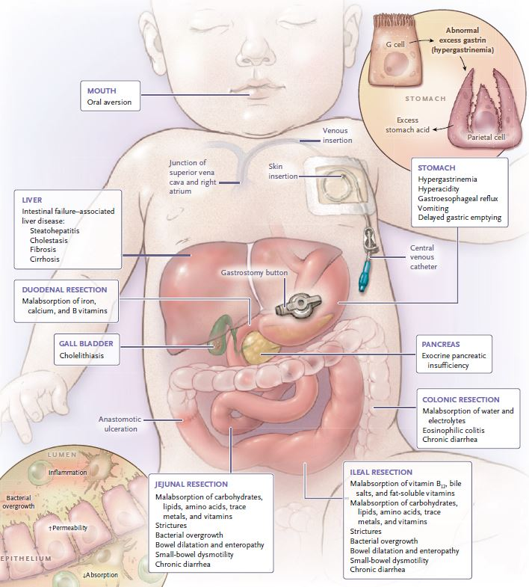
GI Manifestations of Intestinal Failure
Duggan CP, Jaksic T. Pediatric Intestinal Failure. NEJM. 2017;377:668.
Notes:
The numerous GI and nutritional manifestations of intestinal failure include malabsorption of nutrients, small-bowel dysmotility and bacterial overgrowth, and IFALD. To adequately consider these ramifications, clinicians loosely classify patients according to 3 GI anatomical parameters: length of residual SI, presence or absence of ICV, and presence or absence of colon. Of course the likelihood of adequate adaptation depends on severity of GI compromise and the absorptive capacity of the intestine. Nonetheless, the mechanism for intestinal malabsorption in SBS is more complex than the mere reduction in bowel length or surface area, the types of bowel segments involved in SBS also influence the patient’s prognosis for achieving nutrition-related autonomy. A child with relatively higher absorptive capacity may require PN for only a year or two whereas a child with an ultrashort gut/low absorptive capacity may have limited adaptive potential, without the capacity to achieve PN independence. In other words, the probability of achieving enteral autonomy is clearly associated with small bowel length.
For example, SBS patients with all segments of small bowel and a colon in continuity(jejunoileocolonic anastomosis) have the best prognosis and are usually relatively quicker to advance on EN and wean off TPN. SBS patients with a jejunocolonic anastomosis need more residual small bowel to wean off TPN, whereas those with an end jejunostomy need the most residual small bowel to wean. The proximal 100 cm of the jejunum is the primary site of CHO, protein, and water-soluble vitamin absorption. Fat absorption occurs over a longer length of small bowel. The terminal ileum is the primary site of carrier-mediated absorption of B12 and enterohepatic circulation of bile. When small amounts of ileum are resected, hepatic synthesis of bile can compensate for the losses from unrecycled bile. The bile entering the colon interferes with colonic fluid absorption leading to watery diarrhea. In contrast, when the ileum features extensive resection, the amount of unrecycled bile loss exceeds the maximum rate of hepatic synthesis of bile, leading to bile insufficiency, fat malabsorption, and steatorrhea. In addition massive ileal resection leads to gastric hypersecretion and more rapid gut transit, contributing to increased output, potentially interfering with pancreatic enzyme activity.
Prevalence of SBBO among patients with SBS is unknown, but may be frequent in those with resected ICV, dysbiosis, abnormal intestinal motility, and intestinal resection. This can cause alteration in bile salt absorption and overall intestinal malabsorption. The absence or presence of the colon plays a significant role in the patient’s symptoms and prognosis. The colon is also the site for bacterial fermentation of fiber and malabsorbed CHO in SCFAs which can provide a substantial number of calories via colonic salvage. Water soluble MCTs are effectively absorbed in the colon similar to the SCFAs, so much so that the imperative to use MCT-containing formulas to augment digestion/absorption in the small intestine is dwarfed by the imperative to use them as fodder for colonic salvage. In addition, patients with a colon in continuity can salvage up to 1000 additional calories per day, through bacterial fermentation of CHO into absorbable SCFAs.
Finally, normally dietary oxalate binds to calcium and is excreted in the stool. However, in the presence of fat malabsorption, fatty acid anions compete with oxalate anions to bind to available calcium. The excess and unbound oxalate are absorbed in the colon, and filtered in the kidneys. The high concentration of serum oxalate couples with relative dehydration, metabolic acidosis, and hypomagnesemia in SBS patients to facilitate oxalate stone formation in the kidneys. For this reason, patients who retain a colon are advised to consume a lowfat low-oxalate diet, increase calcium intake, and remain well hydrated to minimize the risk of oxalate nephrolithiasis.

Slide 8
Impact of Multidisciplinary Intestinal Rehab Programs (IRPs) on Management of Pediatric Intestinal Failure
4 studies in the past 4 years examining effect of IRP on outcomes
First cost-effectiveness study of pediatric intestinal failure (IF) pts
Mortality: decreased significantly after introduction of an IRP. The cause of death shifted from IFALD to other comorbidities associated with prematurity
Enteral autonomy: of the 3 studies reporting EN outcomes, 2 reported a significant decrease in length of PN dependence
Conclusion: despite studies’ limitations (single center enrollment, small sample size), intestinal failure pts managed by an IRP demonstrated improved clinical outcomes
Calculating treatment costs of IR pts and of pts receiving PN but not offered IR
Average 1st-year treatment: $275,000-$311,000; average subsequent years annually: $35,000-$54,000
IR prolonged the average pt survival by 1.2 years over the 40-year period
Cost savings achieved for each additional life-year gained by IR: $330,000
Conclusion: IR proves a cost-effective treatment of children with IF, improving survival while saving costs
Belza C, Wales PW. Curr Opin Pediatr. 2017;29:334-9.
Groen H et al. Am J Clin Nutr. 2017;105:417-25.
Notes:
Optimizing nutrition, medical, and surgical treatment appears a complex task and needs to be provided in a thoroughly multidisciplinary fashion. What is the evidence doing so improves outcomes and cost-effectiveness?
Enteral autonomy: if the primary goal of intestinal failure management is the achievement of enteral autonomy, then a major advantage of the established IRP program appears the coordination of enteral nutrition advancement, for many patients referred to IRPs often appear lacking EN or have not advanced to their enteral feeding capacity.
Talk about transfers of patients from GI practices in Macon and Columbus.
Children’s Hospitals of Amsterdam Medical Centers – simulated tx of IF in children a discrete-event model, deriving data from patient records. Time horizon of 40 years: 1 scenario without IR (all regressing to TPN) and 1 scenario with IR)

Slide 9
Evolving Strategies to Achieve Enteral Autonomy and Prevent IFALD
IROC
CLABSI Prevention
Intralipid restriction or Smoflipid/Omegaven
Cycling TPN & customized nutrition support
Stimulate intestinal adaptation
Microbiome engineering
Promote motility via aggressive EN advancing
Notes:
So what strategies do multidisciplinary IR programs, including the IROC program, use to expedite enteral autonomy and prevent IFALD?
CLABSI Prevention: While most of our patients get ethanol locks to help reduce the rate of CLABSIs in our Intestinal Rehab patients, our primary means of prevention is through intensive caregiver training. Our nurse coordinator spends many hours teaching our CVL patients’ families before initial discharge from the hospital to ensure they can successfully care for the line at home using strict aseptic technique. Diligent care for the CVL at home by caregivers is our best means of preventing CLABSIs so our teams expends a lot of energy and effort into this discharge education.
Lipid engineering: we have transitioned most our patients to either Smoflipid or Omegaven, continuing to restrict the few who remain on Intralipid to < 1 gm/kg/day. I’ll discuss the critical role of IV lipid nutrition support in preventing IFALD later in the presentation.
Cycling TPN: Cyclic or non-continuous PN is a strategy used for both treatment of IFALD and prophylaxis of the disease to prevent development of cholestasis. The intermittent, as opposed to continuous, supply of glucose and amino acids is thought to allow more efficient substrate utilization resulting in metabolic unloading of the liver.⁹ In infants, cyclic PN is related to lower or stabilized serum bilirubin levels;⁹ and if used prophylactically (initiated prior to the onset of hyperbilirubinemia), may decrease the incidence of hyperbilirubinemia. Current recommendations are largely based on small studies that assessed physiological changes when cyclical PN was introduced. We initiate prophylactic cycling of TPN in infants as young as 3 months old, usually by the time they are receiving some degree of enteral nutrition support during the TPN off-cycle time to prevent hypoglycemia.
Stimulate intestinal adaptation: nutritionally, it is known that the higher the complexity of a nutrient, the higher the workload of the digestive mechanisms involved. Thus, the more digestion a nutrient needs (e.g. whole protein or LCT), the more hyperplasia it will cause. Thus, nutritionally, stimulating intestinal adaptation means advancing to polymeric formula and food as quickly as possible without unduly precipitating ostomy or stool output. This is the tenuous balance the IROC team tries to achieve while transitioning patients from elemental to polymeric or blenderized formulas. IROC clinicians also use various medications to improve enteral tolerance to advancing feedings, including antidiarrheal agents such as Imodium, promotility agents such as Erythromycin, agents to prevent gastric acid hypersecretion such as PPIs, and of course, ultimately, if indicated, a GLP-2 analogue Teduglutide (GATTEX) to stimulate intestinal adaptation.
Promote motility via aggressive EN advancing: optimally using a standing feeding advancement order spanning both the inpatient and outpatient environment. This involves the shared understanding between clinicians and caregivers of the importance of continually advancing enteral feeding as tolerated.
Microbiome Engineering: prescribing probiotics with specific species to confer a specific evidence-based clinical benefit, all customized to the individual patient. Gone are the days of utilizing a standard Lacto and Bifido genera supplement. We have engaged in this type of engineering to successfully address D-lactic acidosis in our SBBO patients: more on that using a case study later in the presentation.

Slide 10
The Intestinal Rehab of Children’s (IROC)
Program Demographics
64 active patients
Intestinal failure diagnoses: short gut (gastroschisis, volvulus, atresia, necrotizing enterocolitis), dysmotility (Hirschsprung disease, megacystis microcolon intestinal hypoperistalsis syndrome), and idiopathic
26 chronic parenteral nutrition-dependent patients and 6 receiving customized IVF
2 isolated intestinal transplant and 5 multivisceral transplant patients
Program staff: 3 physicians (Drs. Berauer, Bashaw, Romero) 1 surgeon (Dr. Megan Durham), 1 nurse educator (Jennifer Aksoy), 1 nurse coordinator (Tina Shah), 1 nurse practitioner (Lauren Mullen), 1 RD, and 1 social worker (Margaret Clark)
Data collocated as of 8/24/21
Notes:
In the parlance of the ASPEN PIF section definitions, 50% or 32 patients currently in the IROC program have achieved enteral autonomy, not counting the countless others who’ve graduated from the IROC program to the general GI clinic.

Slide 11

National Survey of U.S. Pediatric Intestinal Rehab Programs
71 children’s hospitals reporting a PIR program to the 2017 USNWR.
58 active programs returned a 14-item questionnaire
34 classified as large programs (> 50 pts)
Park C, Cowles R et al. J Parenter Enteral Nutr. 2021;45(6):1249-58.

Slide 12
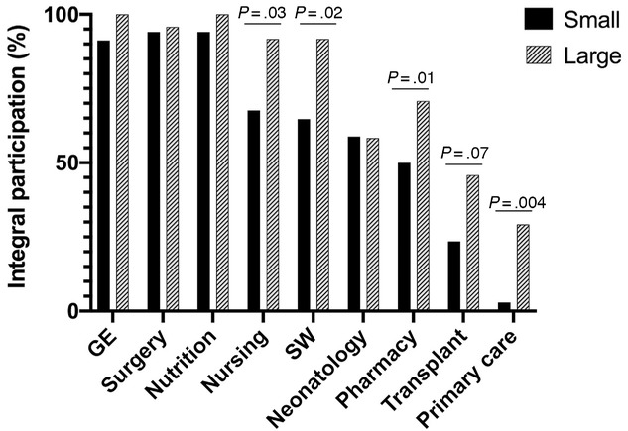
National Survey of U.S. Pediatric Intestinal Rehab Programs, cont’d
Majority of programs had gastroenterology, surgery, nutrition, nursing, and social work services involved.
Large programs were more likely to serve as referral centers; have greater participation by nursing, social work, and primary care; have more dedicated time by gastroenterology, surgery, nursing, nutrition, and social work; have more frequent meetings; and have various funding sources (P < .05).
Critical components of a modern PIR program include gastroenterology, surgery, and nutrition services with strong nursing and social work support.
Park C, Cowles R et al. J Parenter Enteral Nutr. 2021;45(6):1249-58.
Notes:
As expected, larger programs had access to a wider range of resources, such as coinciding transplant centers, external funding, and increased personnel and dedicated time, including meeting frequency. A particularly interesting finding was the higher rate of involvement by nursing and social work services in larger programs, which were disciplines that demonstrated having more dedicated time in centers overall. In studies examining the role of participating members in multidisciplinary care for cancer patients, active involvement of nurses during multidisciplinary meetings led to the perception of increased effectiveness by team members. This could be explained by the more holistic contributions made by nurses, who often times play a major role in patient intake, education, and counseling, thereby gaining deeper insight into the patients’ views and psychosocial needs. Similarly, in dealing with patients with a complex disease that requires frequent office visits, hospital admissions, and various home services, the role of an effective social worker appears critical. Furthermore, multidisciplinary meetings have been shown to positively affect patient assessment management practices, and outcomes across specialties (we are trying to restart our preclinic rounding meetings and certain continue our multidisciplinary TPN management meetings)
If we extended the x-axis to include other ancillary services such as ST, child psychology, and even teachers,, then we could safely conclude an even greater differential between large and small PIF programs. The current research indicating a lower health-related QOL for PIF patients and caregivers highlights the importance of all PIF programs expanding staffing to increase the health-related QOL for this incredibly complex population.

Slide 13
Nutrition Care Pathway for Pediatric Intestinal Failure Patients
Parenteral Nutrition Support
Tube-Mediated Nutrition Support
Oral Formula and Complemen-tary Foods
Notes:
We apply our theoretical, evidence-based, and collaboratively-based knowledge across the entirety of the nutrition care pathway for intestinal failure patients, almost universally stretching from the initiation of PN post-resection in the NICU to eventual advancement to an exclusively oral diet, often over many years. This represents a highly individualized process, often resisting the establishment of enteral and oral evidence-based feeding advancement protocols, due to high rates of inter-individual variation in feeding tolerance, regardless of anatomy.

Slide 14
Parenteral Nutrition Management of IF Patients
General Guidelines
PN caloric provision, in addition to any EN, should follow hypocaloric feeding strategy, considering weight gain at the 10-25%ile for age as acceptable within context of IFALD prevention for the duration of PN support. In the absence of significant enteral nutrition, PN may provide 90-110 kcal/kg/day.
Fluid provision based on ostomy, fistula, and drainage tube loss, typically providing a total 120 mL/kg/day for infants.
For those patients not meeting Smoflipid qualifying indications, clinicians should engage in Intralipid minimization strategy to address increased risk of IFALD, limiting to < 1 gm/kg/day while ensuring > 0.5 gm/kg/day to prevent EFA deficiency while receiving a majority of calories from PN.
When compressing PN cycle, clinicians should not exceed maximum glucose infusion rate (GIR) or maximum lipid infusion rate (LIR)
 | GIR (mg/kg/min) | LIR (gm/kg/hour)
Infants | 14-18 | 0.15
Children (1-10 yrs) | 8-10 | 0.08-0.13
Adolescents | 5-6 | 0.11
Notes:
Within the context of an IROC population featuring highly variable residual intestine length and functionality, estimating energy requirements represents a very subjective enterprise.
As I mentioned previously, PN cycling constitutes an important role in preventing IFALD. Of course, while compressing the PN cycle, we must be careful not to exceed the patient’s glucose or lipid oxidative capacity for fear of precipitating hyperglycemia and hypertriglyceridemia and all of the negative attendant consequences on patient outcome, particularly immune impairment.

Slide 15
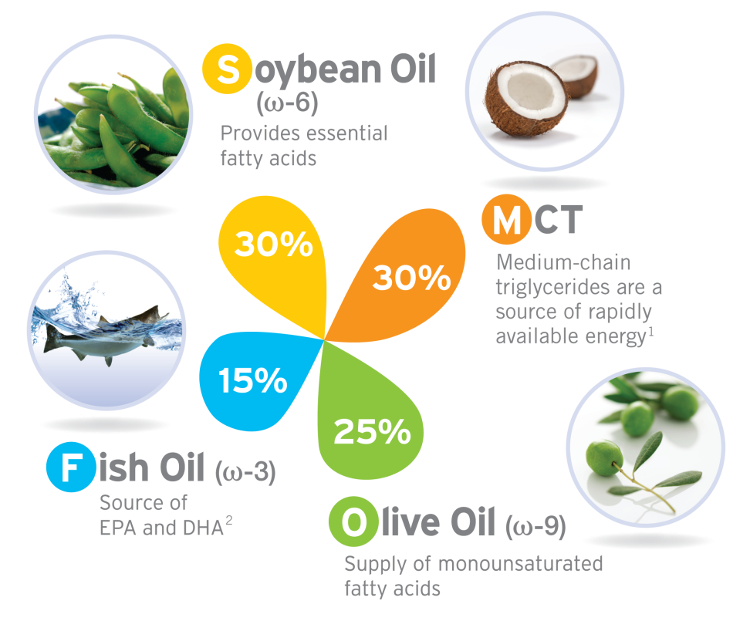
Smoflipid Debut in the U.S.
Achieved FDA approval in July 2016 for use in adults; not yet approved for U.S. pediatric and neonatal patients.
Studies ongoing regarding Smoflipid safety & efficacy, e.g. EFA status in neonatal patients.
Smoflipid used since 2009 in European pediatric patients, generating a wealth of research data.
Notes:
Smoflipid is not approved in the U.S. for pediatric patients because the safety and efficacy of Smoflipid have not been established in pediatric patients, particularly preterm infants. As per the FDA, the company-sponsored studies did not provide sufficient data to establish that Smoflipid provides sufficient amounts of essential fatty acids in the pediatric population.
Several phase III trials, many in the NICU, are currently evaluating the safety and efficacy of Smoflipid compared to Intralipid in hospitalized neonates, in an attempt to obtain a pediatric indication for Smoflipid.
Fortunately, European pediatric nutrition support practitioners have used Smoflipid since 2009, generating a wealth of research concerning Smoflipid’s potential efficacy, particularly in the chronic TPN population as a means of preventing or even reversing PNAC. Assured by the European data and ongoing use in the U.S. by major centers of care, U.S. clinicians are increasingly utilizing Smoflipid off-label as a standard-of-care for neonatal and pediatric patients.
You can now witness this increased utilization at Egleston where the majority of non-IROC TPN patients are receiving Smoflipid in both ICU and non-ICU settings. And why not? Smoflipid is equally priced to Intralipid and features a greater diversity of lipid types and sources in addition to its positive immunomodulatory, anti-inflammatory, and hepatoprotective effects in addition to potentially decreasing patient length-of-stay.

Slide 16
Smoflipid Use in Chronic Parenteral Nutrition Pediatric Patients
Multiple studies have compared Smoflipid to standard soybean oil-based fat emulsion in pediatric populations, including preterm infants, at doses of up to 3.5 gm/kg/day.
Goulet et al examined 28 home PN children for one month, finding a decrease in total bilirubin levels in the Smoflipid group and an increase in the Intralipid group
Muhammed et al compared IFALD children treated with Smoflipid to those remaining on soy-based lipid emulsion, finding an immediate and sustained fall in bilirubin levels as early as one month after transitioning.
Attard et al achieved similar results when comparing Smoflipid with soybean oil-based emulsion in preterm infants with IFALD, revealing a significant reduction in the rate of increase, and then reversal of direct bilirubin levels.
Goulet O et al. J Parenter Enteral Nutr. 2010;34(5):485-95.
Muhammed R et al. J Pediatr Gastroenterol Nutr. 2011;54(6):797-802.
Attard M et al. Arch Dis Child. 2012;97:A54-A55.
Notes:
The Smoflipid product features an omega-6 to omega-3 fatty acid ratio of 2.5:1 as compared to a 7:1 ratio for the soybean oil-based fat emulsion known as Intralipid. So theoretically, with reduced concentrations of omega-6 fatty acids and phytosterols, patients on chronic TPN with Smoflipid would demonstrate a reduced incidence of IFALD as compared to patients receiving Intralipid. Multiple studies have compared Smoflipid to standard soybean-oil based fat emulsion in pediatric populations, including preterm infants, at doses of up to 3.5 gm/kg/day. The results of these studies have not only confirmed the safety of Smoflipid but also its potential efficacy in children with IFALD.

Slide 17
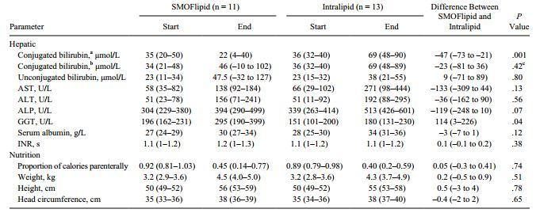
Preventing Progression of IFALD in PN-Dependent Infants with Early IFALD
Diamond et al embarked on a randomized controlled multicenter pilot trial, lengthening the treatment period beyond the previously cited short-term studies to 12 weeks.
When comparing those receiving Smoflipid to those receiving Intralipid, they found Smoflipid pts had a lower conjugated bilirubin and appeared more likely to experience a decrease in conjugated bilirubin to 0 μmol/L
Diamond IR et al. J Parenter Enteral Nutr. 2017;41(5):866-77.
Notes:
To explore whether Smoflipid would reduce the risk of IFALD progression in children receiving parenteral nutrition and demonstrating early hepatic dysfunction, Diamond et al embarked on a randomized controlled multicenter pilot trial, lengthening the treatment period beyond the previously cited short-term studies to 12 weeks.
Conclusion: Compared with Intralipid, Smoflipid reduces the risk of progressive IFALD in children with intestinal failure.

Slide 18
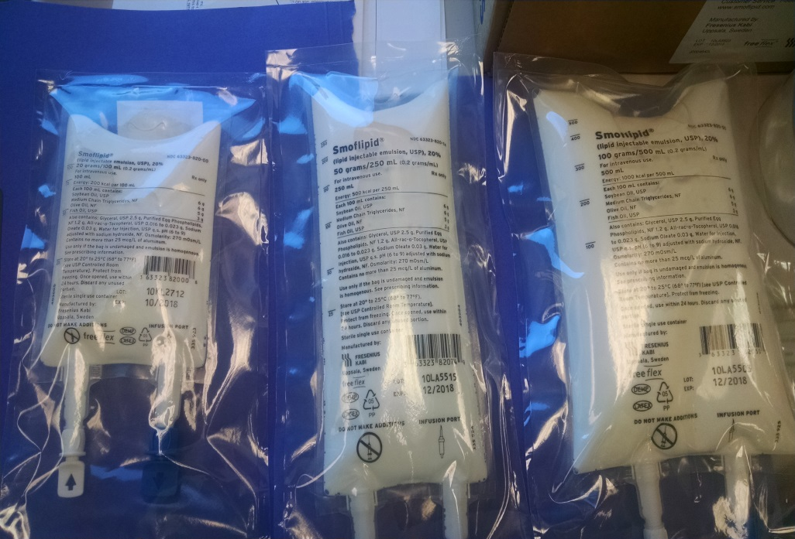
Smoflipid Debut at Children’s Healthcare of Atlanta
Smoflipid approved by Children’s PNT committee in July 2017 for use in inpatients meeting any one of the following criteria (in intestinal rehab pts):
  Expected PN duration of > 1 month
  Patient requiring parenteral Intralipid minimization to < 1 gm/kg/day.
  Direct bilirubin ≥ 2 mg/dL serially measured over one month, after ruling out other potential etiologies such as sepsis, drug-induced cholestasis, and obstructive jaundice.
  Evidence of IFALD by liver biopsy
Pediatric GI MD must follow patient post-discharge
Dosing: 2-3 gm/kg/day
Current Smoflipid IROC population: 18 patients
Notes:
We have noticed that dosing Smoflipid at 2 gm/kg/day may result in linoleic acid deficiency (0.3 gm/kg LA), indicating a need for liberalization of lipid to 2.5-3 gm/kg/day.
This provides 5% of total kcal and 0.4 gm/kg/day

Slide 19
Use of Omegaven in Treating Parenteral Nutrition-Associated Liver Disease
Product | Intralipid | Smoflipid | Omegaven
Oil Source (%)
Soybean | 100 | 30 | 0
Coconut (MCT) | 0 | 30 | 0
Olive | 0 | 25 | 0
Fish | 0 | 15 | 100
Fat Comp (gm) per 10 gm/100 mL
Linoleic (18:2) | 5 | 2.85 | 0.1-0.7
α-Linolenic (18:3) | 0.9 | 0.275 | <0.2
EPA (20:5) | 0 | 0.25 | 1.28-2.82
DHA (22:5) | 0 | 0.05 | 1.44-3.09
Cost per 100 mL | $12 | $17 | $57
FDA approved Omegaven on 7/27/18 for use in children with parenteral nutrition-associated cholestasis
Fish-oil monotherapy (1 gm/kg/day) demonstrated as a safe and effective therapy for PNALD, with successful resolution of biochemical cholestasis and avoidance of liver transplant
What are the indications for Omegaven in treating PNALD, particularly within the context of Intralipid minimization and Smoflipid availability?
Does the paucity of linoleic acid and arachidonic acid in Omegaven constitute a risk for essential fatty acid deficiency?
How long should clinicians use Omegaven to prevent cholestasis redevelopment: indefinitely or on an intermittent basis?
Notes:
Approved after an extended compassionate use period
Omegaven’s ability to both prevent and treat EFA deficiency appears belied by its extremely low LA content of 0.16 gm/50 mL, insufficient to meet the minimum LA requirement of 0.1 gm/kg/day when dosing Omegaven at <1 gm/kg/day. Omegaven appears to reduce the physiologic requirement for LA.
As clinicians, we find ourselves, in the wake of the FDA’s approval of Omegaven, facing a bevy of parenteral lipid options, attempting to determine if having all 3 options on formulary appears clinically indicated.

Slide 20
Indications for Omegaven in Treating Parenteral Nutrition-Associated Liver Disease
In 2005, Gura et al reported that the replacement of Intralipid (SO) with Omegaven (FO) effectively reversed IFALD (direct bili < 2) in 2 short gut infants.
Calkins et al compared 10 pts transitioned from SO to FO for 6 months with 20 historic controls receiving SO, estimating, using the Kaplan-Meier method, that 75% in the FO group would experience cholestasis resolution by 17 weeks vs 6% in the SO group.
Lee et al reported two infant IFALD cases featuring complete resolution of biochemical cholestasis after transitioning from Smoflipid at 2-3 gm/kg/day to Omegaven at 1 gm/kg/day.
Gura KM et al. Pediatrics. 2006;118(1):197-201.
Calkins KL et al. J Parenter Enteral Nutr. 2014; 38(6):682-92.
Lee S et al. J Parenter Enteral Nutr. 2016:437-440.
Notes:
To initiate their long string of Omegaven research in IFALD pediatric patients at Boston Children’s, Kathy Gura et al in 2005 ……..
Kara Calkins et al at UCLA, Mattel Children’s Hospital, another notable center of Omegaven research, compared….
Finally, Lee et al began the clinical exploration of transitioning IFALD patients from Smoflipid to Omegaven……..

Slide 21
Use of Omegaven in Treating Parenteral Nutrition-Associated Liver Disease
Prevention and Treatment of EFA Deficiency (EFAD)
Length of Therapy
Nandivada et al analyzed the incidence of EFAD in 30 IFALD patients requiring chronic PN and FO for at least 3 years, reporting not only resolution of cholestasis but also the absence of EFAD, as typically evidenced by a triene:tetraene ratio of > 0.2.
Calkins et al investigated outcomes for IFALD children treated with 6 months of FO, and who then restarted SO, finding SO resumption associated with cholestasis development in nearly ¼ of pts.
Nandivada P et al. J Parenter Enteral Nutr. 2017;41(6):930-37.
Calkins K et al. 2018;DOI:10.1002/jpen.1463 [Epub ahead of print]
Notes:
Because FO is dosed at 1 gm/kg/day, there are concerns that long-term FO could contribute to poor growth or an essential fatty acid deficiency. However, in the 15 years of research into Omegaven in IFALD, studies have consistently demonstrated that growth improves with FO, and that FO monotherapy is not associated with EFAD development.
One example of a study examining EFA status in IFALD patients is Nandivada et al at Boston Children’s. This study, in addition to many studies examining EFA status in IFALD patients on FO revealed that FO remarkably not only prevented EFAD, but also treated EFAD in IFALD children. The preferred biomarker for EFA status in these studies was the triene:tetraene ratio, an elevated ratio indicative of more Mead acid produced than arachidonic acid
Long-term data on IFALD children receiving Omegaven followed by resumption of Intralipid or Smoflipid after normalization of cholestasis appears scant. Calkins et al at UCLA/Mattel Children’s conducted the first exploration of this transition, finding that nearly ¼ of patients resuming SO redeveloped cholestasis. Indeed, this study now serves as the justification for continuing FO monotherapy indefinitely pending transplant or achievement of enteral autonomy at UCLA and Boston, the rationale being that the increased cost of prolonged Omegaven “rescue” therapy as compared to Smof and Intralipid appears justified when compared to the prohibitive cost of transplantation and post-transplant care. Other centers of care appear comfortable with restarting Smoflipid depending on a host of factors, including the patient’s medical history, intestinal anatomy, sepsis episodes, and other risk factors such as age and the direct bilirubin at the initiation of Omegaven.
This leads to 3 questions a clinician must ask prior to initiating Omegaven: what are the indications, how do I monitor EFA status, and how long do I administer Omegaven, indefinitely or rotationally? To this point, the long-term effect of Smoflipid on cholestasis-free and transplant-free survival is unknown. It is also unclear if substituting Smoflipid for FO after cholestasis resolution vs long-term FO is of any benefit.

Slide 22
IROC Patient Case Study of Omegaven
8 year old female with h/o duodenal atresia, duodenoileostomy with only 1.5 cm of ileum with intact ICV and full colon.
Consumed 6 oz of Elecare Junior daily and minimal solid foods
Listed for multivisceral tx at Pittsburgh
Receives 14-hour cyclic TPN
Transitioned from Intralipid to Smoflipid at 2 gm/kg/day in March 2017
Failed to respond to Smoflipid; thus, we transitioned to Omegaven at 1 gm/kg/day in mid-January 2019
Excellent cholestasis resolution in 4 months, along with improved copper excretion
 | June 2017 | Sept 2018 | Dec 2018 | May 2019 | July 2019 | Sept 2021
Direct bilirubin | 3.2 ↑ | 7.5 ↑ | 9.8 ↑ | 1.6 ↑ | 0.7 ↑ | 0.1
Triene: Tetraene Ratio | - | 0.02 | - | 0.024 |  | 0.019
Linoleic acid | - | 3,809 | - | 940 ↓ |  | 725↓
Serum copper | - | - | 181 ↑ | 33.7 ↓
Notes:
Transitioning to Omegaven resulted in a significant decrease in linoleic acid, at least superficially consistent with a linoleic acid deficiency, but notice the unchanged triene:tetraene ratio indicating the absence of a deficiency. My correspondence with UCLA and Boston led to the confirmation that clinicians should consider the Holman ratio as the definitive marker for EFA deficiency, not the serum linoleic acid. Reduced linoleic composition fo alternative ILEs such as Omegaven could result in false-positives for EFAD if the definitive diagnosis of a triene:tetraene ratio greater than 0.2 is not used. It is presumed that the metabolites of linolenic acid metabolism such as EPA and DHA may correct the clinical symptoms of EFAD or somehow decrease the requirements. Thus, in the absence of any symptoms consistent with LA deficiency such as dermatitis, dyspigmentation, impaired immunocompetency, growth failure, and given the acceptable ratio, we have continued the current Omegaven dosing of 1 gm/kg/day with no need for supplemental enteral or parenteral linoleic acid.
In addition to her remarkably improved cholestasis, her Cu excretion improved dramatically, resulting in a reversal from a mild toxicity to a signficant Cu deficiency! We thus reintroduced Cu to her PN at a repletion dose of 50 mcg/kg/day for one week prior to returning to a basal dose of 20 mcg/kg/day.
To this day, this patient represents our only Omegaven recipient.

Slide 23
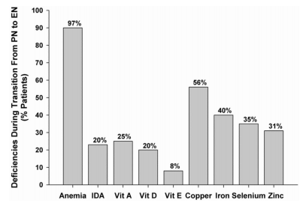
High Prevalence of Multiple Micronutrient Deficiencies in Children with Intestinal Failure
Longitudinal study of 30 patients at Boston Children’s CAIR transitioning from parenteral nutrition to exclusive enteral nutrition
33% of pts had at least one vitamin deficiency; 80% at least one trace element deficiency
50% of pts had multiple micronutrient deficiencies
Yang CF, Jaksic T, Duggan C et al. J Pediatr. 2011;159:39-44.
Notes:
During my initial years as a nutrition support practitioner covering the intestinal rehab population, I existed under the naïve presumption that PN provided the requisite micronutrients needed to avoid deficiencies.
Median transition from PN to full EN lasted 12 weeks.
After transition to 100% of EN, 70% had at least one vitamin deficiency and 77% had at least one mineral deficiency with the most common deficiencies being Vitamin D (68%), zinc (67%), and iron deficiency (37%).
When comparing the rates of fat-soluble vitamin deficiencies between the two sampling time frames, the prevalence of Vitamins D and E rose significantly while deficiencies of copper, iron, and selenium were all less prevalent after exclusive EN was attained.

Slide 24
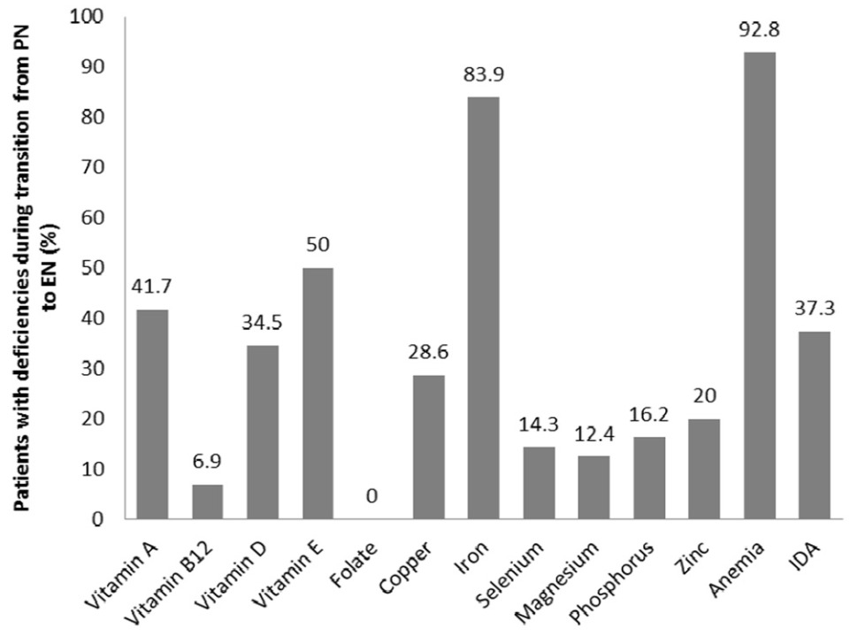
High Prevalence of Multiple Micronutrient Deficiencies in Intestinal Failure, cont’d
Retrospective review of 178 patients at Cincinnati Children’s transitioning from parenteral to exclusive enteral nutrition
35% had at least one vitamin deficiency; 56% ≥ 1 trace element deficiency
33% had multiple micronutrient deficiencies
Ubesie AC, Kocoshis SA, Cole CR et al. J Pediatr. 2013;163:1692-6.
Notes:
Similar to the Boston study, Cole et al found that most trace element deficiencies (iron, copper, and selenium) decrease in prevalence during the transition to exclusive enteral nutrition, but zinc deficiency increases in prevalence after successful transition to exclusive enteral nutrition.

Slide 25
High Prevalence of Multiple Micronutrient Deficiencies in Intestinal Failure, cont’d
Retrospective review of 30 intestinal failure patients on parenteral nutrition for at least one year at the Great Ormond Street Hospital for Children, London
73% had ≥ one trace element deficiency; 43% had ≥ one vitamin deficiency; 27% had multiple micronutrient deficiencies
Deficiencies included copper (47%), vitamin A (43%), selenium (20%), ferritin (20%), and zinc (10%)
Vitamin E, D, B12, and folate all normal
8 patients receiving enteral vitamin supplementation in addition to parenteral vitamins
No significant clinical abnormalities noted despite high prevalence of biochemical deficiencies
Nunez-Ramos R, Gallego S, et al. Gut. 2015;64:A504
Notes:
One of the frustrating aspects to interpreting these studies is the significant interinstitutional variability in micronutrient biomarkers and how they are interpreted.
Despite the variability, the data support the greater prevalence of trace element deficiency during TPN administration as compared to vitamin deficiency.
In addition, most programs do not encounter classical deficiency symptomology; instead, they appear faced with an onslaught of labs indicating biochemical deficiencies.

Slide 26
Chronic TPN and Micronutrient Deficiencies: Conclusions of Studies
High prevalence of micronutrient deficiencies indicates a need for regular, protocolized lab monitoring, particularly in the absence of independent indicators of micronutrient deficiency risk such as anthropometric measurements, disease/anatomy, and enteral micronutrient supplementation
Aggressive, individualized micronutrient supplementation
Despite at least partial parenteral nutrition supplementation, patients demonstrated high deficiency prevalence, suggesting a need to review current parenteral micronutrient supplementation guidelines
After transitioning to exclusive enteral nutrition, most trace element deficiencies decrease in prevalence while zinc deficiency prevalence increases
Notes:
Independent variables related to micronutrient deficiency prevalence come into play more so after the transition to exclusive enteral nutrition, particularly the presence of an MVI supplement and an intact ileocecal valve.
The lack of knowledge concerning parenterally infused micronutrient pathophysiology makes it very difficult to predict the micronutrient requirements or TE kinetics in the average patient.
2) Dose-concentration relationships between TE doses and serum TE concentrations significant for zinc (P < .0001), manganese (P = .012), and chromium (P < .0001) but insignificant for selenium (P = 0.51) and copper (P = 0.77)
Interindividual variations for TE requirements exist, indicating use of individualized TE products for optimal intake.

Slide 27
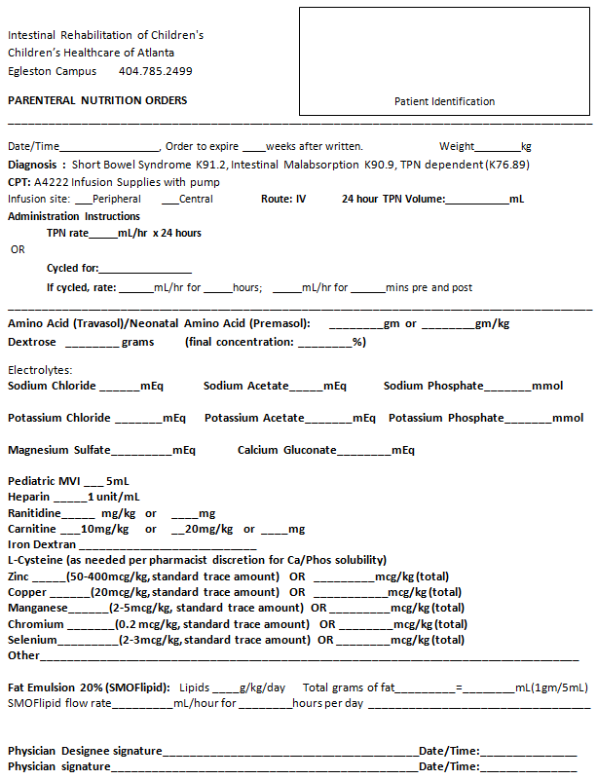
IROC’s Parenteral Nutrition Forms, Tailored to Trace Element and Lipid Individualization

Slide 28
Importance of Micronutrient Monitoring & Supplementation in Chronic TPN Pediatric Pts
Patients with marginal or biochemical micronutrient deficiencies usually don’t exhibit any specific clinical features
Vitamin and trace element deficiencies may theoretically inhibit intestinal adaptation. Research has linked vitamin A deficiency with compromised intestinal adaptation and zinc deficiency with impeding mucosal growth in response to extensive bowel resection in rats.
In addition, research has implicated Zn and Se deficiency in depressed immunity
Scant research has examined the relationship between marginal trace element deficiency and clinical outcome in chronic TPN pts
French study of 73 adult patients with chronic intestinal failure on long-term TPN revealed not only a significant incidence of Se, Cu, and Zn deficiency, but also an independent association between Se deficiency and a higher risk of infection (1).
1) Uzzan M et al. Article in press. Clin Nutrition. 2016; http://dx.doi.org/j.clnu.2016.05.008
Notes:
Patients with marginal TE deficiencies usually don’t exhibit any specific clinical features. In the general population, the effects of marginal TE deficiencies are unclear.
Micronutrients play important roles in the maintenance of gastrointestinal structure and function, including mucosal immunity, and deficiencies of vitamins and TEs may theoretically inhibit intestinal adaptation. For example, research has implicated Vitamin A deficiency with compromised intestinal adaptation and zinc deficiency with impeding adaptive mucosal growth in response to extensive bowel resection in rats. In addition, research has implicated depressed immunity with Se and Zn deficiency, making monitoring and supplementation potentially valuable in improving outcome for patients at risk for CLABSIs.
Scant research has examined the relationship between marginal trace element deficiency and outcome in the chronic TPN population, but one study of 73 adult patients with chronic intestinal failure on long-term TPN revealed not only significant incidence of Se, Cu, and Zn deficiency, but also an independent association between Se deficiency and a higher risk of infection.

Slide 29
Potential Micronutrient Management Confounders
Parenteral trace element (TE) and multivitamin (MVI) product shortages
Effects of malnutrition and/or inflammation
Nutrition regimen (i.e. exclusive parenteral nutrition vs partial parenteral nutrition vs exclusive enteral nutrition)
Nonorganic/socioeconomic factors
Stooling/Ostomy output
Inpatient/Outpatient continuum of care
Notes:
Obviously, we can agree on the importance of protocolized micronutrient monitoring; however, a multitude of confounders awaits us:
The high interinstitutional variability in laboratory test selection and monitoring frequency revealed by the practice survey appears reflective of practitioners’ angst in determining lab selection, monitoring frequency, and interpretation with variables such as intestinal anatomy, liver function, bacterial overgrowth, malnutrition, inflammation, and degree of parenteral nutrition dependence affecting values in largely unknown ways. Indeed, there is no standard biochemical monitoring regimen for pediatric PN, and a minimum data set for stable patients at different ages needs to be defined in order to avoid unnecessary and expensive repeat testing
Serum TE concentrations do not necessarily reflect total body TE stores, and levels are affected by the response to stress or injury. Although tissue TE redistribution occurs during the phase of the inflammatory response to stress, this is typically significant in acutely ill or hospitalized patients and is of a lesser significance in stable home PN patients.
Nonorganic/socioeconomic factors: AquADEKs supplementation may constitute impediment to compliance, a monthly supply typically costing $20-40. Georgia Medicaid collaboration for micronutrient repletion and maintenance regimens.
Stooling/ostomy output: SBS patients have exceedingly high intestinal zinc and selenium losses due to short intestinal surface absorption area, rapid GI transit time and chronic diarrhea.
The continuum of care includes hospital, home, school, daycare, diffuse family.

Slide 30
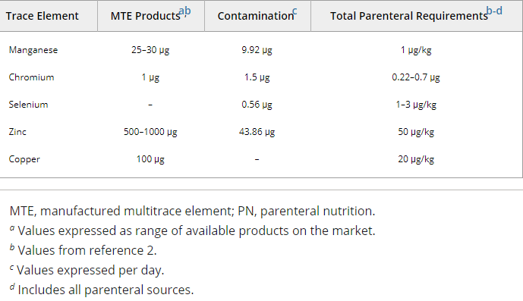
Quantitative Assessment of Trace-Element Contamination in PN Products
Olson et al tested 65 products available for PN compounding for Mn, Cr, Se, Zn, and Cu contamination
Theoretical pediatric PNs formulated to assess impact of macro- and micronutrient doses on PN trace-element contamination
Trace element contamination detected in 75% of components tested.; Cr and Mn detected in 66% and 52% of components respectively.
NaPhos and KPhos contained the most chromium; MgSulfate the most manganese
Pediatric MTE Products, Calculated PN Contamination, and ASPEN Recommendations for Parenteral Trace Element Requirements
Olson LM et al. JPEN. 2019;doi.org/10.1002/jpen.1668
Notes:
Olson et al at University of Nebraska Medical Center
Theoretical pediatric PNs formulated based on 10 kg patient to assess impact of macro- and micronutrient does on PN trace-element contamination

Slide 31
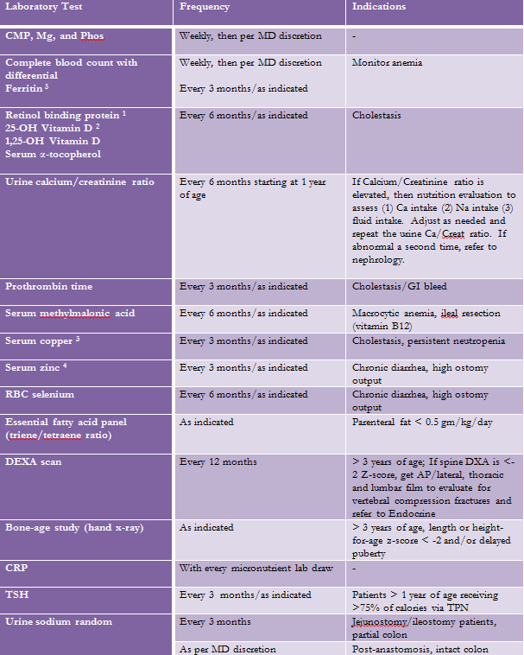
Micronutrient Monitoring for Transitional Feeding Pts on Parenteral Nutrition +/- Enteral Nutrition
Notes:
To address the previously discussed micronutrient monitoring confounders such as inflammation, anatomy, ostomy output, and cholestasis, the IROC group first decided to split its clinical population into three protocolized micronutrient deficiency risk groups depending on nutrition regimen:
Transitional feeding patients on parenteral nutrition +/- enteral nutrition
Exclusive enteral nutrition patients within one year of TPN discontinuance
Exclusive enteral nutrition patients without TPN for at least one year.
Within each of the three nutrition support groups, we have assigned a monitoring frequency for each of the at-risk micronutrients, consistent with the risk of deficiency, in general the monitoring of trace elements assuming a greater importance while on parenteral nutrition, the monitoring of fat-soluble vitamins assuming a greater importance post-TPN discontinuance. We constructed these micronutrient monitoring protocols based on the IROC program’s empiric evidence, our communications with other national programs, facilitated by our representation in the PIFWG collaborative practice group, and extensive literature reviews.
Furthermore, within each nutrition support group, in addition to monitoring, we have included an indications column to guide us in further individualizing monitoring, depending on conditions such as anatomy, ostomy output, presence of cholestasis, and other factors.

Slide 32
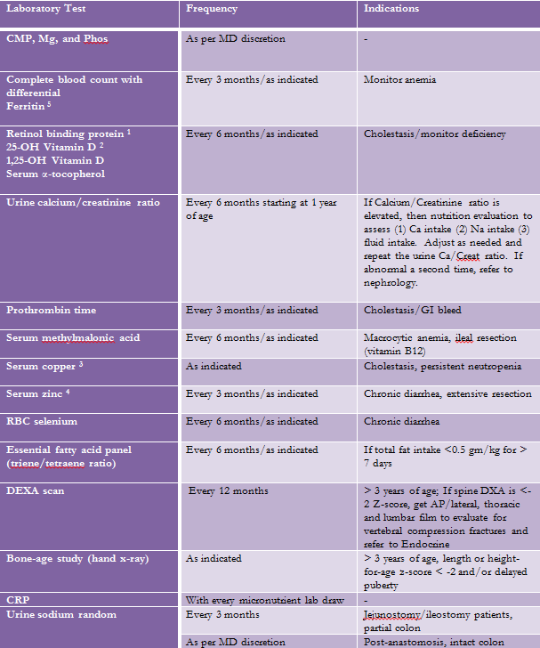
Micronutrient Monitoring for Patients Receiving Exclusive Enteral Nutrition – acute period <1 yr post-TPN

Slide 33
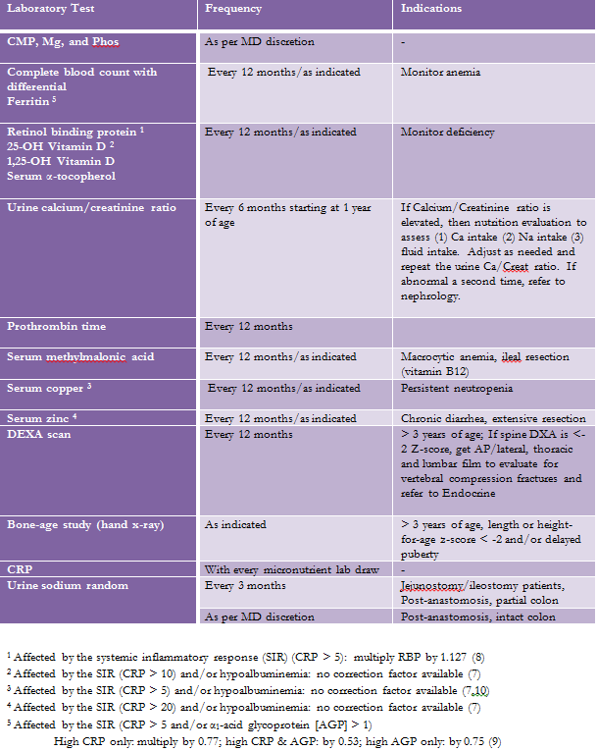
Micronutrient Monitoring for Patients Receiving Exclusive Enteral Nutrition – chronic period >1 yr post-TPN
Notes:
Many micronutrient biomarkers are unreliable indicators of nutrition status when infection or inflammation are present.
Inflammation usually depresses the concentration of most micronutrient biomarkers; thus, ignoring the effects of inflammation, may lead to inappropriate repletion and increasing the risk of provoking a toxicity – as detrimental to clinical outcome as a deficiency.
To address this risk and ensure more reliable micronutrient marker interpretation, the IROC team orders a CRP concurrently drawn with each micronutrient panel. The CRP appears the best validated, most extensively used biomarker in assessing microinflammation. This allow us to address ferritin as a positive APR and RBP, copper, zinc, and Vitamin D as negative APRs. If an erythrocyte biomarker is available, then we will use it as a more reliable indicator, for example RBC selenium. We also commonly include a serum albumin as a marker of malnutrition, allowing the team to take this into consideration when evaluating serum micronutrient marker values.
We have provided those adjustment factors for RBP, Vitamin D, serum copper, serum zinc, and ferritin.
In conclusion, the intestinal rehab clinician should endeavor to include CRP with each micronutrient panel to improve the accuracy of marker interpretation and prevent inappropriate clinical interventions.

Slide 34
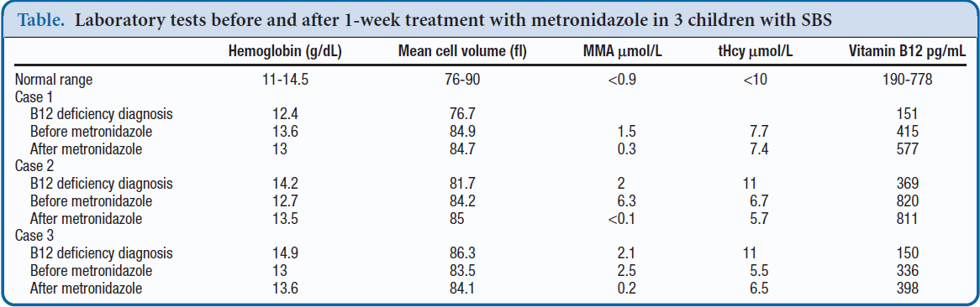
Is Serum MMA a Reliable Biomarker of Vitamin B12 Status in Short Bowel Children?
Serum MMA shown to have a higher sensitivity for vitamin B12 deficiency, aiding in early detection
Serum MMA declines following antibiotic treatment in short gut patients with SBBO
Report of 3 patients by Duggan et al revealed normalization of elevated MMA after ABX treatment for SBBO.
Jimenez L, Duggan CP et al. J Pediatr. 2018;192:259-61.
Notes:
Protocolizing lab monitoring may ensure rigorous oversight of our patients’ micronutrient status, but does not necessarily facilitate the interpretation of certain micronutrients within the context of short gut’s unique pathophysiology. The most obvious example of the difficulties in micronutrient interpretation for short gut patients is vitamin B12, the deficiency of which constitutes the most common in our post-TPN population, particularly those with a history of extensive ileal resection.
Metabolism of tHcy and MMA occurs via vitamin B12 dependent enzymatic pathways, and, thus, elevations in these byproducts serve as indicators
of vitamin B12 status, making them acceptable complementary biomarkers. Measurements of MMA and tHcy levels decline after adequate supplementation and are often used to confirm treatment response. Changes in MMA levels in particular have been shown to have a higher sensitivity for vitamin B12 deficiency and aid in early detection of deficiency in comparison with serum B12 levels alone.
Unfortunately, case reports in the literature began to cast doubt on the reliability of serum MMA as a biomarker of B12 status in short gut patients with chronic small bowel bacterial overgrowth as evidenced by observations of declining MMA following antibiotic treatment. These observed changes in MMA concentration were hypothesized to be secondary to changes in gut flora, which included a reduction in bacterial counts and propionate measures, as well as a shift in bacterial population.
Of particular note, Dr. Chris Duggan and his colleagues at Boston Children’s published a report of 3 patients with SBS receiving parenteral vitamin B12 supplementation who had elevated plasma MMA levels on routine monitoring, with subsequent normalization of MMA after antibiotic treatment for
presumptive SBBO. It is hypothesized that propionate, a precursor to MMA, produced by excessive gut bacterial fermentation, is responsible for the
elevation in plasma MMA levels, thus rendering MMA an unreliable marker of B12 status in short gut patients.

Slide 35
The IROC Approach to Vitamin B12 Assessment
Originally, we checked serum MMA and vitamin B12, but have revised our B12 monitoring to a dual panel of serum MMA and serum homocysteine, once every 6 months in the <1 year post-TPN discontinuance population and once annually in the > 1 year post-TPN population
 | MMA | Homocys
B12 deficiency | Elevated | Elevated
SBBO | Elevated | WNL
Folate deficiency | WNL | Elevated
Notes:
To ensure the reliability of our B12 monitoring protocol, particularly in the post-TPN population, we now use a dual panel of serum MMA and homocysteine.

Slide 36
Micronutrient Supplementation Protocol for Intestinal Failure Patients
Water-soluble MVI DEKAs Plus should constitute first-choice supplement for intestinal failure pts. If parents unable to assume out-of-pocket ($15-40 monthly) expense, clinician should initiate regular MVI
If patient diagnosed with multiple micronutrient deficiencies while taking MVI, clinician may liberalize dosage.
Age | DEKAs Plus Drops or Softgels | Polyvisol drops, Centrum Jr chewable or tablet
0-12 months | 1 mL daily | 1 mL daily
1-3 years | 1 mL twice daily | 1 mL twice daily
4-8 years | 1 softgel daily | 1 tablet daily
9 + years | 1 softgel twice daily | 1 tablet twice daily
Notes:
We prefer DEKAs Plus products (containing Vitamins A, D, E, K, and the B vitamins in addition to Se and Zn) under the theoretical assumption that short gut patients absorb water-soluble micronutrients more easily, facilitated not only by the TPGS (tocopherol polyethylene glycol succinate) within the context of intestinal failure associated liver disease and enhanced absorption independent of luminal bile acids, but also by the ease of the lipophilic compound absorption across a reduce surface area of gut. Limited evidence exists that TPGS (d-alpha tocopheryl polyethylene glycol 1000 succinate)-containing products, including DEKAS Essentials and Plus products in addition to AquADEKs, prove better able to overcome FSV deficiencies in biliary atresia and Alagille’s; thus, we continue with DEKAs Plus as our primary recommendation if economically feasible.

Slide 37
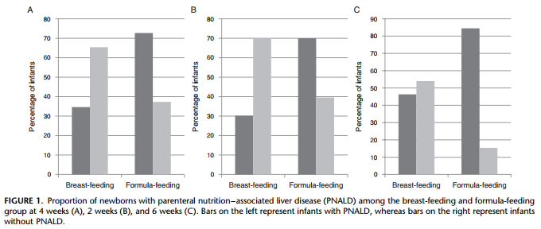
Enteral Nutrition Management of IF Patients:
Breastmilk Feeding
Andorsky et al’s retrospective review of SBS infants on PN > 90 days revealed breastmilk use negatively correlated with PN duration
Kuklarni et al’s retrospective analysis revealed that infants on PN for > 4 weeks receiving breastmilk feeding appeared less likely to develop PNALD (35%) compared with those fed only formula (73%) and had significantly lower conjugated bilirubin and mean max AST. Mixed-feeding infants receiving a higher percentage of breastmilk showed a significant negative correlation with the mean max conjugated bilirubin.
Kulkarni S et al. J Pediatr Gastro Nutr. 2013;57:383-8.
Andorsky DJ, Duggan C et al. J Pediatr. 2001;139:27-33.
Notes:
Although at first glance, breastmilk may not be considered the enteral feeding of choice for infants with SBS as the nutrients are intact and not hydrolyzed, the literature indicates that the use of BM results in improved GI tolerance and reduced duration of PN in comparison to protein hydrolysate formulas.
Andorsky concluded that breastmilk’s unique components, including growth factors, Igs, and nucleotides could be responsible.

Slide 38
Enteral Nutrition Management of IF Patients:
General Principles of Formula Selection
No consensus exists on the most appropriate formula to use for short gut syndrome patients.
Some studies suggest a benefit of a more complex diet with long-chain fat, peptides/intact protein, and complex carbohydrates on enhancing adaptation while others support the influence of an elemental diet on the weaning of PN & enteral tolerance.
IROC consensus characteristics for optimal formula:
  Isosmolar
  Featuring MCT as significant fat component
  Either hydrolyzed or elemental
Notes:
Similarly, there are limited data with regard to optimum feed type (in the absence of breast milk) and mode of enteral nutrition (continuous vs. bolus) for infants on PN²⁶.
If the patient does not have the option of breastmilk feeding, then the practitioner must select an appropriate formula designed for maximum tolerance and absorption within the context of their unique intestinal anatomy.
Given limited patient numbers, evidence from RCTs on this subject is severely lacking; thus, no consensus exists on the most appropriate formula to use for short gut syndrome patients. Semi-elemental or elemental formulas are most frequently initiated. The literature has yet to identify the precise macronutrient types and distribution most conducive to intestinal adaptation and weaning from parenteral nutrition supplementation.
CHO: the provision of excessive levels of simple CHOs can have significant osmotic effects, exacerbating diarrhea and ostomy output.
Complex nutrients do appear to stimulate intestinal adaptation better than simple nutrients such as amino acids, peptides, and monosaccharides, and is thought to be explained by the “functional workload” hypothesis which essentially states that the greater the bowel must work to digest a nutrient, the greater the inducement to adapt. In children, protein hydrolysate or even amino acid containing formulas are still predominately used for a number of theoretical reasons.
Enteral fats, particularly LCTs have the greatest potential for exerting trophic effects in the promotion of intestinal adaptation. While MCTs are more water soluble and have improved absorption in SBS children, they also have a higher osmotic effect and less of a trophic effect on the gut. MCTs not only feature the advantage of improved absorption, but also offer the opportunity for colonic salvage.
Limited data suggests improved weaning from TPN associated with use of elemental formula. Others believe SGS predisposes patients to increased risk of milk protein allergy. Regardless, we tend to recommend initiation of an elemental formula post-resection to theoretically reduce PN duration, cost, and complications, benefitting the patient’s quality of life.

Slide 39
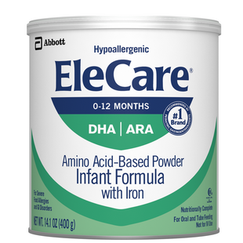
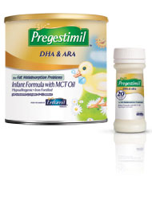


Enteral Nutrition Management of IF Infants:
Formulas
Elemental formulas:
  Elecare Infant, Neocate Infant, Alfamino Infant
Semi-elemental formulas:
  Pregestimil, Alimentum, Gerber Extensive HA
Polymeric formulas:
  Gerber Good Start Infant, Similac Advance, Enfamil Premium
Notes:
Elemental formulas:
Elecare infant: 33% of fat as MCT, 43% of kcal as CHO, osmolarity of 350 mOsm/kg
Neocate Infant: same as Elecare Infant
Semi-elemental formulas:
Pregestimil: 55% of fat as MCT, isotonic
Alimentum: 33% of fat as MCT
For those infants with minimal resection or intestinal aganglionosis in the absence of significant resection, the clinician may employ a standard cow’s milk formula polymeric formula.

Slide 40
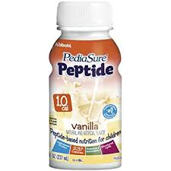


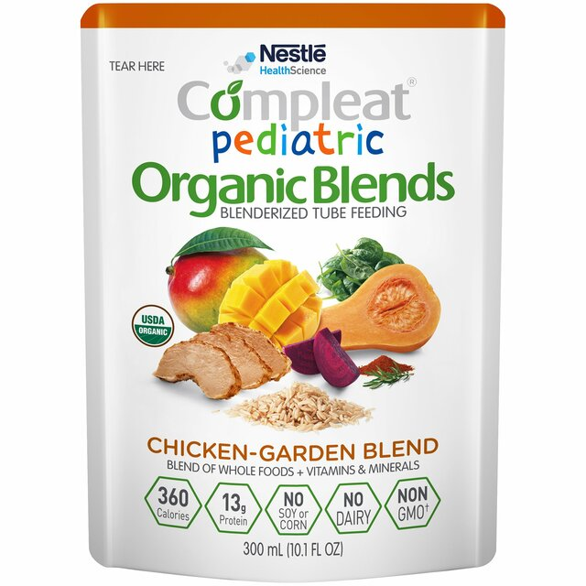
Enteral Nutrition Management of IF Children:
Formulas
Elemental formulas:
  Elecare Junior, Neocate Junior, Alfamino Junior
Semi-elemental formulas:
  Pediasure Peptide 1.0 cal / 1.5 cal, Peptamen Junior 1.0 /1.5
Polymeric formulas:
  Pediasure Enteral, Nutren Junior
Blenderized formula:
  Compleat Pediatric, CP Organic Blends, Pediasure Harvest
Notes:
Elecare Junior: 33% of fat as MCT
Pediasure Peptide: 50% of fat as MCT, osmolarity of 450
Peptamen Junior: 60% of fat as MCT, osmolarity of 260, unflavored
Pediasure Peptide 1.5: 60% of fat as MCT
Compleat Pediatric: 20% MCT, Osmolality: 380
A pilot trial at Connecticut Children’s Hospital revealed the safety and efficacy of Compleat Pediatric for those patients with greater than 30 cm residual small intestine in addition to an intact ICV and colon. We currently have 5-10 patients on this blenderized RTF formula.

Slide 41
Enteral Nutrition Advancement in IF Patients:
Continuous infusion generally appears better tolerated and allows for better total nutrient absorption.
Enteral infusion advanced in accordance with stool output, vomiting, irritability, and ostomy output (an output of > 40 -50 mL/kg/day contraindicating further advancement).
Continuous infusion advanced, along with small oral feedings, and parenteral nutrition weaned isocalorically.
Stages of weaning:
  EN = ¼ goal; cycle PN to 20 hours
  EN = ½ goal; cycle PN to 16 hours
  EN = ¾ goal: cycle PN to 10-12 hours and d/c lipid infusion
  EN > ¾ goal: wean PN to off and potentially start customized IVF
Notes:
The IROC program maintains a focus on using continuous feeding infusion to expedite weaning of parenteral nutrition weaning. Once patients are weaned from TPN, then patient can advance to tube-mediated or oral bolus formula feedings.

Slide 42
Nutrition Recommendations for Older Children and Adults with Short Bowel Syndrome
 | Colon Present | Colon Absent
CHO | 50-60% of caloric intake Complex carbohydrates | 40-50% of caloric intake Complex carbohydrates
Fat | 20-30% of caloric intake Ensure adequate essential fatty acids MCT and LCT | 30-40% of caloric intake Ensure adequate essential fatty acids LCT
Protein | 20-30% of caloric intake High biologic value | 20-30% of caloric intake High biologic value
Fiber | Net secretors Soluble fiber | Net secretors Soluble fiber
Oxalate | Restrict | -
Notes:
Soluble fiber, carbohydrate, and MCT entrance into the colon contributes to energy salvage.
We do not make it practice in IROC to prescribe soluble fiber such as pectin or banana flakes unless ostomy output remains elevated. We generally encourage fibrous foods as source.
For patients with end jejunostomies, a much higher allocation of fat and low allocation of CHO may be indicated.

Slide 43
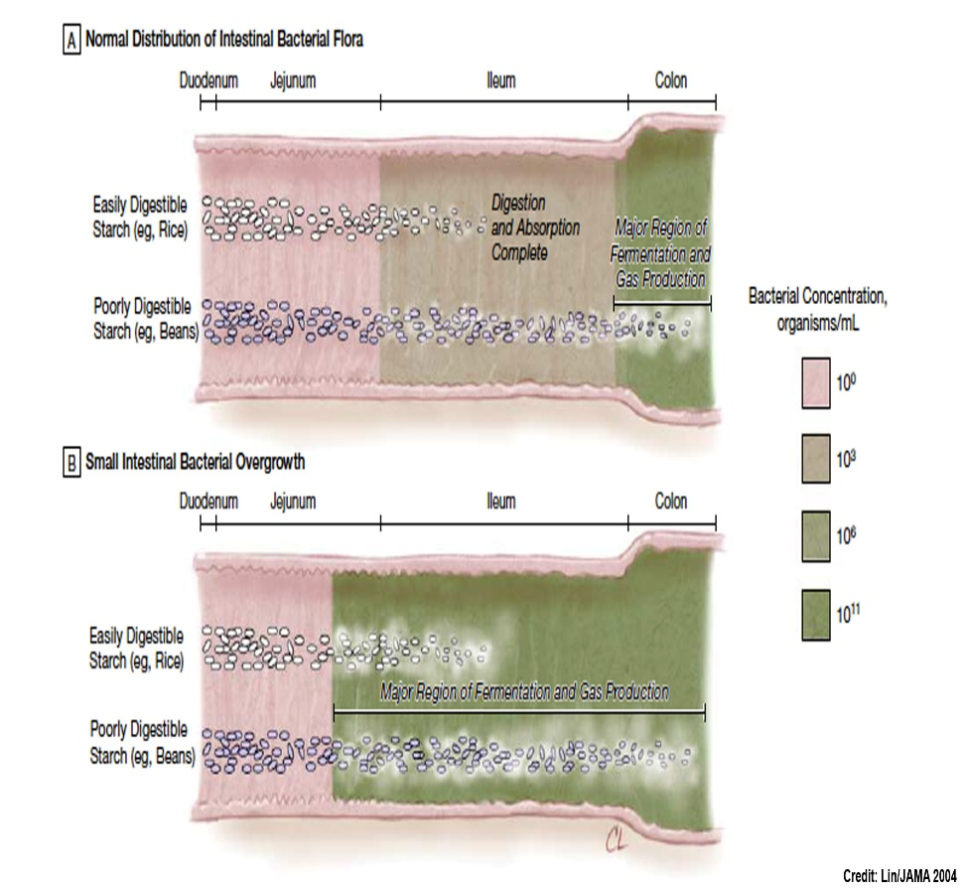
Small Intestinal Bacterial Overgrowth (SIBO)
Disruption of the normal small bowel bacterial population
May result in gas, bloating, flatulence, altered bowel function, and frank malabsorption
IROC prophylaxis (including those with no ICV): intermittent Flagyl, Gentamicin, etc
For many SBS patients, recurrent D-lactic acidosis remains a risk, even while receiving intermittent antibiotic therapy, characterized by muscle pain/cramping and unusual sleepiness, fatigue, and weakness
Notes:
The bacteria invade the small intestine, producing inflammatory cytokines, denuding the brush border and its enzymes (leading to further digestion of unabsorbed carbohydrate), deconjugating bile acids, leading to steatorrhea and frank malabsorption of fat-soluble vitamins.
Small intestinal bacterial overgrowth is thought to contribute to development of IFALD but is difficult to diagnose²⁴. Polymerase chain reaction (PCR) techniques using bacterial 16S ribosomal RNA primers²⁵ have potential to serve as a guide for antibacterial therapy. A simple test for bacterial overgrowth is required to inform the need for interventions and their effectiveness.

Slide 44
Small Intestinal Bacterial Overgrowth
Yilmaz et al investigated the use of a non-D-lactate-producing probiotic to reduce D-lactate-producing bacteria and hence, reduce incidence of D-lactic acidosis
Case report of 4-year-old boy with 20 cm residual small intestine, ICV, and intact colon, on a low-sugar diet with elemental formula, experiencing recurrent D-lactic acidosis despite intermittent gentamicin and flagyl
Initiated probiotic (L. rhamnosus GG, B. lactis, B. breve, B. longum)
Stool samples collected during cyclic antibiotic regimen and during probiotic regimen with antibiotics
Probiotic initiation resulted in disappearance of L. plantarum, a well-characterized causative agent of D-lactic acidosis, after 3 weeks
Patient has remained stable on probiotic therapy in the absence of antibiotics for more than a year
Yilmaz B et al. Pediatrics. 2018;142(3)
Notes:
Child experienced recurrent D-lactic acidosis, evidenced by elevated serum and urinary L-lactate, characterized by multiple ER visits during the first years of his life in which the admitting symptoms were ataxia, fatigue, and muscular weakness, addressed with fluid resuscitation and Flagyl. At the age of 4 years, the episodes became more frequent, requiring cyclic gentamicin and flagyl. This study offers great promise in preventing D-lactic acidosis solely via probiotic therapy while avoiding intermittent antibiotic therapy and the presumptive dysbiosis this engenders.

Slide 45
SIBO IROC Patient Case Study
10-year-old boy with 25 cm residual small bowel, ICV, and intact colon on 8-hour cyclic TPN rx and Gtube feeding of nightly continuous and daytime boluses of Compleat Pediatric
Chronic, intermittent symptomology consistent with SIBO: somnolent, belligerent, waspish, and drunk-like behavior
Maintained on low-sugar diet, but admittedly noncompliant at times, the symptoms typically following ingestion of high-CHO foods
SIBO prophylaxis: gentamicin daily on alternating weeks, two weeks monthly
Initiated Probiota Bifido, solely consisting of non-lactate-D-producing bifido species: B. breve, longum, bifidum, and lactis, the patient experiencing complete resolution of symptomology, maintaining symptom-free status for 2 years.

Slide 46
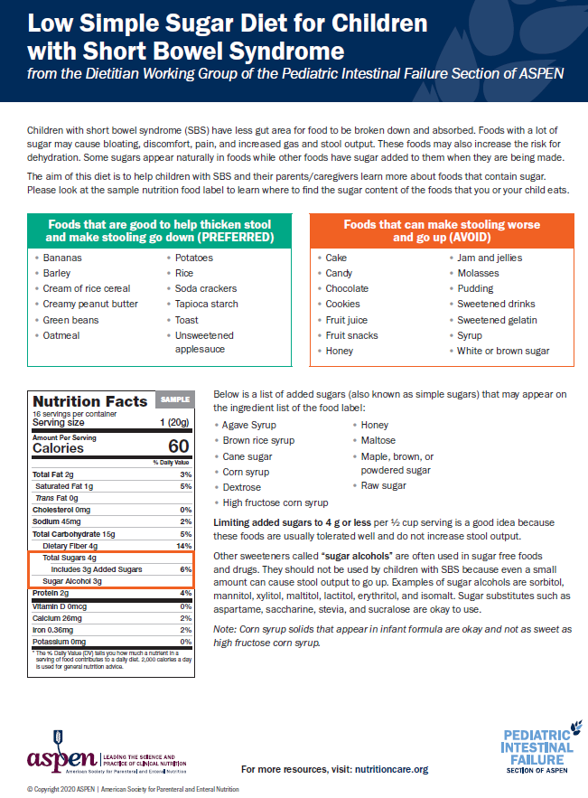
Dietary Therapy for Short Gut Patients
Carbohydrates: whole grain breads and cereals
Fats: oils, butters, creams
Proteins: meats, cheeses, fish, eggs, beans
Avoid most fruits and all sugars and sugar substitutes, keeping added sugars to < 4 gm per ½ cup serving
Limit lactose: yogurts, soy milk, Lactaid, and hard cheeses
For those with ostomies or diarrhea: bananas, rice, potatoes, oatmeal, peas, etc
Notes:
The ASPEN PIFWG of dietitians recently developed a 3-page low simple sugar diet for SBS patients
In 2016, the FDA required manufacturers to include “added sugars” as a label ingredient in its food labeling regulations.
Menus based on the Low Simple Sugar Diet for Children with Short Bowel Syndrome were recently developed, with a GSU graduate nutrition student analyzing them this summer. We can expect Dr. Nucci to send the menus to the ASPEN clinical practice committee for approval soon, hopefully being able to use them as valuable supplements to the short gut diet.

Slide 47

Inauguration of the Short Gut Diet at Children’s
Implemented in April 2020
Based on PIFWG’s low simple sugar diet in addition to experiences of the IROC group
Notes:
Utilizing the initial drafts of the Low Simple Sugar Diet for Children with Short Bowel Syndrome handout, I proceeded to develop a de novo, institutional Short Gut diet menu, implementing it in April 2020 . I worked with Andrea Robinson, manager of food service at Egleston to develop the diet for system-wide use, largely using not only guidance from the ASPEN PIFWG of dietitians, but also the experiences of the IROC group in transitioning patients from formula to foods. Institutional diet has improved compliance inpatient, alleviating nursing staff from having to order the appropriate dietary selections while on the regular diet.

Slide 48


Diet History Assessment Tool for Pediatric Intestinal Failure
Notes:
In addition to composing the Low Simple Sugar diet for Children with Short Bowel Syndrome, the PIFWG of dietitians also composed a “Diet History Assessment Tool,” making several revisions over the past 1-2 years, with the final draft now awaiting approval from the ASPEN Clinical Practice Committee. The assessment tool is modeled after a FFQ questionnaire with IF clinicians potentially finding this of benefit on a recurring basis (perhaps biannually) to evaluate their patients’ intake and re-educating if indicated. Admittedly, I am guilty of not soliciting a diet hx upon every clinic visit, presuming that after initial diet education, the caretakers will maintain compliance with the Short Gut diet. Similar to the short gut room service menus helping pts and caretakers to maintain compliance inpatient, the Diet History Assessment Tool will hopefully help me and my IROC colleagues identify areas of noncompliance and re-educate if indicated.
Dr. Anita Nucci is assisting with its implementation as a research tool as part of a study examining the intake of PIF patients. Connecticut, Nemours, and Pittsburgh Children’s will take part in this multicenter study, with the study already approved by the ASPEN Board. We hope to be part of this multicenter study of intestinal failure patient intake, acting in collaboration with Dr. Nucci to obtain IRB approval.

Slide 49

Launch of the IROC Research Registry
Children’s IRB approval received August 2021
Data usage agreement between Children’s and GSU signed
Dr. Berauer will acquire consent from IROC patients/families
Dr. Nucci will extract demographic, intestinal, nutritional, anthropometric, and transplant variable data from EPIC and enter into REDCap database starting this month
Demographics: gest age; primary, secondary diagnosis; transplant status; baseline T. and D. bili
Intestinal: liver status (T. bili); small bowel length; D, J , I, TI, Lg intestine present; STEP procedure
Nutritional: oral/TF/PN; formula; oral solids; IL/Smof/Omegaven IV fat (gm/kg/day); % enteral/PN kcal; time on PN
Anthros: weight and length z-scores; BMI; MUAC

Slide 50
Future Directions of IROC Nutrition Support
Completing REDCap data collection, including nutritional data points, for the IROC Research Registry in collaboration with Dr. Anita Nucci
Engineer dietary advancement protocols to expedite weaning from tube-mediated nutrition supplementation and better meet patient’s feeding skill milestones. Will use the expanded “Infant Complementary Feeding Survey” results provided by PIFWG RDs in 2020 and submitted to Nutrition in Clinical Practice later this year for publication.
Launching a natural history of growth in pediatric intestinal failure study featuring a collaboration between IROC (Dr. Berauer, Dr. Nucci) and Pittsburgh Children’s ICARE group (Dr. Jeffrey Rudolph), sponsored by Takeda Pharmaceutical. Study goal: describe growth in the population over the length of the condition and examine the effect of GATTEX® (teduglutide; glucagon-like peptide-2 analog) on the natural history process. Completion: early 2023.
Notes:
After completing the data collection for IROC patients, IROC clinicians could use the REDCap data base, potentially in collaboration with other centers, notably Pittsburgh’s ICARE group, to evaluate myriad nutrition support research questions.
Up until now, we have lacked national standards for the introduction of complementary foods in the short gut population. The first RD Survey was published in 2019, with a newly expanded survey distributed to PIFWG RDs in 2020. The IROC group could use the published “Infant Complementary Feeding Survey” results to craft clinical guidelines for introducing and advancing complementary foods earlier and more effectively, thus supplanting an overdependence on tube-mediated feeding and reducing the high incidence of feeding disorders and oral aversion in our group, mostly reflective of the high rates observed in PIF programs nationally.

Slide 51
Conclusions
Intestinal failure patients managed by an IRP demonstrate improved clinical outcomes
Primary goal of intestinal rehabilitation: to enhance adaptation of the remnant small bowel via aggressive enteral feeding advancement, facilitating parenteral nutrition weaning and achievement of enteral autonomy
The high prevalence of micronutrient deficiencies in the chronic PN patient population indicates a need for regular, protocolized lab monitoring
The significant incidence of oral aversion in intestinal failure patients indicates a need for earlier introduction of oral formula and solid foods, active involvement of ST/OT, and potential use of behavioral strategies by interdisciplinary feeding teams

